Slide 1
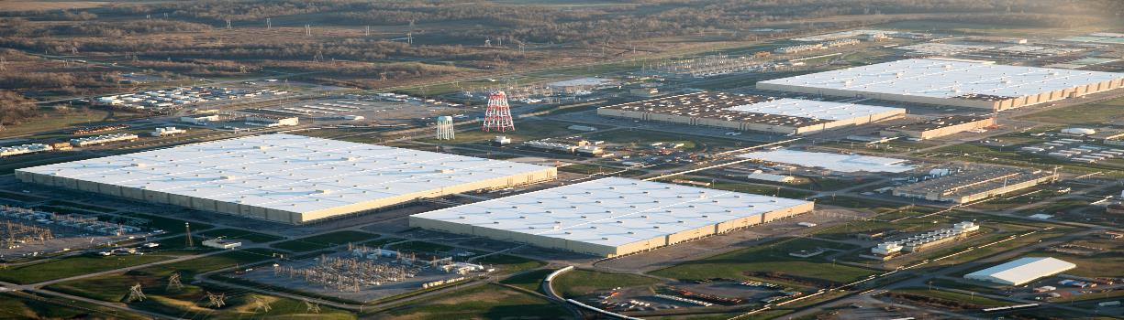
Moderation Control Challenges
in a Shutdown Facility
Tom Hines – DOE Nuclear Safety Oversight Lead
Matthew Wilson – Senior Nuclear Criticality Safety Consultant
2017 ANS Annual Meeting

Slide 2
Moderation Control Challenges in a Shutdown Facility
  Purpose - To present the challenges the site encountered maintaining moderation control after the enrichment operation ended, the activities in response to an ORPS Significance Category 1 event, and the need to evaluate the shutdown/deactivation impact on the Nuclear Criticality Safety Evaluation (NCSE).
Notes:
This deposit occurred in a 42-inch diameter bypass piping in process building C-337.

Slide 3
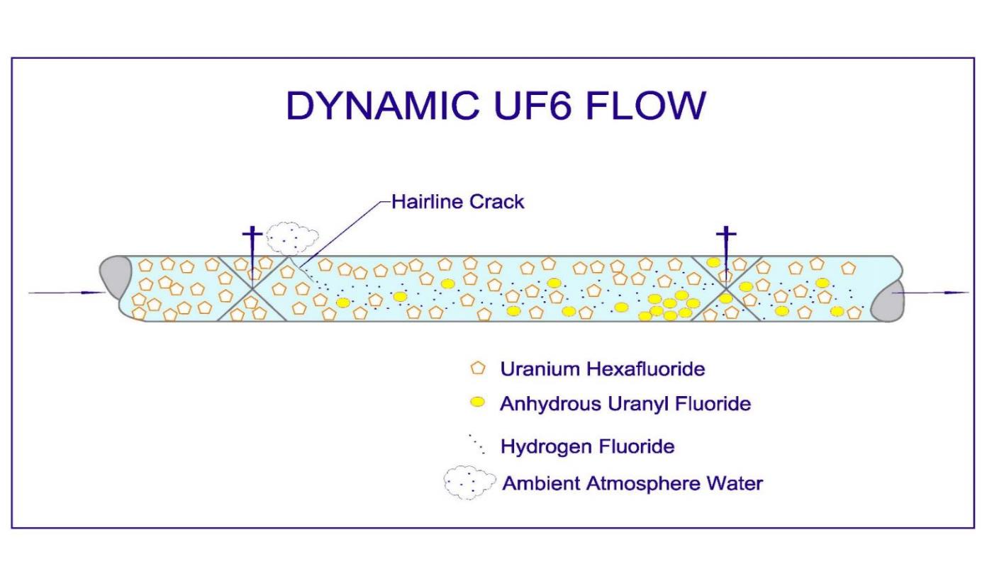
Moderation Control Challenges in a Shutdown Facility
Historical Enrichment Operation – Simplified Pictorial of UF₆ Flow thru Piping
Below atmospheric pressure
Notes:
When the Paducah plant was enriching uranium the piping was typically below atmospheric pressure. Moisture (moderation) that would enter the process from the atmosphere was chemically mitigated by the uranium hexafluoride (UF₆) that flowed through the system. UF₆ is a fluorinating agent that reacts rapidly with water preventing formation of UO₂F₂ hydrates.
A criticality is not possible with uranium enriched to less than 6 wt. % ²³⁵U unless moderation is provided. Paducah’s enrichment process was limited to < 5.5 wt. % ²³⁵U.
Chemistry – Water from the atmosphere entered the UF₆ process piping through a small penetration. The UF₆ reacts with the water generating uranyl fluoride and hydrogen fluoride. The uranyl fluoride is a solid anhydrous compound that “deposits” in the process. The HF is a gas that is exhausted out of the process through a permitted vent stack. This chemistry resulted in an anhydrous uranyl fluoride deposit that would not achieve a criticality regardless of mass.

Slide 4
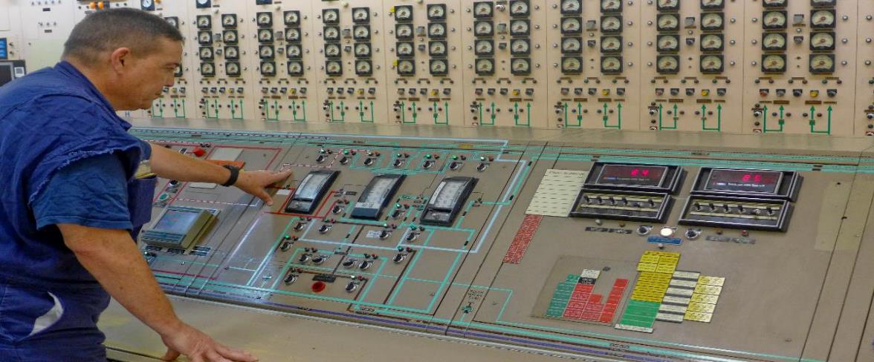
Moderation Control Challenges in a Shutdown Facility
    Enrichment Activity – Fluorinating Gas (UF₆) in Abundance and Process Continuously Monitored
  The enrichment operation had an ample and readily available source of fluorinating gas as UF₆
  Operations personnel continuously monitored the process and quickly reacted to air leaking into the process gas system for operational efficiency and production.
Notes:
Moderation was naturally controlled by chemistry and Operations had a keen interest in repairing leaks in the system.

Slide 5
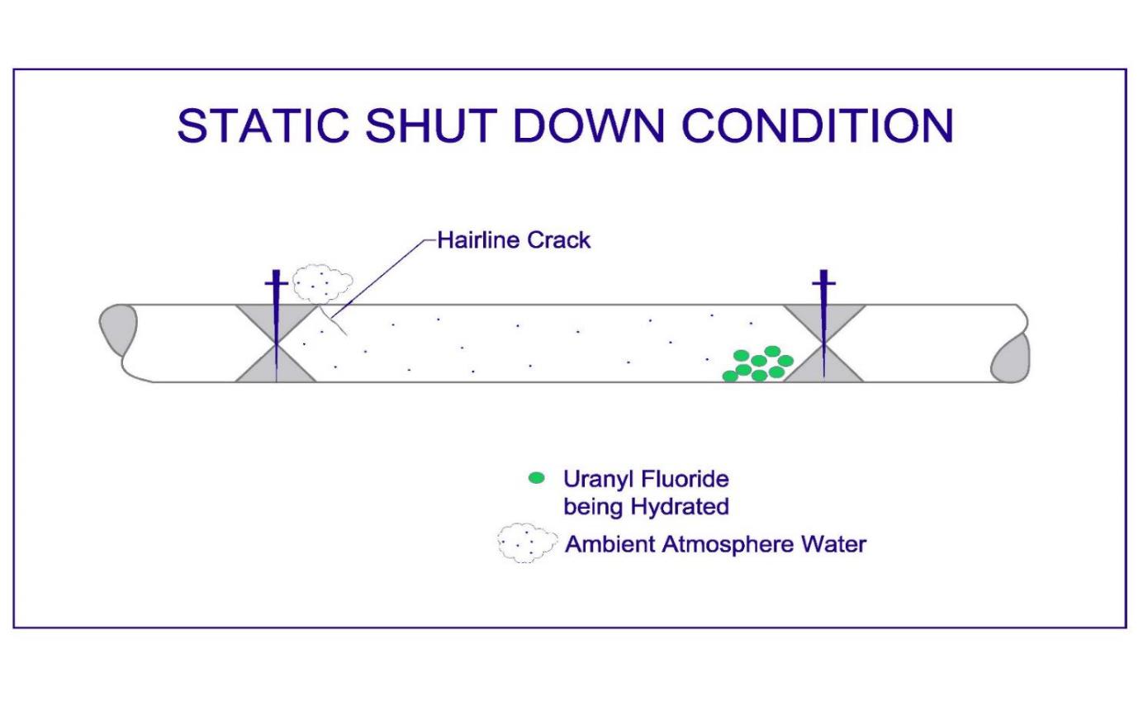
Moderation Control Challenges in a Shutdown Facility
Current Status – Simplified Pictorial of Stagnant Piping (NO UF₆ PRESENT)
At atmospheric pressure
Notes:
When the uranium enrichment activities were ended the UF₆ in the processing equipment was removed; however, uranyl fluoride deposits remained. How much remains has not been determined.
The chemistry that prevented hydration of uranyl fluoride no longer exists. Moderation now has to be controlled by preventing moisture from the atmosphere entering the piping systems.
Chemistry – Moisture from the atmosphere enters the piping from the inevitable small cracks in piping systems. This moisture slowly hydrates any uranyl fluoride that may be present. If a significant uranyl fluoride deposit is present in large diameter piping (>14-inches in diameter) and is hydrated with atmospheric moisture, a criticality hazard exists.

Slide 6
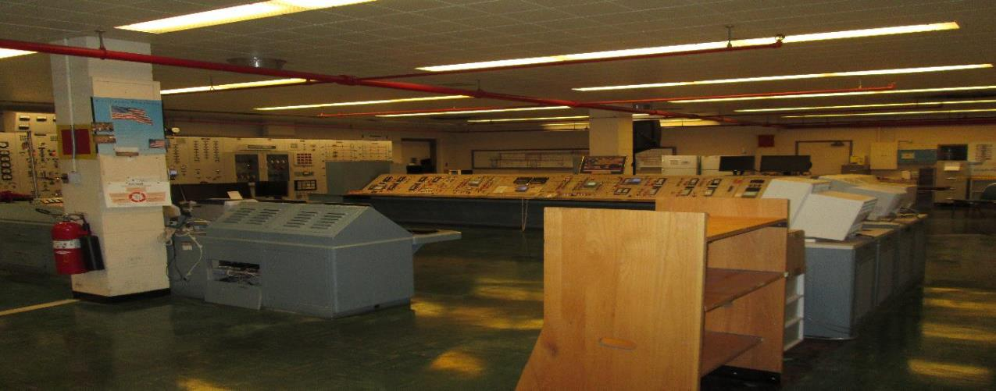
Moderation Control Challenges in a Shutdown Facility
  Deactivation Activity – No UF₆ and Process NOT Continuously Monitored
  For deactivation activities the headers are pressured near atmospheric pressure with dry air and then moisture sampled at least every 6-months.
  Contrasting with the enrichment activities, personnel have no “operational need” to prevent moisture from entering the headers. Moisture prevention is solely for NCS.
Notes:
The fluorinating environment is no longer present!!!

Slide 7
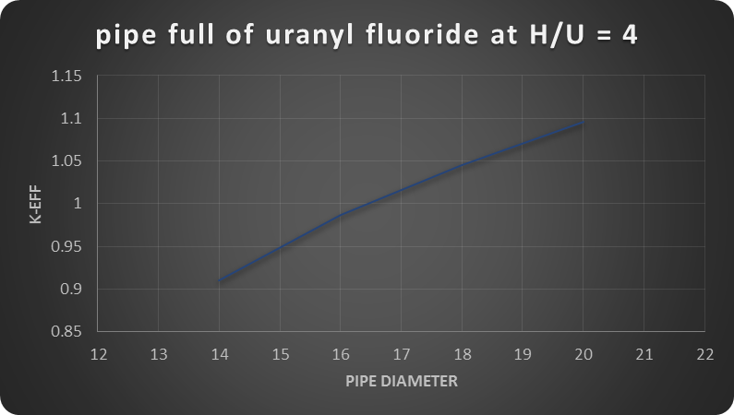
Moderation Control Challenges in a Shutdown Facility
Criticality Safety Considerations for Large Diameter Cascade Piping at Paducah
  Piping up to 10-inches diameter is safe regardless of moisture content (ATMOSPHERE from cracks in piping or LIQUIDS from roof leaks, sprinkler activation, etc.).
  Piping between 10-inches and 14-inches diameter is safe for moderation levels that could occur when exposed to ATMOSPHERE (NO LIQUIDS).
  Piping > 14-inches diameter can become a criticality hazard if exposed to moisture from the atmosphere.
Notes:
Significant hydration of a deposit from ambient atmospheric conditions takes months.
Shown is a graph of k-eff versus pipe diameter based on a simple KENO model without reflection or process upsets.

Slide 8
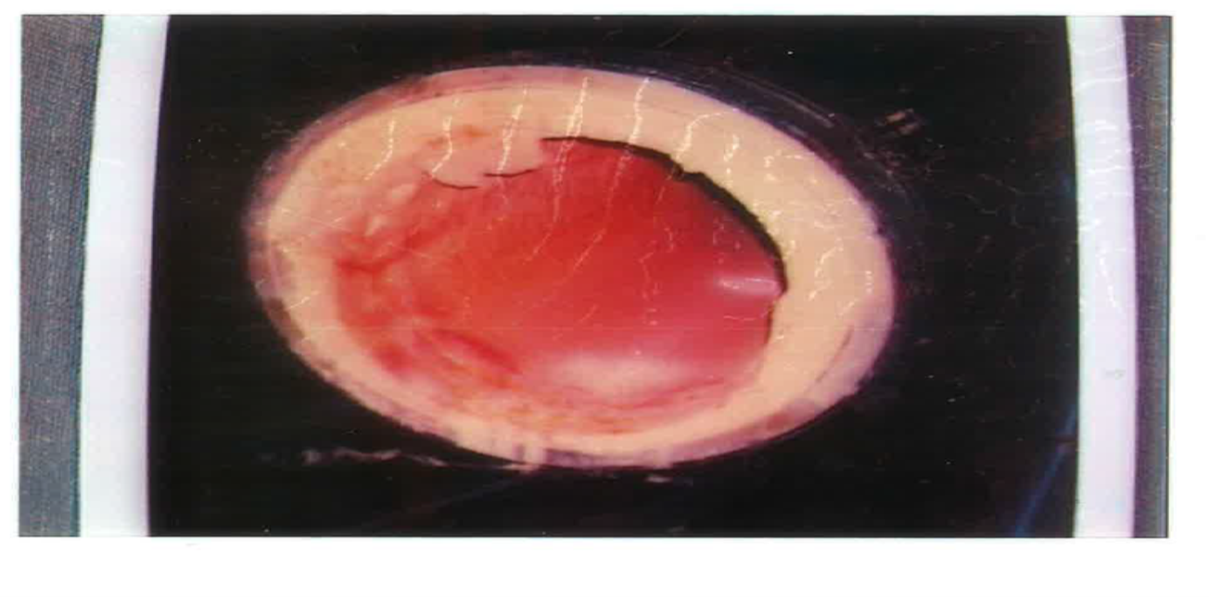
Moderation Control Challenges in a Shutdown Facility
“Real-life” 42-inch Pipe Deposit KENO Results for Similar Deposit
  wt. % ²³⁵U is ~ 0.8 wt. % ²³⁵U is 5.5
Notes:
Real-life deposit was about 20-feet long, estimated weight was 15,000-lbs, thickness ~5-inches.
Shown is a graph of k-eff versus annular thickness based on a simple KENO model without reflection or process upsets.

Slide 9
Moderation Control Challenges in a Shutdown Facility
The contents of the piping changed resulting in a fundamental change to the operation.
  Enrichment Plant Operating:
    UF₆ abundant and flowing (fluorinating environment)
    Moderation controlled by passive design feature of piping and naturally controlled via process chemistry
    Leaks into the process were quickly seen by process instrumentation or surging compressors
    Leaks into the process were quickly repaired because of production and cost efficiency
  Enrichment Operation Ceased and Facility being Deactivated:
    Uranyl fluoride deposits that remain in the piping are fixed
    Moderation controlled by passive design feature of piping and administrative control to confirm dry gas environment by sampling
    Leaks into the system are not quickly known
    Operations personnel now react to moisture ONLY because of NCS control
ITS REALLY HARD TO KEEP ATMOSPHERE OUT OF VAST PIPING SYSTEMS THAT ARE NOT ACTIVELY BEING USED FOR SOME TYPE OF PROCESS!!!

Slide 10
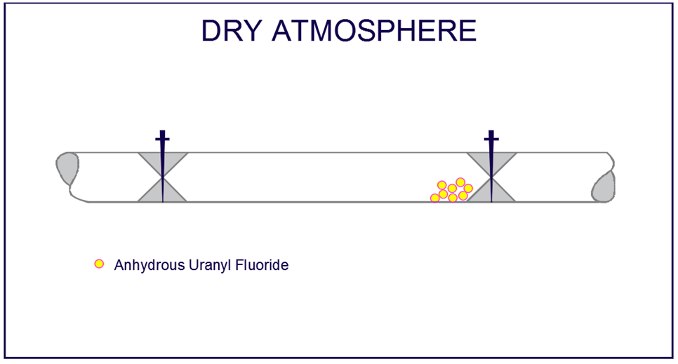
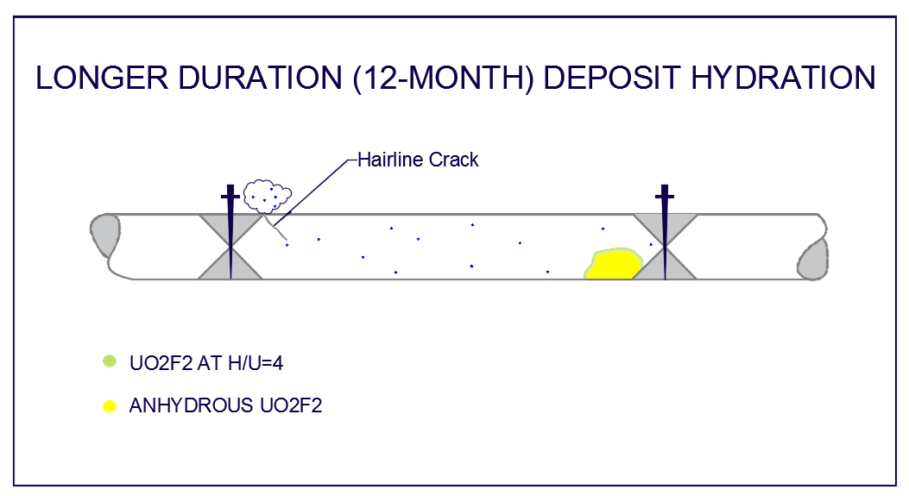
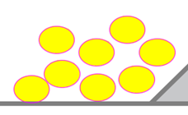

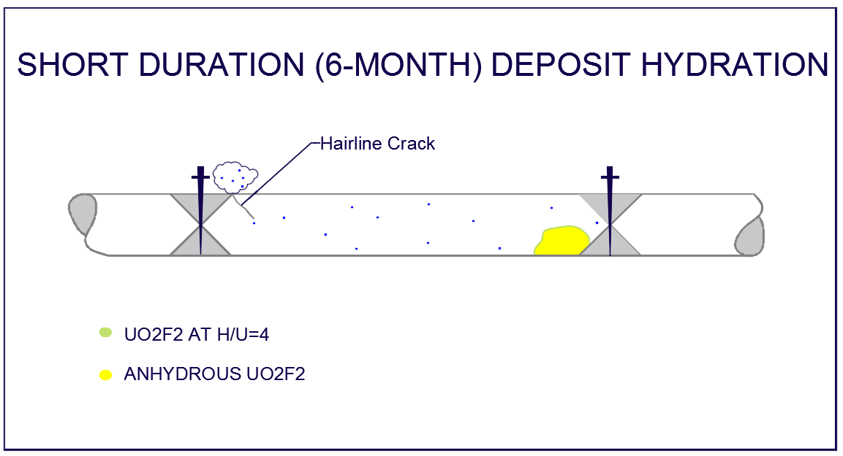
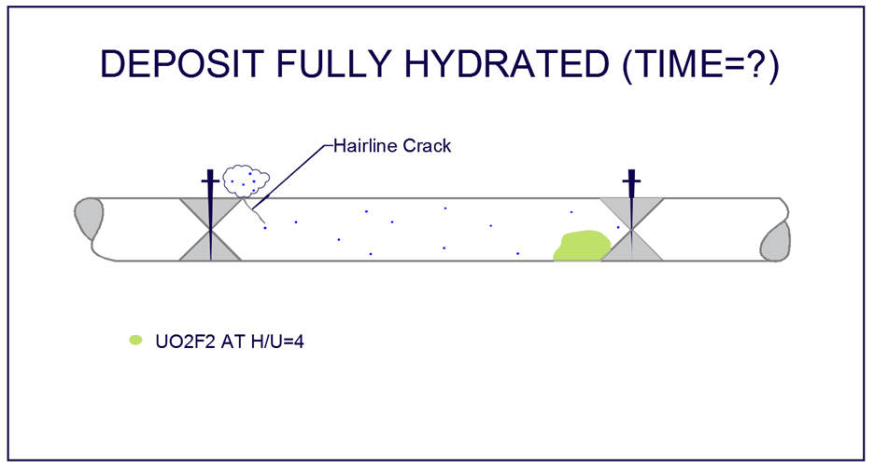

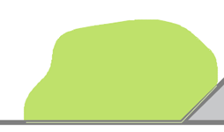
Notes:
UO2F2 hydration studies and the NCSE demonstrates that a deposit can be exposed to atmospheric air for up to 12-months and remain safe. The length of time to hydrate a deposit to a level where a critical configuration could exist depends on many factors such as surface area, humidity in air, and exposure time. The Paducah site D&D is forecast to start in approximately 20-years so in lieu of NCS controls, deposit hydration to an unsafe level could occur.

Slide 11
Moderation Control Challenges in a Shutdown Facility
Current Control Scheme
  Passive NCS Control:
    The integrity of the piping is maintained as a passive design feature limiting exposure of the contents to the external conditions.
      The boundary between the uranium compounds inside the piping and atmosphere is resistant to exchange with the atmosphere but not leak tight.
  Administrative NCS Control:
        Establish moderation control by maintaining the piping in a dry gas environment that is verified at least semi-annually by sampling that shows moisture content is less than 1300 ppm_{v}.
        OR
        Establish moderation control by re-establishing a fluorinating environment.
        OR
        Establish mass control by showing the piping to contain a combined mass to the points of isolation is < a single unit safe mass at an ^{H}/_{U} of 4.
Notes:
Significant hydration of uranyl fluoride takes many months, > 12, thus the semi-annual sampling frequency is required.

Slide 12
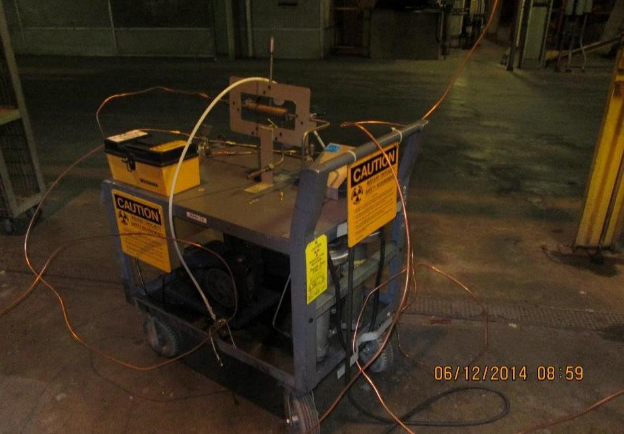
Moderation Control Challenges in a Shutdown Facility
  Moisture Sampling Process
    Sampling volume, sample point, and boundaries must be defined.
    Valve configuration (open or closed) must be known.

Slide 13
Moderation Control Challenges in a Shutdown Facility
  Simplified Diagram of a Cell Bypass Piping Volume
  Paducah is currently moisture sampling 18 different piping volumes.
                Volumes range from 2,000 ft³ (~ 2 semi-trailer tanks) to 20,000 ft³ (~ 16 semi-trailer tanks) depending on pipe diameter and length.
                Sampling is a collaborative effort between Operations, Maintenance, and the Laboratory.
                Several man-hours are required for a sampling evolution ($$$).

Slide 14
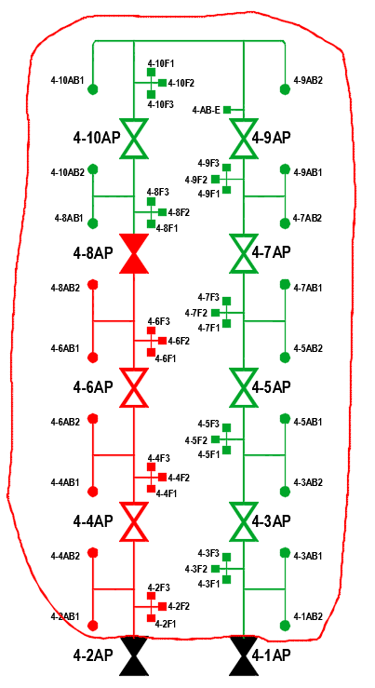
Moderation Control Challenges in a Shutdown Facility
  What went wrong resulting in the ORPS SC-1 Event?
  August 2015 – System sampled in excess of moisture limit – ORPS SC-2 Event
  October 2015 – While troubleshooting source of moisture for above issue, discovered a closed valve that isolated a section of piping from its sample point.
                The isolated section of piping had not been sampled for at least two sampling evolutions.
                The extent of the hydration of any deposit in the isolated section was not immediately known.
                The issue was categorized as an ORPS SC-1 event because no documented controls were available to prevent a criticality.
                The piping was subsequently sampled and verified to be in a “dry” condition.
Closed Valve
Sample Point

Slide 15
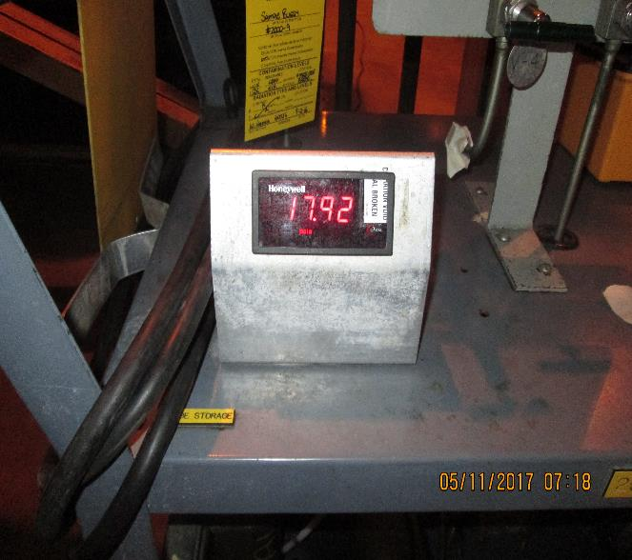
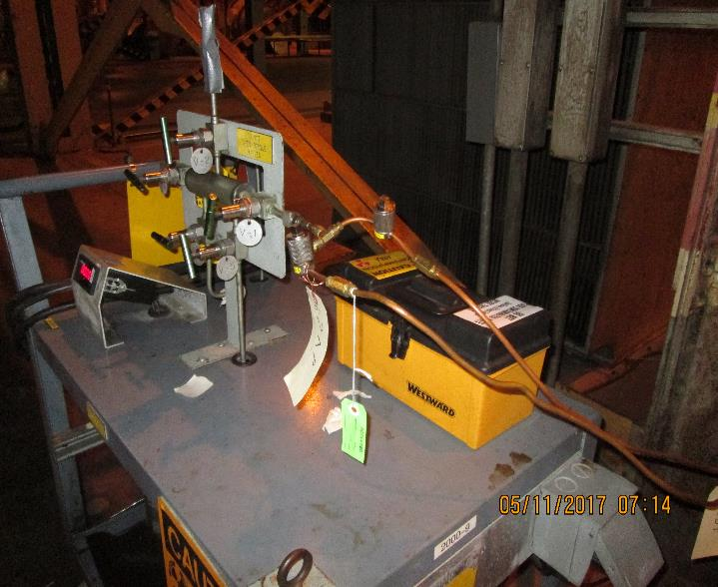
Moderation Control Challenges in a Shutdown Facility
  A compensatory measure has been implemented at Paducah to maintain a slightly positive pressure of dry air in header volumes (except headers that contain fluorine).
  This practice has proven effective for maintaining systems in a dry condition at Portsmouth and is also working at Paducah.

Slide 16
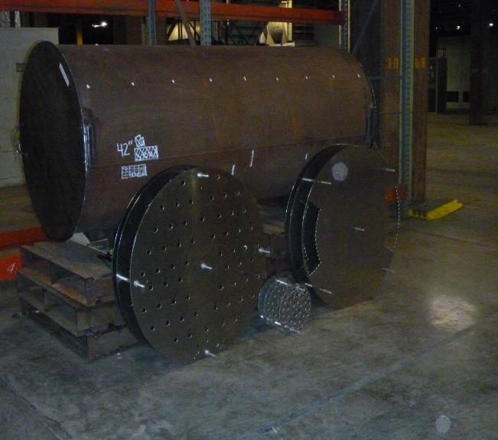
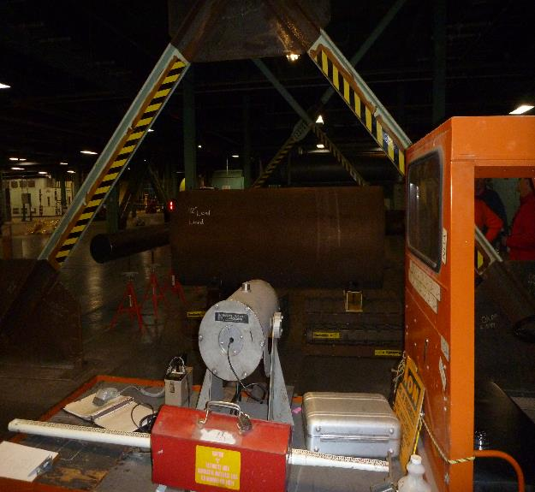
Moderation Control Challenges in a Shutdown Facility
  Paducah is working toward identifying the fissile material mass in the piping to facilitate using a different control scheme. Once mass is known, a right-sized control set can be established.
      Non Destructive Assay method development

Slide 17
Moderation Control Challenges in a Shutdown Facility
  In Summary:
    Paducah is working toward characterizing the remaining fissile material at the site.
        The Request for Proposal (RFP) for the upcoming contract period requires characterization for deposit/Hold-up removal for the process facilities.
    Paducah is working toward writing or revising the NCSEs to align with the deactivation mission.
        The RFP requires the NCSEs to be revised to address current facility conditions, the scope of the performance work statement (deactivation) and identified deficiencies in the current controls.
          Benefits:
        Eliminate unneeded controls
        Right-sizing the NCS Program footprint
Notes:
The operating NCSEs were evaluated and bounded the deactivation mission. But…..the controls are not aligned well.
Current deficiencies include less than adequate ability to ensure moisture limits are met for cascade piping.

Slide 18
Moderation Control Challenges in a Shutdown Facility
  Questions/Open Forum

Slide 19
Moderation Control Challenges in a Shutdown Facility
  Once event was discovered many groups came to “help”
ORPS
Contractor investigation and cause analysis
PPPO investigation
DOE HQ trip
DOE Office of Enforcement Report

