Slide 1
Considerations for Using FGE Conversion Factors in Type A Shipping Packages at the Savannah River Site
Brittany Williamson & James Baker
Sr. Criticality Safety Engineers
American Nuclear Society, 2017 Annual Meeting
San Francisco, CA
June 12, 2017
SRNS-STI-2017-00361

Slide 2
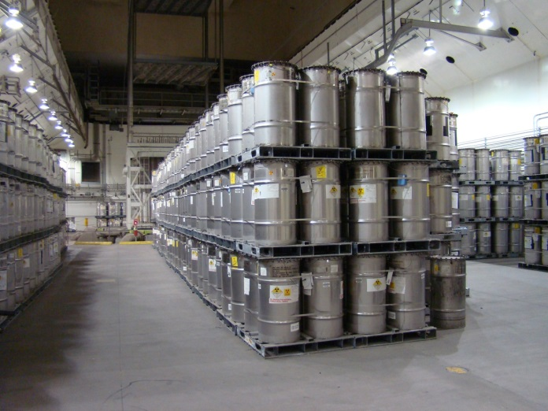
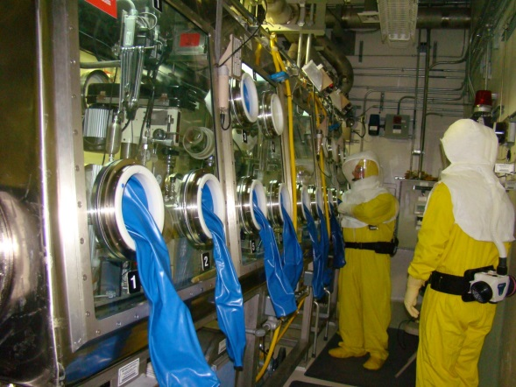
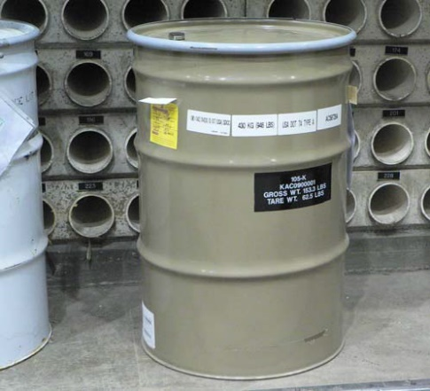
Introduction: K-Area
K-Area was originally a reactor area for plutonium production
Today, K-Area is a premier nuclear materials storage facility with surveillance capabilities
Large arrays of shipping packages
Non-destructive evaluation (NDE)
Calorimetry, digital radiography, active and passive neutron multiplicity counters
Destructive Evaluation (DE)
One dry glovebox for sampling oxide, in-situ measurements, and Pu downblend missions
TRU waste is generated from the glovebox activities
SRNS-STI-2017-00361

Slide 3
Introduction: Fissile Gram Equivalent (FGE)
It is useful to have a standardized way to compare containers of fissile materials with different nuclides or a mixture of multiple nuclides
For TRU waste, Contact Handled-Transuranic Waste Authorized Methods for Payload Control (CH-TRAMPAC) is commonly used for FGE values
FGE values may be derived from a ratio of subcritical mass limits from ANS-8.1, ANS-8.15, or other calculations or handbooks
Example from ANS-8.1 single parameter subcritical mass limits
²³⁵U is 780 g
²³⁹Pu is 480 g
780/480=1.6
This indicates that 1 g ²³⁹Pu has the same multiplication as 1.6 g ²³⁵U
This can also be seen when looking at a graph of the critical mass vs. concentration of both Pu and U
SRNS-STI-2017-00361

Slide 4
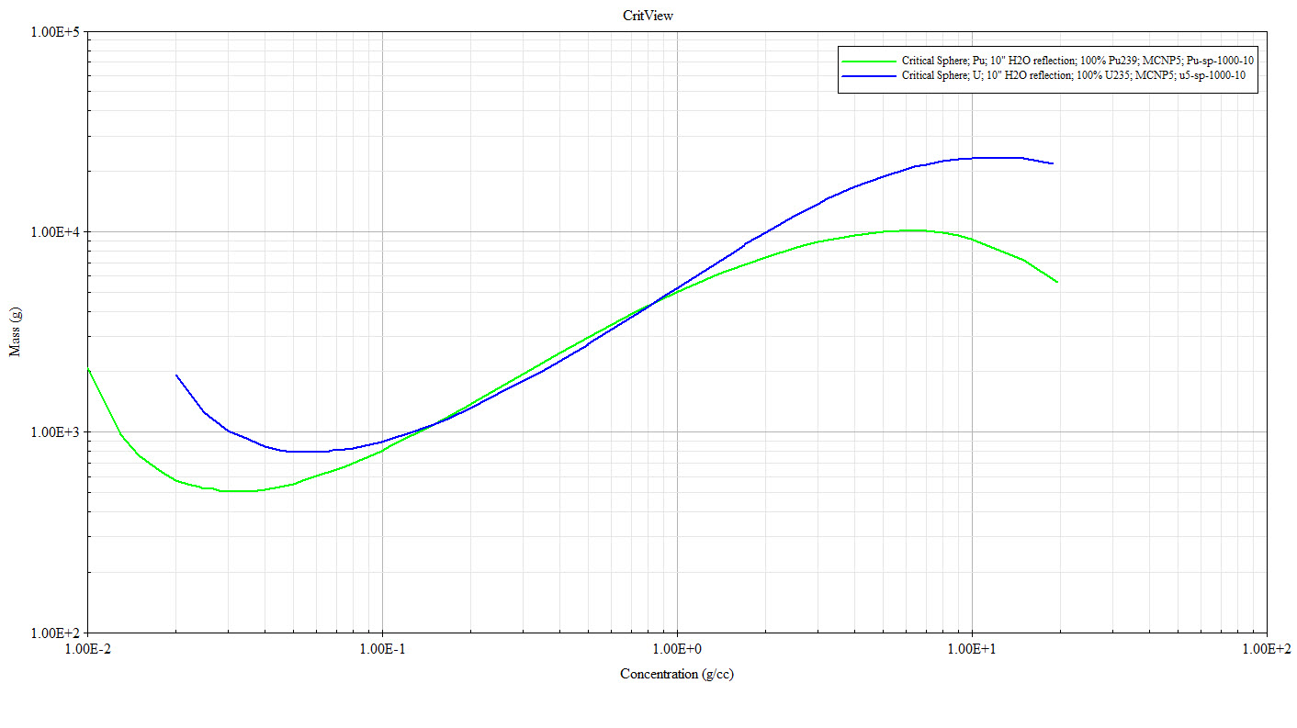
Critical Mass Curve
800 g
500 g
$$\frac{800}{500}=1.6$$
SRNS-STI-2017-00361

Slide 5
Potential Non-Conservatism
This ratio is valid for systems that are:
Optimally moderated
Isolated/not in an array
What happens when we are at a different location on the critical mass curve?
SRNS-STI-2017-00361

Slide 6
Critical Mass Curve
Anthony Wilson (Sellafield) – Enhancements to a Dissolver Burn Up Credit Safety Case to Reduce Further Gd Use in the Thermal Oxide Reprocessing Plant (THORP)
1,130 g
1,110 g
$$\frac{1,110}{1,130}=0.98$$
0.4 g/cc
SRNS-STI-2017-00361

Slide 7
Critical Mass Curve
SRNS-STI-2017-00361

Slide 8
Critical Mass Curve
Red box indicates region where the 1.6 FGE conversion factor may not be conservative between 0.05 g/cc and 4.0 g/cc
SRNS-STI-2017-00361
8

Slide 9
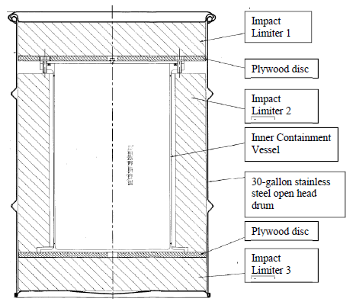
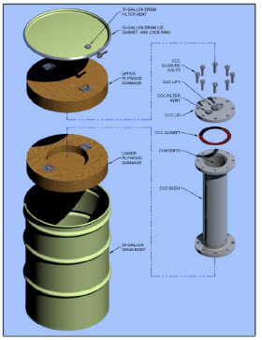
K-Area Specific Considerations
K-Area has two Type A waste packages that fall into the red region of concern
SAFDRUMs are used to transport Pu oxide samples on-site
Pu oxide is modeled at a concentration of 0.42 g/cc
Criticality Control Overpacks are used for Pu downblend missions
Pu oxide is modeled at a concentration of 0.18 g/cc
Special considerations were given to the following parameters:
Mass
Interaction
Moderation
SRNS-STI-2017-00361

Slide 10
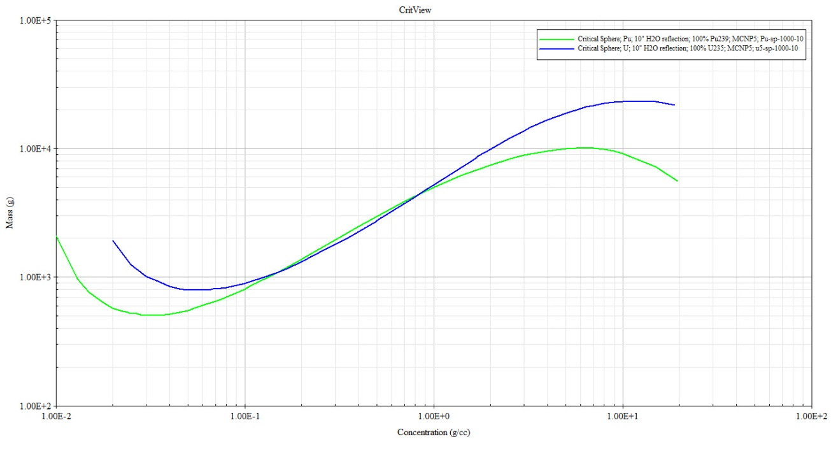
Mass
The lowest point on the critical mass curve is slightly over 500 g ²³⁹Pu
If the mass of the fissile unit in question is less than or equal to 500 g ²³⁹Pu, then converting that mass to g ²³⁵U using the conversion factor of 1.56 (from CH-TRAMPAC) will always yield a value less than 780 g ²³⁵U, which is less than the lowest point of the ²³⁵U curve
Therefore, if the fissile unit in question has a mass of less than or equal to 500 g ²³⁹Pu, regardless of the concentration or density, it is acceptable to use CH-TRAMPAC conversion factors
SAFDRUM mass limit = 195 FGE ²³⁹Pu ☑
CCO mass limit = 380 FGE ²³⁹Pu ☑
SRNS-STI-2017-00361

Slide 11
Interaction
K-Area has large arrays of shipping packages
The limits from ANS-8.1 and ANS-8.15 do not apply to arrays, and therefore FGE conversion factors based on those limits may not be applicable to arrays
MCNP calculations were performed for a large system of 18 kg ²³⁹Pu as oxide representing a large array of Pu downblend cans with a density in the 0.18 g/cc range
The same calculations were performed with 18 kg * 1.56 = 28 kg ²³⁵U in the same volume
K_{eff} from the ²³⁵U cases was ~2% higher than the ²³⁹Pu cases
This confirms that the CH-TRAMPAC conversion factors are not conservative in this region
However, if 2% was added to the system multiplication for all normal and credible abnormal conditions, no cases would challenge system limits
SRNS-STI-2017-00361

Slide 12
Moderation
The Standard Waste Box (SWB) is postulated to have a credible upset mass of 650 FGE ²³⁹Pu
The red region of concern can also be expressed in terms of H/X
From ~530 to ~5
However, due to the large volume of the SWB, if the mass was evenly distributed, the density would be ~0.0005 g/cc – well outside the region of concern
In the normal condition, H/X for the SWB is ~100,000 – well outside the region of concern
In the upset condition, H/X for the SWB is ~7,000 – still well outside the region of concern
SRNS-STI-2017-00361

Slide 13
Other considerations
Product vs. Waste
Poisons
Poisons may change the neutron spectrum of the system, which may invalidate FGE conversion factors
Form
Bimodal systems may have a complicated neutron spectrum, which may invalidate FGE conversion factors
SRNS-STI-2017-00361

Slide 14
Conclusion
The development and applicability of FGE conversion factors was explored, with special emphasis on Type A shipping packages in the K-Area Complex at the Savannah River Site
Most packages are under 500 g ²³⁹Pu, and the CH-TRAMPAC conversion factors were shown to be acceptable
Array considerations were demonstrated to increase k_{eff} by no more than 2%, which is still safe when applied to all cases
For the one Type A shipping package that may have more than 500 g ²³⁹Pu, the moderation was shown to be well outside the region of concern
Therefore, CH-TRAMPAC conversion factors may be used for all Type A shipping packages in K-Area at the Savannah River Site
SRNS-STI-2017-00361

Slide 15
Questions?
References
CritView
https://ncsp.llnl.gov/ncsinfoMain.html
NCSP Homepage -> NCS Information -> ARH-600 Handbook link on the left
B. Williamson, Criticality Calculations for Storage and Handling of Shipping Packages in the K Area Complex, N-CLC-K-00288, Savannah River Nuclear Solutions, Aiken, South Carolina (2016).
J. Baker, Nuclear Criticality Safety Evaluation: Fissile Oxide Processing in the K-Area Interim Surveillance Vault in the K-Area Complex, N-NCS-K-00062, Savannah River Nuclear Solutions, Aiken South Carolina (2015).
SRNS-STI-2017-00361

Slide 16
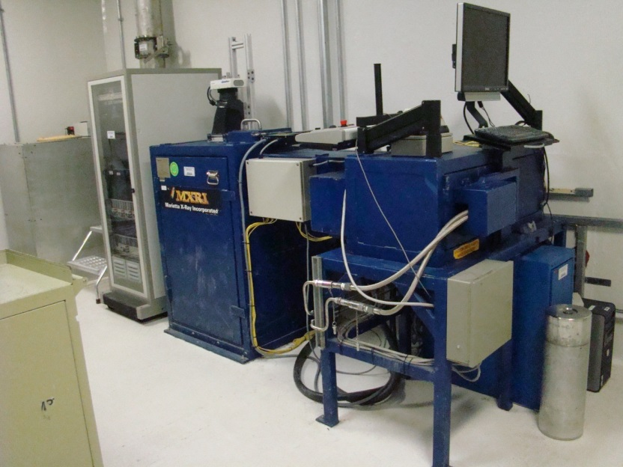
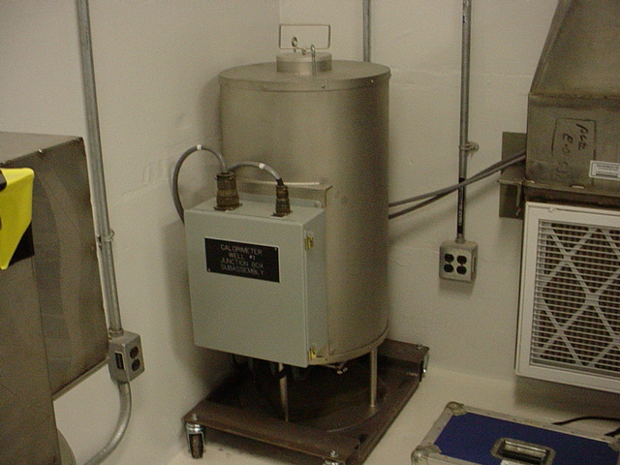
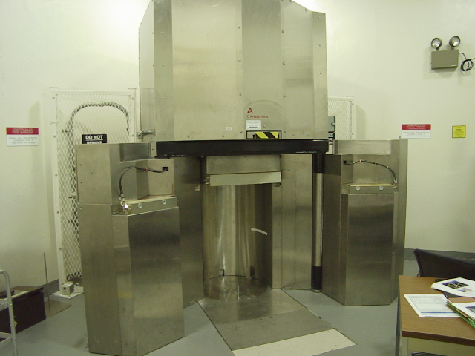
Extra Pictures
SRNS-STI-2017-00361

Slide 17
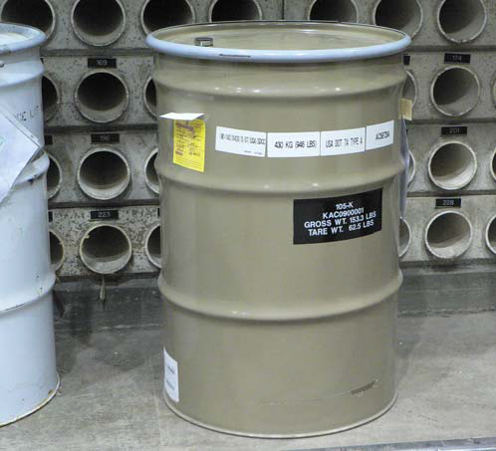
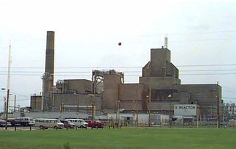
Extra Pictures
SRNS-STI-2017-00361

Slide 18
Rule of Fractions
$\sum_{i=1}^{n}{\frac{m_{i}}{M_{Si}}≤1.0}$
$m_{u}+\sum_{i=1}^{n}{m_{i}\frac{M_{Su}}{M_{Si}}≤M_{Su}}$
Example
150 g ²³⁹Pu and 350 g ²³⁵U
Convert to FGE ²³⁹Pu
150 + (350*0.65) = 377 FGE ²³⁹Pu
ANS-8.15-1981 indicates this is valid and under the ²³⁹Pu limit of 450 g, so therefore it is safely subcritical
ANS-8.15-2014 indicates this may not be valid
Compare the total mass of the system to the most restrictive limit
500 g total > 450 g, so this is not necessarily safely subcritical, additional justification is needed
SRNS-STI-2017-00361

