Slide 1
The NDaST Half Monte Carlo Method: Combining Total Monte Carlo with Nuclear Data Sensitivity Profiles
I.Hill, J.Dyrda, N.Soppera, M.Bossant
ANS Annual Meeting 2017
11 – 15 June 2017
San Francisco

Slide 2
Overview
Different methods for uncertainty propagation of nuclear data – linear propagation vs. Monte Carlo sampling
The NDaST tool and recent feature advances
The new Half Monte Carlo Method (HMM)
HMM development & verification
Comparison of propagation methods for PMF001 with 1000 random TENDL-2014 libraries
Conclusions, further work and developments

Slide 3
Uncertainty Propagation Methods
‘Classical’ linear propagation – sandwich rule
Simple, fast, detailed results
Linearity required (model params→XS→keff)
Need sensitivities and covariance matrices
Monte Carlo sampling – sample libraries based on covariances
Slow
Detail can be lost (reactions, energies)
Exact within the constructed covariance
Copes partially with non-linear response (XS→keff)
Does not need model sensitivities
TMC / UMC – sample libraries based on nuclear model parameter uncertainties
Very Slow
Detail can be lost (reactions, energies)
Exact
Works completely for high order responses (model params→XS→keff)
Requires no sensitivities / covariances, just uncertainties in nuclear model params

Slide 4
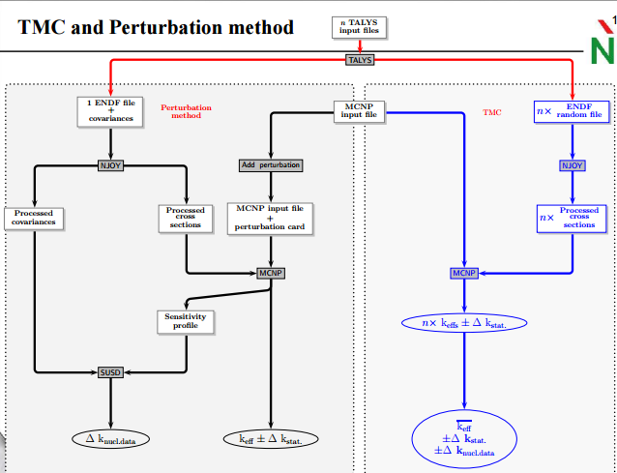
TMC: Why so Slow?
Run your nuclear modelling code [TALYS, EMPIRE]
couple of min×1000 ~ day
Run NJOY
couple of min×1000 ~ day
Run your Monte Carlo Transport Code
couple of hours×1000 ~ month
Run your Monte Carlo Code for all Fast benchmarks
month×1000 ~ decade
Some have questioned the use of 1000 random files…
they prefer 10,000!!
FYI: We’re looking at 1 isotope

Slide 5
TMC Worth the wait? Overcomes these questions
Are the nuclear data uncertainties Gaussian? Are the responses all linear? (criticality safety implications)
Are all the cross correlations being taken into account between reactions/energies/isotopes in the covariance matrices?
Is the group structure of your covariance processing OK?
Have your sensitivities been well calculated for all reactions? [Angular? Inelastic outgoing energy?]
The results of TMC and Sandwich rule have been compared in multiple papers and the results tend to be within about 20%.
D.Rochman et al, “Nuclear data uncertainty propagation: Perturbation vs. Monte Carlo” Annals of Nuclear Energy (2011)

Slide 6
Overall Perspective
Methods in Practice
Classical sandwich rule has been applied extensively in uncertainty analysis.
TMC is too slow currently except to test select cases to ensure that the classical analysis isn’t too bad.
Learning Potential
Classic sandwich rule provides physical understanding of components
TMC obscures components in statistical noise
Ideal Situation: If we could do TMC fast and get all the component information…..

Slide 7
Increasing the Speed of Validation! NDaST tool
Website: www.oecd-nea.org/ndast/
Evaluated Nuclear Data
Application Data Libraries
NEA Databases
And Tools
Example: JANIS
An open web-based JAVA tool to take advantage ICSBEP and IRPhE benchmark case nuclear data sensitivities
Enables rapid scoping of changes to nuclear data and to propagate nuclear covariance data uncertainties
It also gives access to JANIS for automation of computations and use of processed nuclear covariance data
2016 marks the full release, new features to be added on an annual basis as needed by users
NDaST
Code bias and uncertainty for nuclear applications
NEA Databases
And Tools
Examples: DICE, IDAT

Slide 8
Status: DICE Sensitivity Coefficients
Handbook Edition | Number of Unique Cases | Sources
2012 | 727 | TSUNAMI1D+TSUNAMI3D [VALID]+MMK-KENO
2013 | 3575 | Previous +Non VALID cases SCALE6.0 from Balance Inputs
2014 | 4011 | Previous + MCNP6 + SCALE6.2BClutch
2015 | 4065 | Previous + New Cases
2016 | ~4200 | Previous + New Cases + P1 Sensitivities [~400 cases]
Sensitivity Coefficients are guides to which benchmarks may be good for testing nuclear data changes!
Original cost estimate for sensitivity data $100,000 per 100 cases
Standard problems
Benchmarks
Validation
Code bias and uncertainty for nuclear applications
NDaST
NEA Databases
And Tools
Examples: DICE, IDAT

Slide 9
Nuclear Data Sensitivity Tool (NDaST) Flowchart
Benchmarks (Sensitivities) → Nuclear Data (% Change or Covariance) → Integral Results
Select / load benchmarks
Sensitivities (S) & C/E data
DICE
IDAT
Personal
Numerical Benchmarks
User Input Perturbation (P)
isotope/reaction/energy cross section
S*P
Δk_{eff} for selected cases
C/E output plot grouped by criteria
Covariance data via JANIS (C)
Built in processed data for major libraries
Load personal (coverx)
M energy groups (fixed)
S*C*S^{T}
U_{C(XS)} for selected cases
Additional uncertainty on output plot grouped by criteria
Matrix plot showing individual contribution to U_{C(XS)} by isotope-reaction
AND/OR
JANIS MF33: ENDF/B-VII.1 = 2138 files, JEFF-3.2 = 5688 files JENDL-4.0 = 2155 files TENDL-2013 = 77811 files

Slide 10
NDaST Benefits
Take a nuclear data evaluation, provide evaluators and other users a tool to propagate the impact on integral benchmarks
(∆k_{eff} and uncertainty) …in minutes
See individual reaction effects, not just final totals
Analyse how these ‘compete’ if they are correlated
Understand specifically which energy regions matter
How do perturbations compare with given uncertainties
Propagate uncertainties and judge their reasonability
Do this time and time again as small iterations take place
Allow internationally co-operating projects to manage these processes more easily

Slide 11
Limitations
All based on simple, first order approximations
These might not hold beyond certain limits, depending on strength of secondary effects
Not all cases (around 85% of the total database)
Sensitivities mostly the SCALE 238 group energy structure
Bad choice for certain types of systems & perturbations e.g. movement of large resonances across group boundaries
Reactions (not all are loaded into database)
Difficult to properly handle the energy-dependent PFNS for multiple cases with ranges of spectra
Angular sensitivity (being addressed – 400 P1 sensitivities)
Experimental correlations are not considered
This is not (yet) an adjustment tool

Slide 12
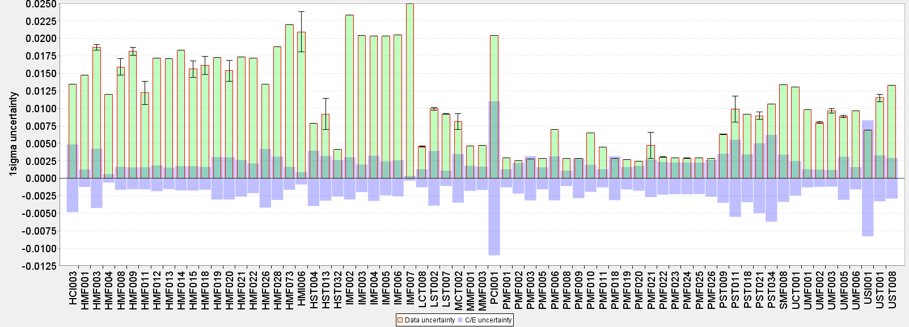
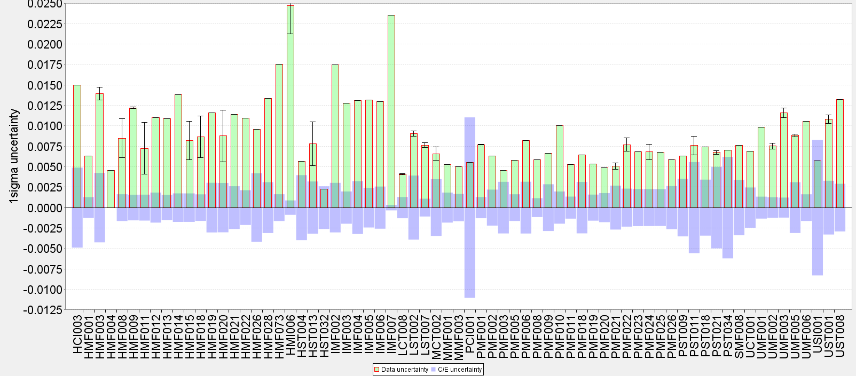
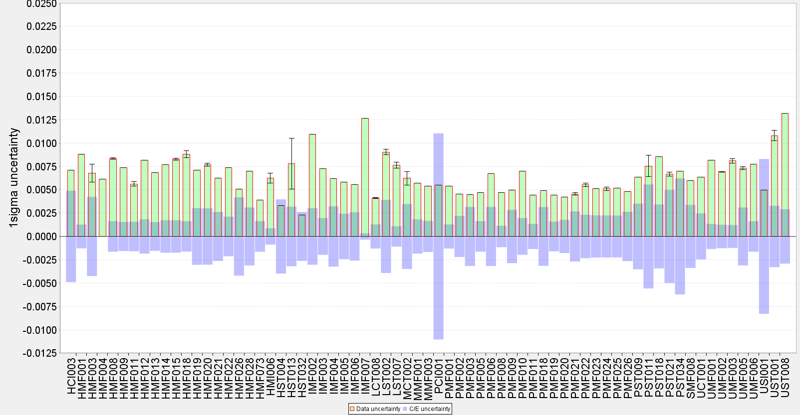
Testing JEFF-3.3 Covariances All Results by Evaluation ID
JEFF-3.3T3
Mean = 1100 pcm
JEFF-3.3T1
Mean = 1043 pcm
ENDF/B-VII.1
Mean = 922 pcm
JENDL-4.0
Mean = 668 pcm
Notes:
Approximately in the same order with HMF / IMF cases normally at the higher end
Some notable example cases change dramatically which are highlighted for later investigation

Slide 13
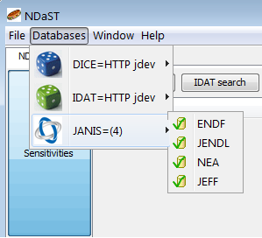
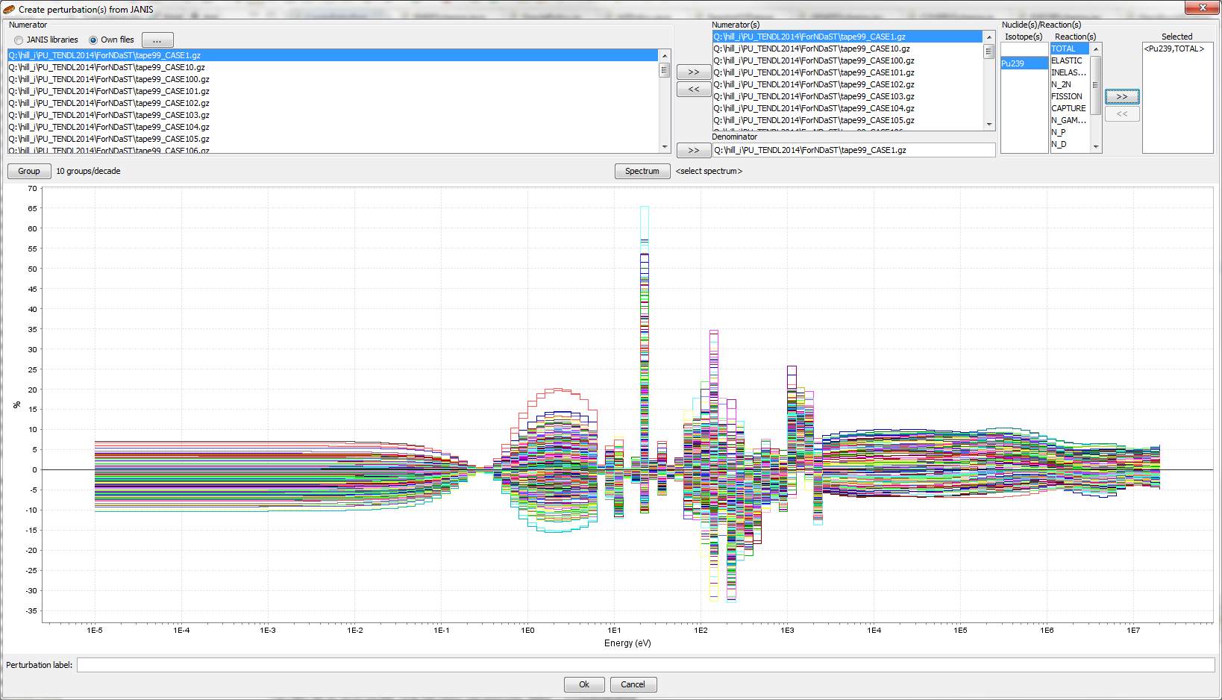
NDaST: Automated JANIS Computations
An automated link has been introduced to the JANIS nuclear data software to generate the perturbation ratios between two evaluations.
Represented within any energy group structure required.
Analytical or personal spectrum weightings may also be applied
Multiple perturbations of the same nuclide-reaction can now be input for faster comparison with one single run
NDaST now has a ‘file upload’ feature, to avoid needing to already have libraries held in a JANIS base.

Slide 14
Half Monte Carlo Method (HMM)
TMC is one solution for non-linear dependencies or non-gaussian uncertainty distributions?
K_{eff} sensitivities in general remain linear over a large range; the same cannot be said for nuclear reaction model parameters and cross-sections.
Instead of running hundreds or thousands of neutronics calculations, can we just take sampled cross section files and perform cheap perturbations with NDaST?
Retain the normal NDaST benefits (a deeper analysis of the reaction / energy effects) without the computational burden.
Comparison for PMF001 Jezebel
1000 SERPENT runs with different random TENDL-2014 Pu239 ace files (downloaded from website)
Propagation through NDaST for same 1000 files
Use the TENDL-2014 Pu239 covariance data for classical result

Slide 15
Necessary Developments (ongoing)
File drag n drop for (H/P)ENDF
New graphical output for comparing multiple perturbations
Handling for PFNS (Chi)
Multiple probability functions for E(E’) within ENDF file structure that need to divided
Need a spectrum averaged perturbation function as a function of E’ (compatible with sensitivity data units)
Verification of different numerical methods (interpolation function, form multi-group bins before or after division)
Parsing of MF31, MF35 needs refinement
Building in statistical moment calculation

Slide 16
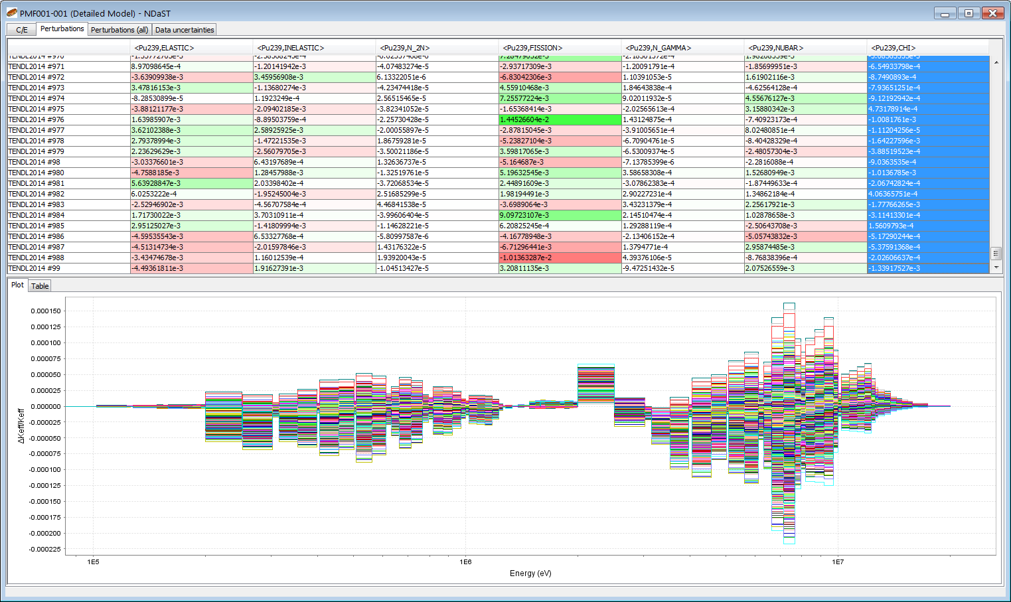
NDaST case detailed output
Select reaction
Select perturbation
Plot ∆k_{eff} vs energy

Slide 17
Half Monte Carlo Method (HMM) Results
k_{eff} distribution, sorted lowest k_{eff} to highest, plotted with the HMM k_{eff} predictions for 20 samples and full automated set
Example breakdown by reaction for 20 sample cases

Slide 18
Delta K_{eff} sorted into bins
 | SERPENT | NDaST
Mean | -0.00115 | -0.00102
St. dev. | 0.008321 | 0.00808
Skew | 0.240368 | 0.25550
Kurtosis | -0.46397 | -0.39692
Maximum difference 161pcm for cases on tails (average for all 13pcm)
- Example of higher order dependency?

Slide 19
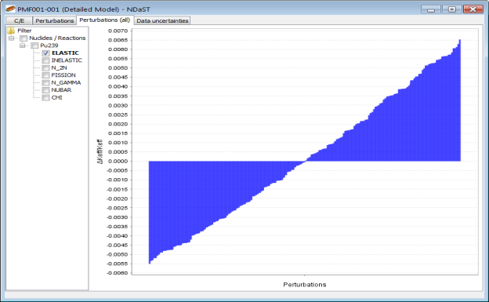
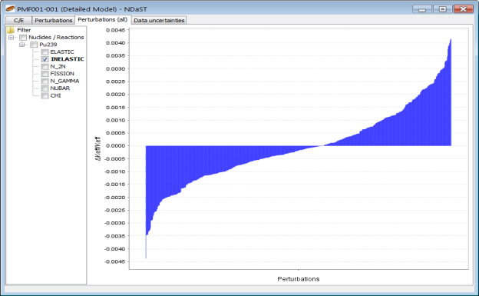
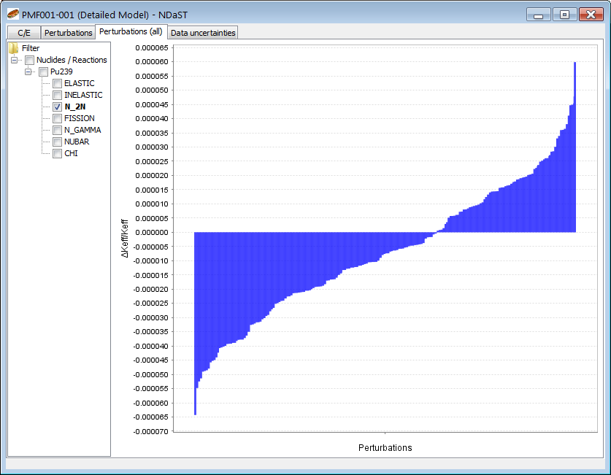
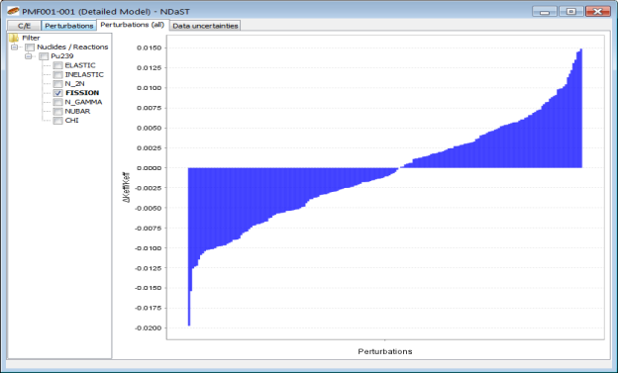
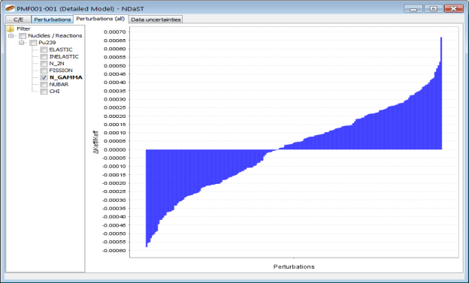
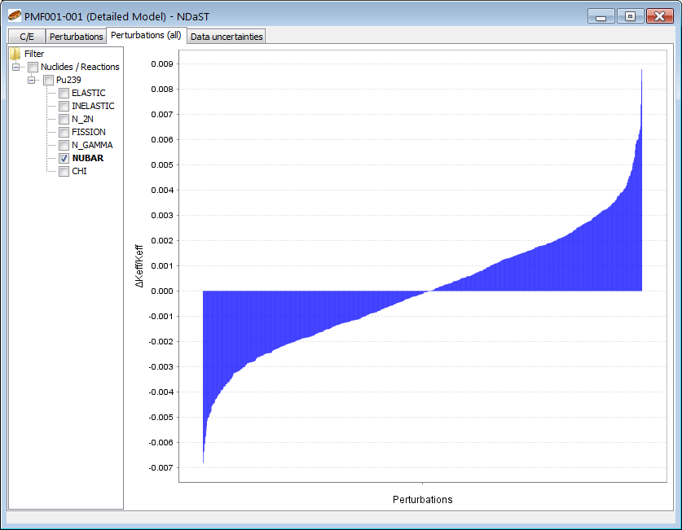
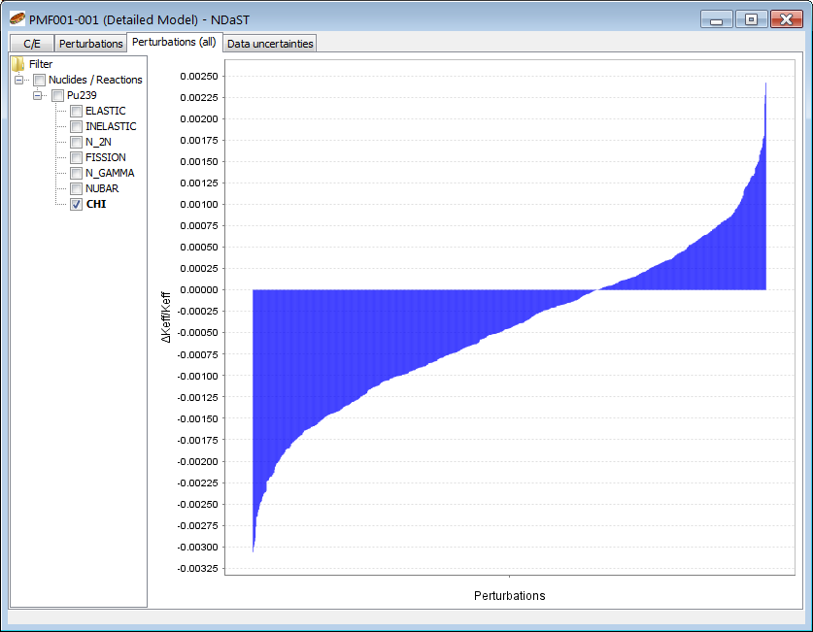
Delta k_{eff} distributions by reaction
elastic
inelastic
n,2n
fission
n,gamma
nubar
 | elastic | inelastic | n,2n | fission | n,gamma | nubar | chi
Mean | 0.00014 | -0.00004 | -0.00001 | -0.00064 | 0.00001 | -0.00002 | -0.00046
St. dev. | 0.00344 | 0.00145 | 0.00002 | 0.00648 | 0.00025 | 0.00238 | 0.00093
Skew | 0.12074 | 0.34519 | 0.11337 | 0.05432 | -0.17265 | 0.18915 | -0.03932
Kurt. | -1.20829 | 0.10658 | -0.45525 | -0.38844 | -0.60157 | 0.02513 | -0.22921
Chi

Slide 20
HMM to classical comparison
 | elastic | inelastic | n,2n | fission | n,gamma | nubar | chi
elastic | 0.00332 | 0.00121 | 0.00015 | 0.00306 | 0.00045
inelastic |  | 0.00277 | 0.00011 | 0.00275 | 0.00030
n,2n |  |  | 0.00002 | 0.00018 | 0.00006
fission |  |  |  | 0.00493 | 0.00088
n,gamma |  |  |  |  | 0.00035
nubar |  |  |  |  |  | 0.00128 |  |  | 0.00802
chi |  |  |  |  |  |  | 0.00470 |  | 0.00929
HMM st. dev. | 0.00344 | 0.00145 | 0.00002 | 0.00648 | 0.00025 | 0.00238 | 0.00093 |  | 0.00790
Off diagonal elements hidden (but treated) within HMM method
Significant disagreement for Chi (factor of ~5)
Method of propagation (constrained v unconstrained?)
Or inconsistency in sampling and covariance calculation?

Slide 21
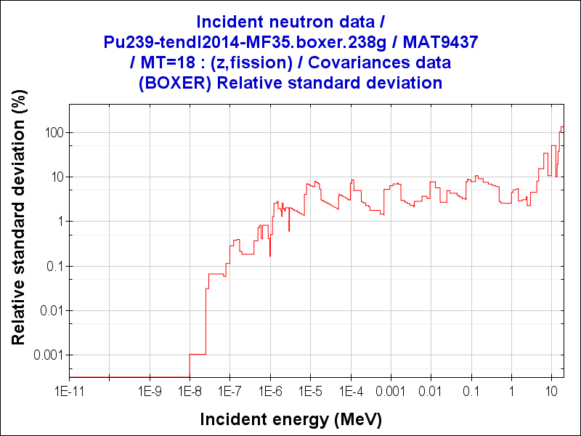
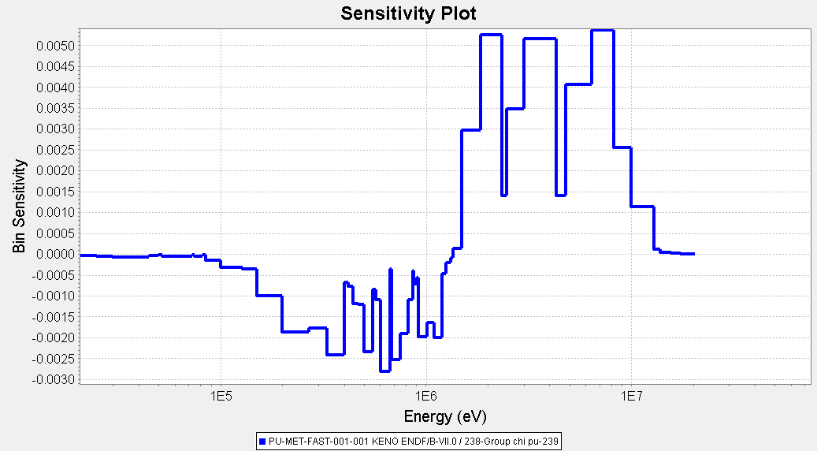
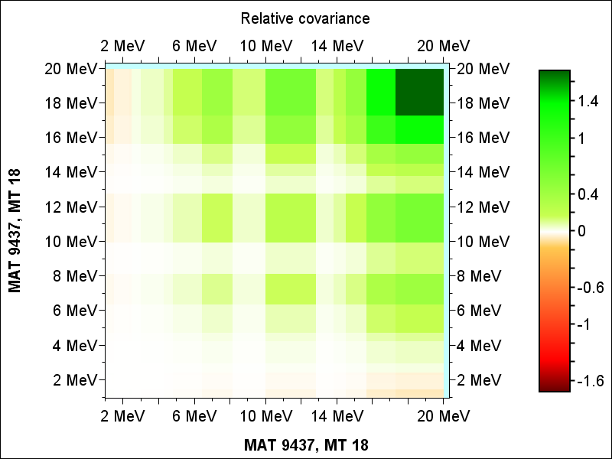
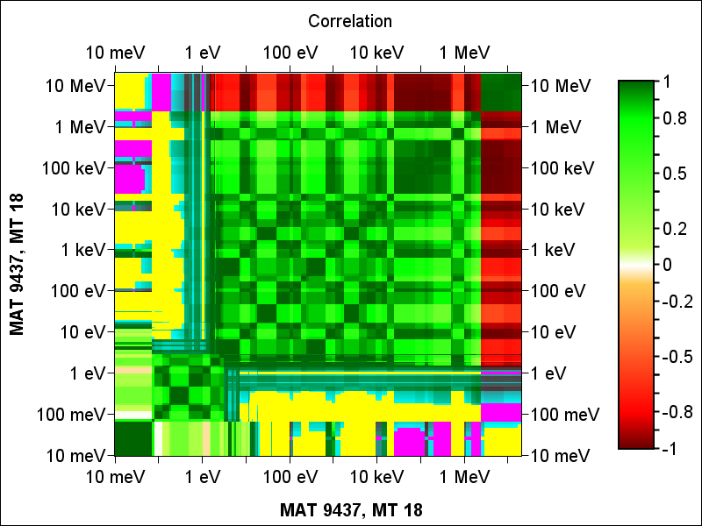
MF35 Chi Covariance
Classical 470pcm has significant contribution from fast sensitivity
In PMF001 10% of fissions are above 4MeV
30% of absolute k_{eff} sensitivity

Slide 22
NDaST: Developments and Collaboration
Some planned new features (development began April 2017):
Complete covariance library selection option
JANIS ENDF file import through NDaST – TMC / Half Monte Carlo
Compensating effects dialogue (e.g. perturbations to preserve totals)
Pre-loadable benchmark set selections (e.g. JEFF, CSEWG, MCNP testing suites)
Representativity values (i.e. calculation of Ck correlations)
Spectrum weighted Chi perturbations more compatible with Chi sensitivities
Automatic selection of nuclides/reaction covariances from sensitivity sdf file
Collaboration areas of interest:
Additional sensitivity files and C/E results to populate the databases
Supported sensitivity and covariance formats (e.g. COVERX libraries)
Compatibility with the NDEC system – propagation of test file perturbations
XML format to contain input / output; benchmark data, perturbations, covariances etc.

Slide 23
Summary, Further Work
~4200 cases (~85%) have 3 group sensitivity data and full sensitivity profiles within DICE – similar also in IDAT
An open web-based JAVA tool named NDaST is now available to take advantage of these data
Enable rapid scoping of changes to nuclear data and to propagate nuclear covariance data uncertainties
Full release in 2016 following a beta testing period, with annual feature developments thereafter
Access to JANIS for automation of computations; now large scale to enable testing of a fast, Half Monte Carlo Method
Verification for PMF001 case; need wider testing, optimization and demonstration with other sampled libraries (which?)

