Slide 1
Bounding the Chemistry Conditions in the HM Solvent Extraction Process Criticality Safety Analyses
Tracy Stover, Stephen Kessler, John Lint
Savannah River Nuclear Solutions, LLC
ANS Annual Conference June 2017
SRNS-STI-2017-00284

Slide 2
Introduction
The HM-Process
Aqueous 2 cycle uranium extraction and purification using low volume percent TBP to extract uranium from nitric acid solution
Mixer-settlers are not geometrically safe
Safety analysis postulates 36 criticality scenarios based on reflux leading to accumulation of fissile material
Due to upset in a process stream
Conservative assumptions made many years go with less sophisticated models
Assumption that reflux continuously builds up fissile material in 3 stages
Distribution goes to 0 or infinity – not physically achievable
Notes:
Reflux is where uranium is stripped from the extractant back into the aqueous phase and concentrates or vice versa.
Say Tributyl Phosphate just in case people don’t know.

Slide 3
HM-Process
1st Uranium Cycle
Separates uranium from fuel matrix, fission products, and most of transuranic actinides
Two 16-stage banks (A and B) and one 12-stage bank (C)
A-Bank, Stage 8 Feed: 6.1 L/min, 1.6M nitric acid, 4.5 gU/L, 4.5 M excess nitrate (1.5M Al-nitrate from dissolution)
B-Bank, Stage 8 Feed is A-Bank Organic Outlet
C-Bank, Stage 12 Feed is B-Bank Organic Outlet
Notes:
The first cycle, consisting of two 16-stage banks (A and B-banks) and one 12-stage bank (C-Bank). The first cycle aqueous product is then concentrated, adjusted for acidity and fed to the second cycle.
Per these conditions, H-Canyon is working to a conservative 73 wt.% enriched uranium flowsheet.

Slide 4
HM-Process
2nd Uranium Cycle
One 16-stage bank (D) and one 12-stage bank (E)
D-Bank, Stage 8 Feed: 8.7 L/Min, 5.5M nitric acid, 5.25 gU/L
D-Bank, Stage 4 Feed: 0.067 L/min 0.02M ferrous sulfamate to strip out remaining plutonium
Included in chemistry but not in criticality for conservatism
E-Bank, Stage 12 Feed is D-Bank Outlet Organic
E-Bank aqueous outlet is final, purified product
Notes:
Further purifies the uranium and removes to a great extent any remaining transuranic actinides and fission products. The ferrious sulfamate is a reducing agent the keeps Pu in an inextractable oxidation state.

Slide 5
Base Cases vs. Analyzed Range
Parameter | Base Case | Operating Range | Analyzed Range
B-Bank aqueous acidity (M) | 1.55 | 1.5 – 1.6 | 0.2 - 4.5
D-Bank aqueous acidity (M) | 0.95 | 0.8-1.5 | 0.05 – 3.5
Base Case is the operational setpoint and is considered normal
Operating range is considered credible abnormal
Outside of this band the process shuts down
Interlocks and/or operator actions
Beyond credible abnormal is the analyzed range
Notes:
At the time of this authorship we have analyzed all of the acid, and most of the flow rate, TBP, and uranium concnetration upsets using this methodology. We however only have limited time here.
The operating limits are the abnormal because on the process parameter is beyond that the process must corrected or shutdown.

Slide 6
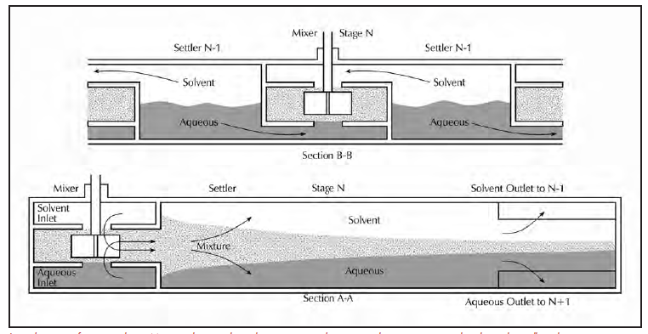
Model of Mixer Settler - Dimensions
Parameter (all dimensions in inches) | 16-Stage Bank | 12-Stage Bank
Settling section height x width x length | 10x8x48 | 12x12x108
Mixing section height x width x length | 8x8x9 | 10x12x13.5
False bottom height | 2 | 2
Bottom, front, and back plate thickness | 0.5 | 0.5
Top and side plate thickness | 0.25 | 0.25
Notes:
See two cross sectional views looking across the stage and down the mixing section end.
Low density solvent or organic phase enters from the top of one stage and higher density aqueous acid enters from the bottom of another stage.
Counter current flow
Mixing section mixes the two phases with an impeller
Settling section, with the exception of baffles (not pictured) and a weir is long free space for the phases to separate
Criticality models neglect all interstitial structures except sides and top and bottom places to conservatively add fissile solution and increase interaction
Here are the assumed dimensions of the two types of banks
A small air pocket is assumed around the mixer-settler, reflective of reality, but is bounded with fully reflected boundary conditions beyond that.

Slide 7
Model of Mixer Settler – Chemical Species
3 unique compositions per stage
Each stream in each stage composed of H, C, O, P, N, U-235, U-238
73 wt.% uranium enrichment
Chemical species listed below:
Name | Chemical Formula | Theoretical Density (g/cm³)
Tributyl Phosphate (TBP) | C₁₂H₂₇O₄P | 0.9727
Nitric Acid | HNO₃ | 1.55
n-paraffin (assumed): | -- | --
20% dodecane | C₁₂H₂₆ | 0.749
40% tridecane | C₁₃H₂₈ | 0.756
40% tetradecane | C₁₄H₃₀ | 0.763
Uranyl nitrate | UO₂(NO₃)₂ | 2.203
Organic
Aqueous
Name | Chemical Formula | Theoretical Density (g/cm³)
Water | H₂O | 0.9982
Nitric Acid | HNO₃ | 1.55
Uranyl Nitrate (aqueous) | UO₂(NO₃)₂ * 6(H₂O) | 2.4183
Notes:
Historically, the canyon processed at the 73 wt.% enriched U flowsheet. This more realistically captured the canyon operations and futhremore, the chemistry sees only uranium. Currently the canyon is switching to a 50 wt.% flow sheet for separations. HEU fuels dissolved may be a mix of enrichments from 20 to 93 wt.% and the solution is downblended with natural uranium to the desired enrichment prior to entering 1st cycle.
These components are all volume and mass “smeared” into the KENO mixtures.
Assumed only U-238 and U-235, assumed settling aqueous, settling organic, and mixing combination.
TBP is 7.5 volume percent of the input organic stream which results in a combined TBP and n‑paraffin density of 0.7743 g/cm³
There is less than 1 g/L trace plutonium which is neglected as it is not extracted and leaves the system with A-Bank aqueous waste.

Slide 8
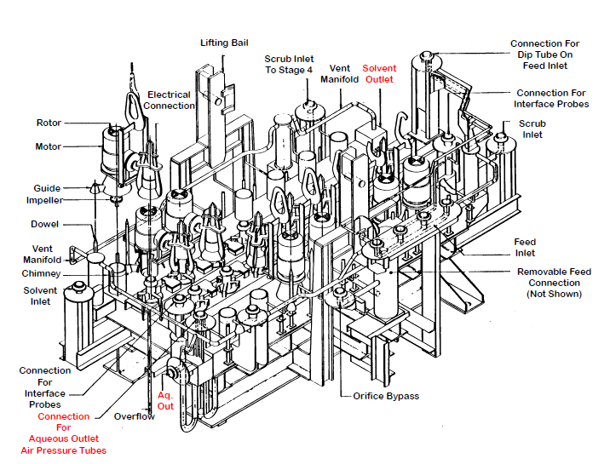
Model of the Mixer Settler
Notes:
Busy, actual diagram
Note the counter current outlets
Note the aqueous pressure controller which allows the operators to manually control the average aqueous and organic volume fractions in the settling sections.

Slide 9
Model of the Mixer Settler
Notes:
The aqueous and organic inlet compositions are smeared into a single composition for the mixer section. The settler section is filled with the aqueous composition on the bottom and the organic composition on the top. In operation, the height may also be set by air pressure an interface controller which averages to 50% each phase in the settling section.
Without this, the volumes are determined by flow rates of each phase.

Slide 10
The Chemistry Bounding Approach
Criticality models are well understood
SCALE 6.1 has been validated and is part of standard SRNS criticality safety methodology
Question then is – how much do we trust the chemical compositions we are entering into SCALE?
SEPHIS has been used for decades for flowsheet development with lab analysis for support
Not explicitly used for safety analysis
Validations conducted against HM-process lab data
Show bias in uranium distribution coefficient prediction tending to over estimate aqueous concentration (conservative)
Notes:
Note that the bias may not be a bad thing for criticality safety. In these systems the multiplication factor tends to follow the aqueous fissile concentration rather than the organic.
SEPHIS is a computer program which simulates the solvent extraction process for uranium and plutonium in systems of nitric acid and tributyl phosphate.

Slide 11
Bounding Parameters
The following parameters are examined
Aqueous and organic uranium concentration
Aqueous and organic acid concentration
Uranium distribution coefficient
Acid distribution coefficient
If the various predictions for credible abnormal stage-wise chemistry are bounded by the SEPHIS beyond credible abnormal conditions, then by spanning the beyond credible abnormal space we at a minimum capture the conditions at the credible abnormals plus any bias SEPHIS introduces
What are the predictions?

Slide 12
The Chemistry Bounding Approach
Show that the chemistry conditions predicted across the maximum analyzed range
Bound:
SEPHIS predicted operational band (by default)
Validation and bias quantification
Code comparison or alternative analysis
Experimental results
Results should be either:
Absolutely bound
Effectively bound
Bound by alternative analysis
Bound by conservative biasing
Bound by first order effects
Notes:
Absolutely bound = all results (biased, alt. code, operational band) are bound numerically by range
Effectively bound = all results that are numerically significant are bound numerically by range, e.g. fissile conc. Of 10^-20 g/L is not going to affect results
Bound by alternative analysis = the alt. code results bound the SEPHIS results
Bound by conservative biasing = the biased SEPHIS results bound the SEPHIS results
Bound by first order effects = when no other argument is applicable, is the process upset in a process parameter that is directly used to calculate the distribution coefficient? If not then its affect on the system will be minimal

Slide 13
Bounding through Validation and Bias
Some validation work has been done for SEPHIS
Shows a bias toward over-predicting the aqueous uranium concentration
Conservatively bias distribution by 30%
Shows mixed results in predicting acid concentration
Conservatively bias distribution by10%
Recalculate operational band stage-wise compositions with bias

Slide 14
Bounding Through Code Comparison
Also may be called alternative analysis
Use SOLVEX
Less sophisticated
Requires user input for distribution coefficient
Allows using HM-process specific distribution coefficient data
Use SOLVEX stage-wise compositions for SCALE models
Notes:
SOLVEX was used prior to SEPHIS and is still employed for alternative analysis and scoping calculations
SOLVEX also simulates the solvent extraction process, but requires a higher level of user input and is limited in functionality and capability
The modernized SEPHIS ACM was not available at the time of this work.

Slide 15
Bounding Through Experimental Results
D-Bank acid upset has been explicitly studied by Savannah River National Lab (SRNL) and has experimental results
Concluded SEPHIS was conservative for criticality safety concerns
Concluded D-bank upset bounded E-Bank acid upsets
Could also bound B and C Bank acid upsets
SRNL mixer settler mock up facility is current undergoing renovation so further experimental results are not an option at this time

Slide 16
Chemistry Bounding Results
The following slides will go rather quickly
If you have specific questions, we can address them at the end
Neutron multiplication follows aqueous uranium concentration so that is what is presented
Distribution coefficient = organic / aqueous concentrations
Also concerned with acid distribution because this affected the H/fissile ratio
See summary for more plots

Slide 17
Aqueous Uranium Concentration
Notes:
Absolutely bound

Slide 18
Aqueous Uranium Concentration
Notes:
Absolutely bound in all but stage 12 of the C-Bank.
The Stage 12 chemistry is bound by alternative analysis. It is also likely the biased SEPHIS results are too conservative, artificially inflating SEPHIS’s inherent over-prediction.

Slide 19
Aqueous Uranium Concentration
Notes:
Absolutely bound

Slide 20
Aqueous Uranium Concentration
Notes:
Absolutely bound in all but stage 12 of the E-Bank.
The Stage 12 chemistry is bound by alternative analysis. It is also likely the biased SEPHIS results are too conservative, artificially inflating SEPHIS’s inherent over-prediction.

Slide 21
All of that… just to say this…
Notes:
When we say the upset does not challenge criticality at the credible abnormal conditions (solid vertical lines), we believe that is true because we have analyzed a range that should include any bias or misprediction.

Slide 22
All of that… just to say this…
Notes:
Ditto

Slide 23
Conclusions
All indications are that by analyzing a wide range, the chemistry conditions at the operational band are bounded
Consistent for all acid upsets analyzed
Benefits of event elimination
Reducing the functional classification of certain equipment
Reducing sampling and lab analysis burden
Time and financial savings to be realized
What’s holding us up?
Confirmation we can use SEPHIS for this purpose

Slide 24
Future Work
Work with SRNL to conclude SEPHIS Modification-4 is “acceptable” for use to predict chemistry conditions for criticality safety analyses
Existing validation work
Existing experimental work
Future experimental work
Analyze remaining events as possible
Temperature upsets and mechanical failures outside scope
Explore using the newly released SEPHIS-ACM
Comparisons to SEPHIS Modification-4
Notes:
Acceptable may be a slight misnomer but is the language being used for now at least internally. We want to be confident that SEPHIS is either conservatively biased or at the very least the chemistry conditions we model bound the actual range of possible upsets, either absolutely or effectively.
SEPHIS-ACM for Aspen Custom Modeler, is probably the biggest upgrade to the SEPHIS code in more than a generation. It ports the methodology completely to a new platform with a GUI interface. Moreover, the ACM version includes improved chemistry correlations, better tracking of materials, more chemical species to be tracked, flexibility to model the entire process system, not just the solvent extraction banks. Perhaps next year the developer of ACM and/or myself will give you an update on it.

Slide 25
Extra Slides

Slide 26
SEPHIS-ACM Screenshot
Notes:
The screenshot here shows the full first uranium cycle modeled including solvent recycle, high and low activity waste streams and product concentration. Each stream tracks 25-40 chemical species compared to the SEPHIS Mod 4’s six.

Slide 27
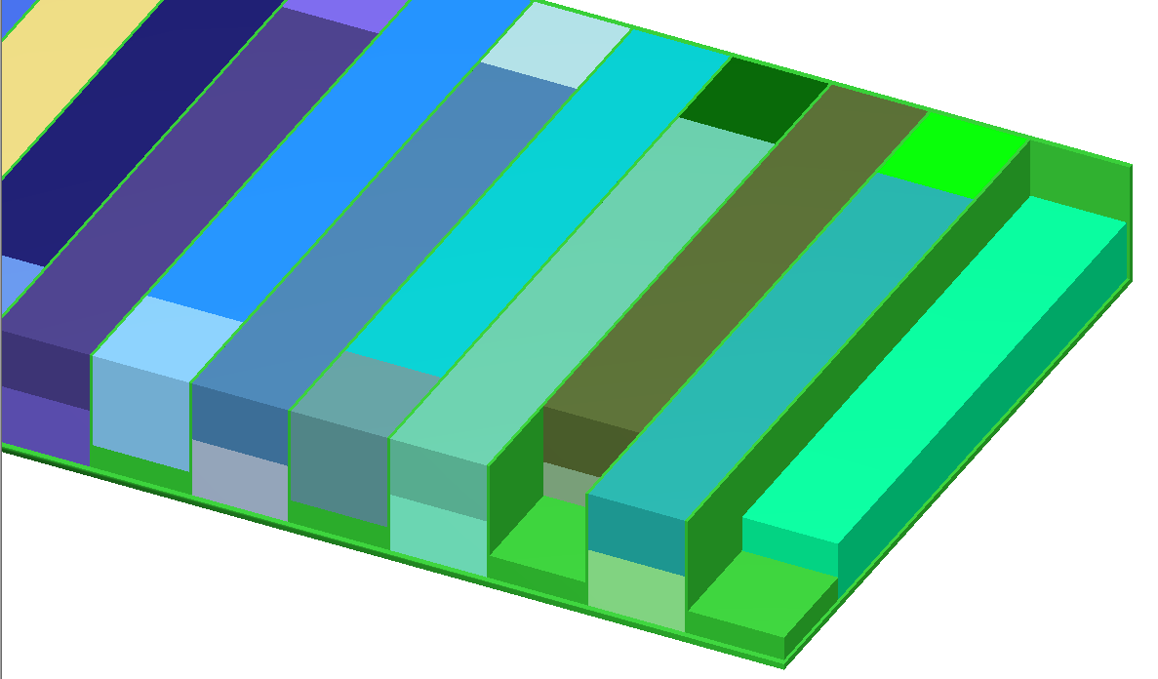
Model of the Mixer Settler
Notes:
Interconnected flow, organic on top, aqueous on bottom

Slide 28
Organic Uranium Concentration
Notes:
Absolutely bound

Slide 29
Organic Uranium Concentration
Notes:
Absolutely bound

Slide 30
Organic Uranium Concentration
Notes:
Absolutely bound in Stages 8-16 of the D-Bank. The remainder of the D-Bank is bound by alternative analysis. In fact only the biased SEPHIS results are out of the overall minimum bound and then only by the difference between 1.78 gU/L and 1.48 gU/L and the unbiased SEPHIS conservatively predicts the higher of those values.

Slide 31
Organic Uranium Concentration
Notes:
Absolutely bound

Slide 32
Uranium Distribution Coefficient
Notes:
Absolutely bound

Slide 33
Uranium Distribution Coefficient
Notes:
Absolutely bound

Slide 34
Uranium Distribution Coefficient
Notes:
Absolutely bound in the E-Bank and in Stages 1 through 7 of the D-Bank. Both the biased SEPHIS and SOLVEX results predict lower uranium distribution coefficients than the bound values. The bank is still effectively bound even with the slight variations because the concentration of uranium in the D-Bank Stages 8 through 16 drops to effectively 0 so slight mispredictions are tolerable since they have negligible (if any) impact on the system multiplication.

Slide 35
Uranium Distribution Coefficient
Notes:
Effectively bound

Slide 36
Nitric Acid Distribution Coefficient
Notes:
Absolutely bound

Slide 37
Nitric Acid Distribution Coefficient
Notes:
effectively bound in the C-Bank. SOLVEX cases are not bounded in C-Bank below 10th stage in C-Bank but the acid concentration is effectively 0 for those stages.

Slide 38
Nitric Acid Distribution Coefficient
Notes:
Absolutely bound in Stages 1 through 7 of D-Bank. Stages 8 through 16 of D-Bank have the acid distribution coefficient under predicted by the biased SEPHIS results and over predicted, though negligibly so, by the SOLVEX results. Review of the aqueous and organic acid predictions found them to be acceptably bounded so by relation, the distribution coefficient is also acceptable.

Slide 39
Nitric Acid Distribution Coefficient
Notes:
Absolutely bound Stages 10 through 12 of the E-Bank. The remainder of the E-Bank is both effectively bound because the predicted value is so lot and bound by conservative biasing. The acid concentrations in Stages 1 through 9 of E-Bank are also negligibly low so that the limits of the SOLVEX correlation data are being approached so there may be some extrapolation in the SOLVEX results for E-Bank.

Slide 40
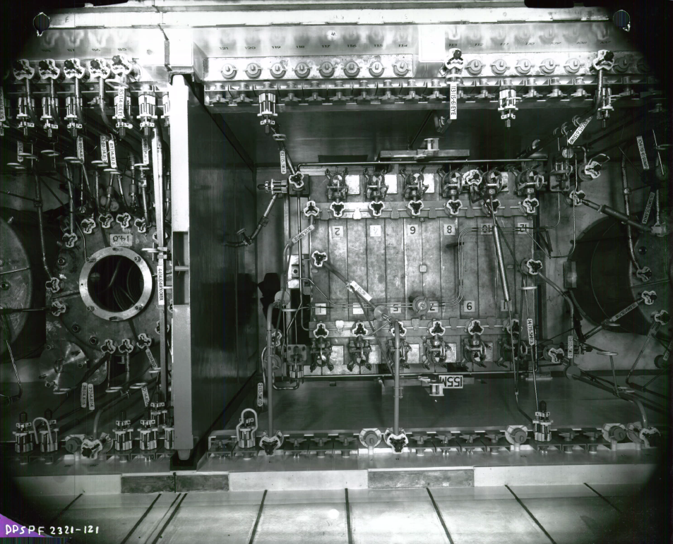
Model of the Mixer Settler
Notes:
Original installation (approx. 1954)

Slide 41
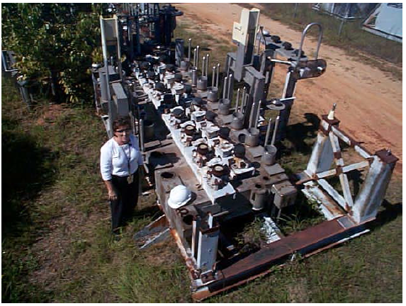
Model of the Mixer Settler
Notes:
16 stage bank Replacement, mid-1990s
People were smaller in the 1990s… I know I was

Slide 42
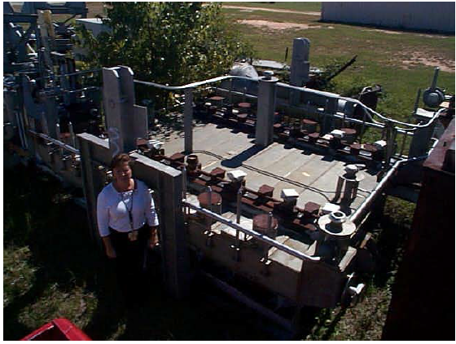
Model of the Mixer Settler
Notes:
12-stage bank Replacement, mid-1990s

