Slide 1
Criticality Scoping Calculations for a Multi-Function Dissolver Insert
Tracy Stover and Stephen Kessler
Savannah River Nuclear Solutions, LLC
ANS Annual Conference June 2017
SRNS-STI-2017-00285

Slide 2
Background – What is a Dissolver and Dissolver Insert
First step in fuel separations and purification at H-Canyon
Dissolver
Stainless steel pot
Loaded with nitric acid
Dissolves uranium-aluminum fuel
Notes:
Uranium-aluminum alloy and usually aluminum clad
The insert fits down inside the dissolver. The picture is true, the dissolver sits on a sloped floor. Canyon cells are sloped so that spills and leaks will collect in a sump.

Slide 3
Background – What is a Dissolver and Dissolver Insert
Dissolver insert
Drops into column in plug-n-play fashion
Feeds fuel to acid solution
Controlled geometry
Controlled feed rate
Gravity or complete submersion
Existing dissolver inserts
Circular well
Slab well
HFIR well
Notes:
Circular is 10 5” wells and was designed originally for SRS reactor assemblies but is currently used for bundled research reactor fuels
Slab well was for various uses and also SRS reactor assemblies, consists of four 4.5”x15” slab wells
HFIR is specifically designed for the dissolution of ORNL’s HFIR cores.
Long cylindrical feed materials are gravity fed into the system. HFIR and likely RHF would be submerged in acid completely

Slide 4
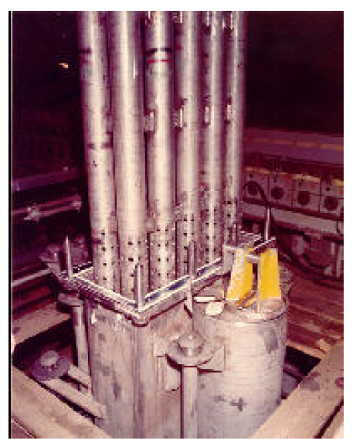
Background – What is a Dissolver and Dissolver Insert
Notes:
Left: HFIR insert
Right: 10-well insert
Center: 10-well insert being placed into dissolver column

Slide 5
Background
Not all material is a cylinder, slab, or HFIR core
Scoping the potential for a new dissolver insert capable of handling miscellaneous fuel forms
Analyzed 5 bounding fuel geometries expected to limit or influence the design of the new dissolver insert
Generic annular plate fuel (APF)
Tower shield reactor (TSR)
Reactor a Haute Flux (RHF)
Knolls Atomic Power Lab reactor (KAPL)
SLOWPOKE reactor core

Slide 6
Modeling Approach and Assumptions
KENO-VI in SCALE 6.1 with a k-safe of 0.966
3 region generic geometry
1) fuel element, 2) insert well, 3) dissolver/bulk solution
5 phase dissolution
0%, 25%, 50%, 75%, 100% of the fuel element dissolved by volume fraction
2 or 3 bulk solution acidity values assumed
0.5M (minimum) 10.4 M (maximum)
4 M, special case for U-Mo and for control
Assume fresh fuel, no burnup credited
Constant dissolver bulk solution volume of 5000 L
Replace stainless dissolver with reflective boundary conditions
Notes:
K-safe is based upon validation work for the SCALE 6.1 code for use with SRNS HEU processes.
Here it is really the insert well that is of interest to the potential design of the new insert.
To prevent U-Mo from co-precipitating in low acid a 3-6 M terminal acid is usually required. The nitrogen poisoning can also provide a slight level of multiplication reduction in cases where the k was close to k-safe. It would usually not be credited but if it is required for chemistry control, it could be.

Slide 7
Modeling Approach and Assumptions
Stainless steel component do not dissolve and would need retrieval – engineering issue
Dissolver components not modeled
Heating coils, sparger, instrumentation tubes
Conservatively increases interaction of fuel-solution
Wells are tailored to fuel designs in search for limiting geometry
Generally close fitting around the fuel element
Limited dimensions
Real wells are up to 20 feet in height
Dissolved U and Al/Mo remain in the well solution until 150 gU/L is exceeded (conservative modeling assumption)
Elements, except APF, dissolved one at a time
Notes:
The stainless steel dissolver insert’s main contribution would be parasitic absorption in the iron, over increased reflection. Numerous past analyses have born this out for HM-process applications. Again, the limiting well geometries are what is of concern to potential insert design.
The 150 gU/L assumption is overly conservative and based upon bounding SRNL predictions of uranium diffusion into the bulk solution. This turns the well solution into an artificially high concentration small volume, more or less surrounded by infinite water reflection. Only the APF required this assumption.

Slide 8
APF Model
Element:
Idealized to bound several types
14 kg 93.5 wt.% U with 10 wt. % Mo
7 inch annulus and 11.7 inch O.D.
0.795 inch thick
Well:
12 inch wide, 14 inch high
2 or 3 inch thicknesses
Two wells separated by 6 or 8 inches

Slide 9
TSR Model
Element
Highly unique
Hollow sphere with 12 annular elements, 4 lower elements, 4 upper elements, 4 lune plates, 1 plug
U-Al fuel form
93.15 wt.% enrichment
Only ~16 wt.% U though
Annular and upper/lower elements bound others in geometry and fissile mass
76-89% free volume in annular and upper/lower elements
Well
Annular element: 18 cm radius and 70 cm height
Upper/Lower element: cubic, 40 cm sides
Notes:
The annular fuel element consists of 472.534 g U (440.18 g U-235) plus 2,578.6 g Al in the fuel, 5,291 g Al in the cladding and 411 g Al additional in the structural materials. The lower/upper fuel element consists of 378.13 g U (352.24 g U-235) plus 2,034 g Al in the fuel, 4,176 g Al in the cladding and 117 g Al additional in the structural materials.
Translates to 93.15 wt.% enrichment but only 16 wt.% U, also 76 to 89% of the elements are free volume.

Slide 10
TSR Model

Slide 11
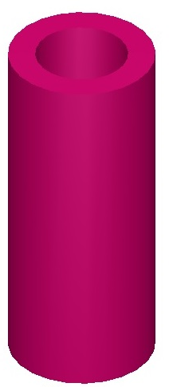
RHF Model
Element:
Similar in design to ORNL HFIR core
280 curved plates around annulus
93 wt.% U-235
15.5 wt.% U
Thick inner/outer Al collars and Al clad
Well:
21.6 cm radius, 98 cm height

Slide 12
KAPL Model
Element
35 U-Al plates, Al clad
94 wt.% enrichment and ~ 24 wt.% U
~33% free volume
Include carbon steel container in dissolution
Over 167 kg of iron
Well
Accommodate oversized 2R container
6 inch radius
27 inch height
Notes:
The oversized package is required for handling as this fuel is still extremely radioactive. The intention will be to dissolve the steel package with the fuel. Iron is already credited as a neutron poison in the facility there is just going to be a lot of it.

Slide 13
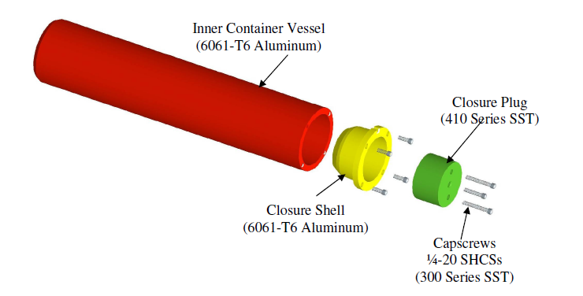
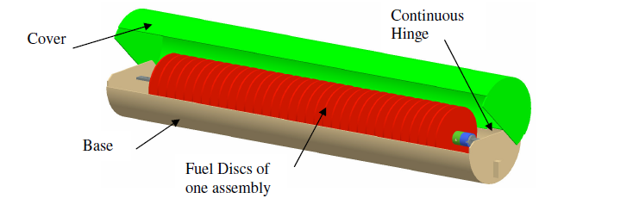
KAPL Model

Slide 14
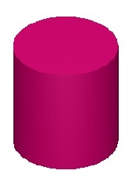
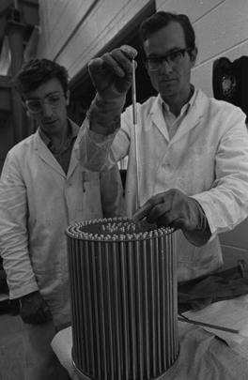
SLOWPOKE Model
Element:
295 pins in circular concentric ring triangular pitch lattice
U-Al alloy fuel, Al clad
93.17 wt.% enrichment, 28.2 wt.% U
82.9% free volume
Well:
35.6 cm H/D=1 cylinder

Slide 15
APF Dissolution Results
Notes:
Results for the 2” well. Note 2” is the generic always safe slab thickness. However, this leaves very little room for operations to maneuver the fuel into the well.

Slide 16
APF Dissolution Results
Notes:
3” well gives the operator room to maneuver the fuel, but there are cases which exceed k-safe. This would most likely results in a limit on terminal acid, which we would need anyway to prevent U-Mo co-precipitation.

Slide 17
SLOWPOKE Dissolution Results
Notes:
SLOWPOKE was close in the 0.5 M and just barely passed. This is why the 4 M case was run. There might need to be a terminal acid limit here as well.

Slide 18
RHF and KAPL Dissolution Results
Notes:
Due to the heavy iron content, even the most limiting KAPL case was highly subcritical. On the other hand, due to the artificial creation of a very high fissile concentration well volume, even the least limiting RHF case did not pass. Other fuels were able to pass at higher acidity, but due to the assumptions made about geometry and material dispersion, the RHF did not pass this scoping.
If you come to my other talk you can see how advanced modeling combined with more realistic chemistry actually shows RHF is also not an issue.

Slide 19
TSR Element Dissolution Results
Notes:
The upper/lower and annular elements passed at both the high and low end of the acidity. The lune plates and the cavity plug will be bounded by these elements so they would also safely dissolve.

Slide 20
Conclusions
All fuels except the RHF safely dissolve with the conservative assumptions made
RHF could likely be shown safe with more advanced analysis since HFIR has been shown to be safe
Scoping indicates a dissolver insert can be designed to accommodate these fuels and the other miscellaneous forms they bound.

Slide 21
Acknowledgements
Mr. Robert Smith
Mr. Stephen Fawcett
Mr. Michael Patrella

