Slide 1
A New Look at Historic CRAC “Divergence” Experiments – Implications for a CAAS Minimum Accident of Concern
Peter L. Angelo
Peter.Angelo@cns.doe.gov
Y-12 National Security Complex, Oak Ridge TN
ANS 2017 San Francisco, CA June 12-16, 2017
Peter Angelo
June 4 2017

Slide 2
Brief Talk
Prologue – A First Encounter with “slow” excursions in a solution reactor
ANS-8.3 MAC and Appendix A relationship
CRAC Experiments – Kinetic and “Divergence” (Cinitique and Divergence)
Evaluation Workflow
Static/Dynamic SCALE-MCNP/COMSOL Modeling
Power History, Temperature, Doubling Time Results
Conclusions/Takeaways

Slide 3
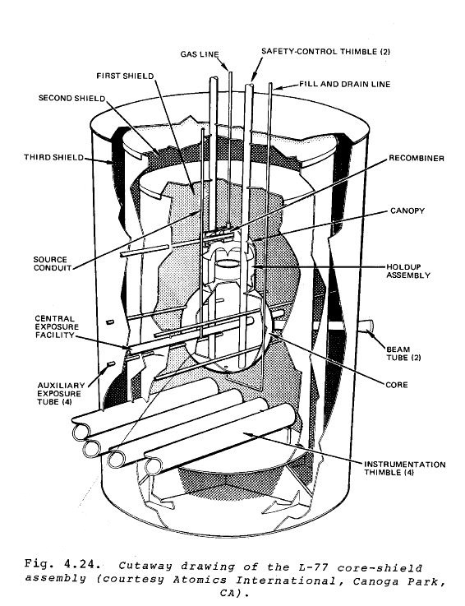
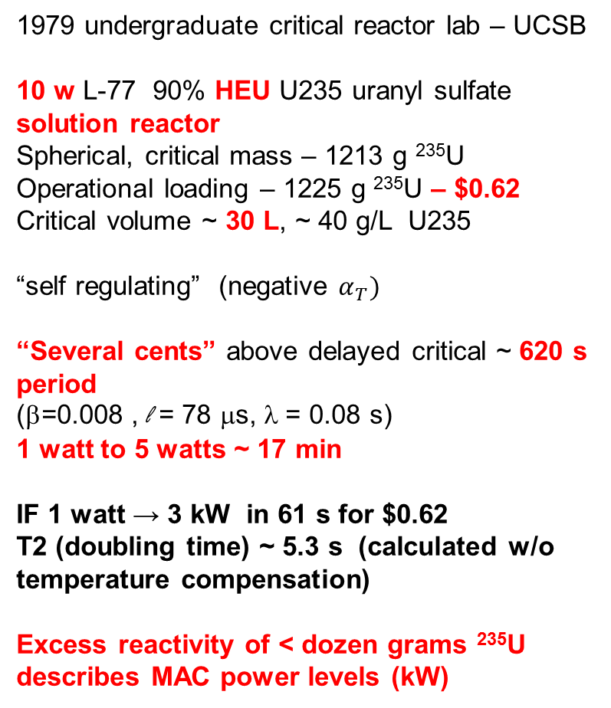
First Encounter with “slow” excursions in fissile solutions
1979 undergraduate critical reactor lab – UCSB
10 w L-77 90% HEU U235 uranyl sulfate solution reactor
Spherical, critical mass – 1213 g ²³⁵U
Operational loading – 1225 g ²³⁵U – $0.62
Critical volume ~ 30 L, ~ 40 g/L U235
“self regulating” (negative $α_{T})$
“Several cents” above delayed critical ~ 620 s period
(β=0.008 , l = 78 μs, λ = 0.08 s)
1 watt to 5 watts ~ 17 min
IF 1 watt → 3 kW in 61 s for $0.62
T2 (doubling time) ~ 5.3 s (calculated w/o temperature compensation)
Excess reactivity of < dozen grams ²³⁵U describes MAC power levels (kW)
From Profio, “Experimental Reactor Physics”

Slide 4
MAC and Appendix A Interrelationship
ANS-8.3 (1997) 5.6 MAC 0.2 Gy/min in air
Appendix A “Characterization of a MAC”
Footnote 4
Why is 0.2 Gy within 60 s implied as the 1997 suggested MAC (a rate)?
Notes the dose, time, distance consideration
0.2 Gy in the “first minute” at 2 m
First paragraph
Is Average Power really Total Fissions/Total Time?
Notes accident dosimetry
Actually Tissue dose
Gy/fission at 2 m, Gy/s
What is the difference between air and tissue?
Mixes values across experiments
Notes lo-hi range of parameters CRAC “slow” experiments
reactivity, peak, average fiss/s
Is the “few cents” valid for 0.2 Gy/min in air?
Concludes
0.2 Gy in 60 s reactivity
Last sentence
A “plausible” CRAC slow excursion power history can address these issues

Slide 5
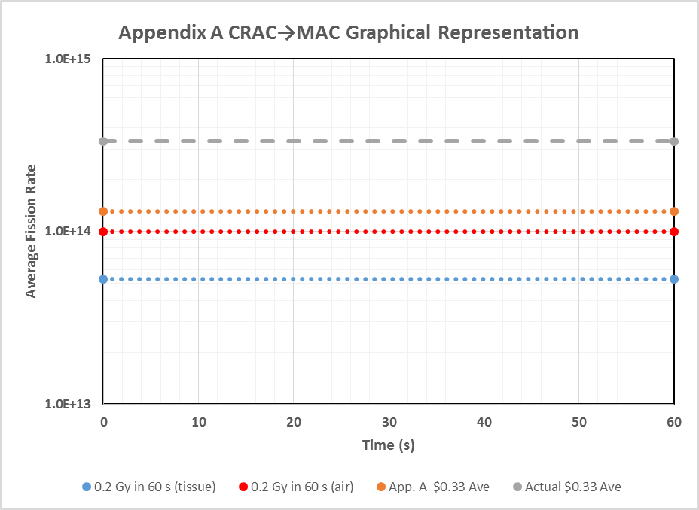
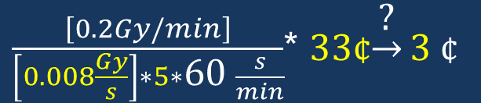
Appendix A CRAC “Average Power” → MAC
Correct $0.33 “Average Power”
“Average Power” not listed in any experiment report or summary. It is an Appendix A construct
Noted $0.33 “Average Power”
0.2 Gy/min in air
0.2 Gy/min tissue
$\frac{\left[0.2Gy/min\right]}{\left[0.008\frac{Gy}{s}\right]∗5∗\text{60 }\frac{s}{min}}$* 33¢$\underset{→}{\text{?}}\text{3} \text{¢}$
Should be Gy/s in air for correct total fissions/effective time and log(fission rate)/reactivity ~ 18¢
Appendix A associates 0.008 Gy/s to 1.3E14 fissions/s and $0.33 – should be 3.3E14

Slide 6
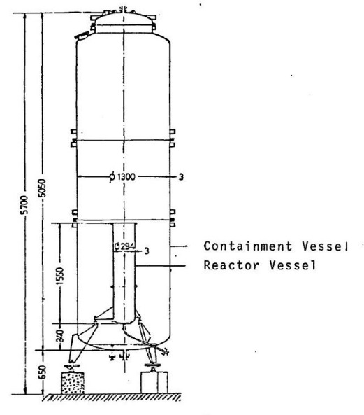
CRAC Experiments – Divergence and Kinetic
CRAC Campaign in late 60s-early 70s
300 mm, 800 mm diameter cylindrical Reactor Vessels (RV) - over 70 experiments
93.2 w% ²³⁵U HEU Uranyl Nitrate Solution
Between 20-400 gU/L concentration
Kinetic Experiments – ramp “potential reactivity” additions from $0.60 to > $ 4
“Divergence” D-xx Experiments – step delayed critical reactivity insertions to “calibrate” d(rho)/dmm at solution specific heights preceded KE
Doubling Times (inverse period) at watt range
NO DOCUMENTED POWER HISTORIES FOR DIVERGENCE EXPERIMENTS
NOTED DIFFERENCES BETWEEN Y-CDC-12 (LeCorche) and Divergence Report (Barbry)
CRAC 300 mm OD vessel

Slide 7
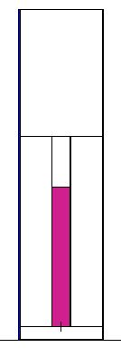
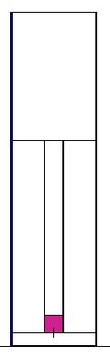
Two Divergence Experiments in ANS-8.3 Appendix A
From “Synthesis of Divergences” Feb 1972
CRAC D01-02 (Report Dec 1968)
  52 gU/L, Vf 179 L Vol, H_{crit} 198.2 cm
  10 min duration
  4 reactivity insertions – final $0.33 step insertion
  Peak Power 1.6E15 fissions/s
  2.0E17 total fissions (Average 3.3E14 fissions/s)
  β_{eff} = 777 pcm , Neutron Lifetime l = 41 μs,
  Cp = 0.84 cal/g-°C
CRAC D08-03 (May 1969)
  202 gU/L, Vf 19.4 L, Hcrit 27.5 cm,
  4 min duration
  3 reactivity insertions – final $0.51 step insertion
  Peak Power 7.8E14 fissions/s
  3.5E16 total fissions (Average 1.5E14 fissions/s)
  β_{eff} = 845 pcm , Neutron Lifetime l = 13 μs,
  Cp = 0.69 cal/g-°C
MCNP CRAC D01-02
MCNP CRAC D08-03
These two experiments represent a “wide spectrum” of considerations

Slide 8
CRAC D01-02 and CRAC D08-03 “Millimeter Effect”
Exp | ΔH cm | ΔH/H_{c} | T2 (s) | ρ (pcm) | ρ ($) | dρ/dH ($/cm)
CRAC D01-02 52 gU/L, Hc 198.2 cm, β=777 pcm
 | 21.9 | 0.11 | 52 | 96.4 | 0.12 | 5.7E-3
 | 32.1 | 0.16 | 30.5 | 140 | 0.18 | 5.6E-3
 | 41.3 | 0.21 | 20.3 | 179 | 0.23 | 5.6E-3
 | 60.2 | 0.3 | 10.4 | 258 | 0.33 | 5.5E-3
CRAC D08-03 203 gU/L, Hc 27.5 cm, β= 845 pcm
 | 0.21 | 7.6E-3 | 18.9 | 204 | 0.24 | 1.15
 | 0.35 | 1.3E-2 | 7.3 | 332 | 0.39 | 1.12
 | 0.46 | 1.6E-2 | 3.8 | 434 | 0.51 | 1.12
“The effect of the millimeter is unfortunately not linear for large delta H and it is therefore not possible to extrapolate the values obtained to calculate the total potential reactivity introduced during the actual (Kinetic) CRAC experiments.”
-F. Barbry ‘Rapport de Synthese Divergences CRAC’

Slide 9
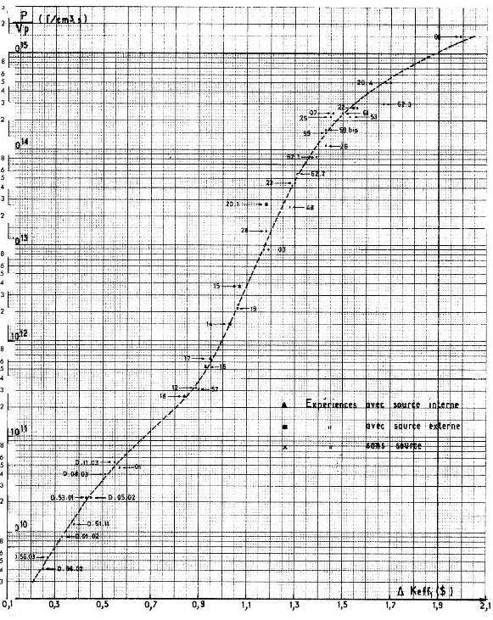
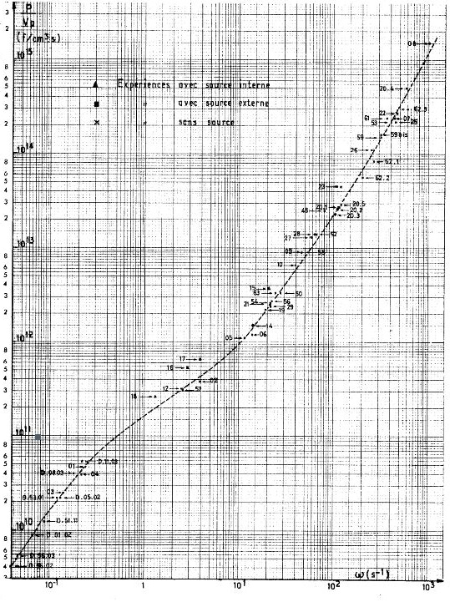
Divergence compared to Kinetic Experiments
Y-CDC-12 (Figs15-19)
Notes similar trends – P/V vs ρ, ω are log-lin, log-log
Divergence \ - KInetic
Divergence \ - KInetic
Power/Volume vs total reactivity
Power/Volume vs inverse period
The Divergence Experiments served to complete the lower end of the P/V vs reactivity and inverse period curves in relation to Kinetic Experiments (SEEC 117)

Slide 10
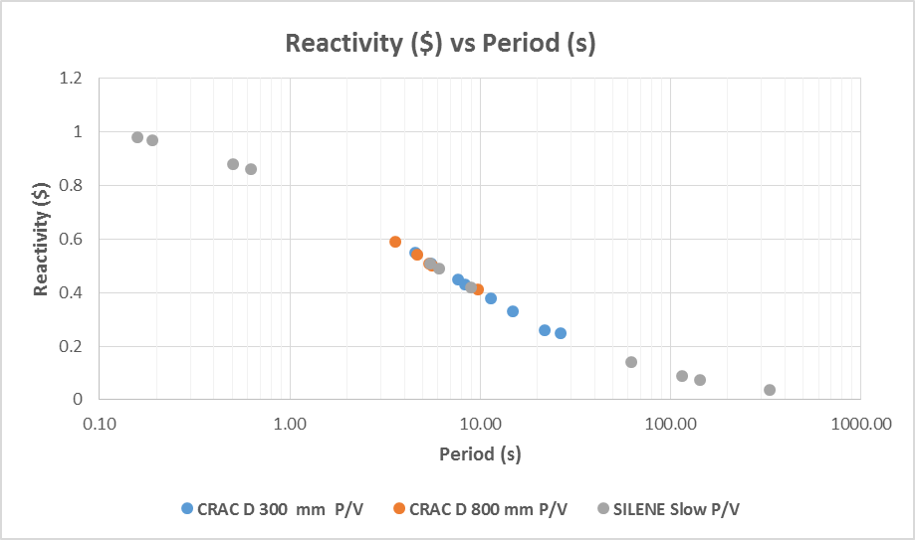
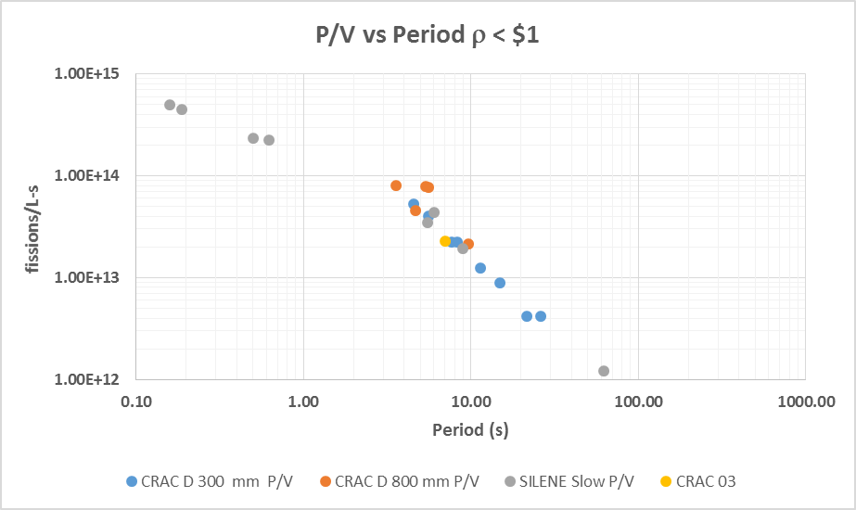
Appendix A Divergence Experiments Compared vs Slow
“Slow” defined in terms of total reactivity, and period or T2
Peak Power/Volume ~ 1E13-1E14 fissions/s-L
Centered around 8 s period (5.5 s Doubling Time T2)
CRAC D01-02 $0.33 (15 s period) not slowest CRAC
(CRAC D56-02 $0.25 26 s period)
CRAC 01 (Kinetic Experiment ρ < $1)
CRAC 03 (Kinetic Experiment) slower than CRAC D08-03
SILENE slow experiments (grey dots) bracket both CRAC Divergence 300mm , 800 mm campaigns
CRAC D08-03
CRAC D01-02
CRAC D56-02
CRAC D08-03
CRAC 01
CRAC 03
CRAC D01-02
CRAC D56-02

Slide 11
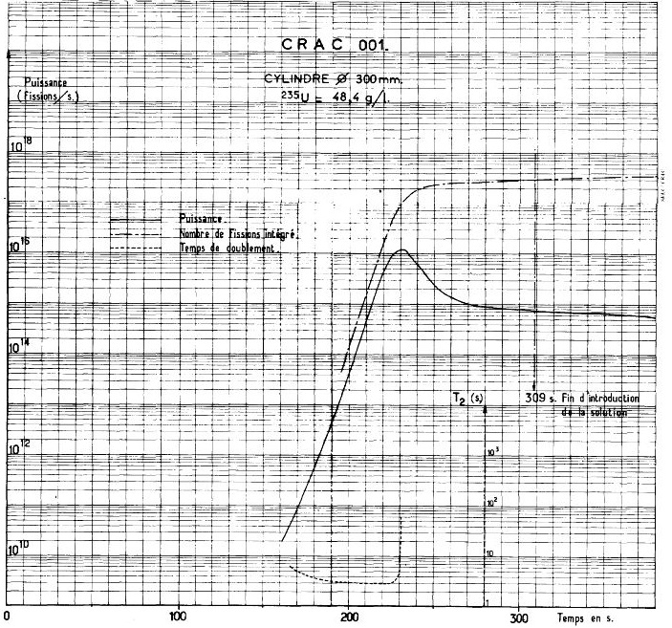
Evaluation Workflow
Same as ICNC 2011 except absolute times vs relative times and COMSOL vs Python code
Determine 0.2 Gy fissions and fission rate for 0.2 Gy/min air using SCALE/MCNP
Determine kinetic parameters, and reactivity feedback parameters– and published values
Apply thermal characteristics (heat capacity, density) from Barbry reports
Use ACTUAL P₀ from Kinetic Experiment power trace, t0 = 0 s, P₀ = 2e10 fissions/s
Determine power history using end state solution heights and reactivities
Evaluate for other solution heights and reactivities notes and others for inter-comparison
Determine reactivity to 0.2 Gy 60 s from same initial conditions
CRAC 01 Kinetic Experiment P₀ at “debut du phenomene” (start of phenomena) 2e10 fissions/s or ~ 0.6 w
t_{deb} =160 s
Ramp rate of insertion – to ultimate $0.57 to peak, t_{p} = 232 s, Δt = 72 s
Rate of insertion (3.4E-3 $/s)
Peak power =1.1E16 fission/s at 226 L
Total Fissions Peak = 2.7E17

Slide 12
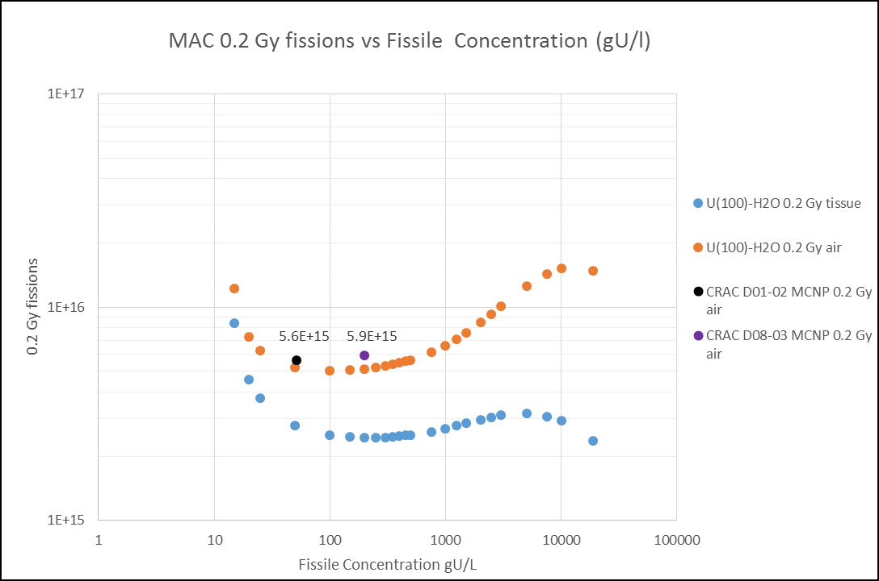
Gy/fission in air for D01-02 and D08-03
U(100)-H2O
CRAC D01-02
CRAC D08-03
2m Air
Spherical geometry lower 0.2 Gy fissions than MCNP model
CRAC concentrations on “flat part” of MAC vs gU/L
D01-02 5.6E15 fissions air, 2.7E15 fissions tissue
D08-03 5.9E15 fissions air, 2.7E15 fission tissue
places 0.2 Gy air/min ~ 1E14 fissions/s vs 4.5E13 fissions/s (tissue)
HIGHER TOTAL FISSIONS and 0.2 Gy/min air means longer absolute times from P0 for a given reactivity insertion
ANS 8.3 Appendix B general moderated
Is 7.7E15 air, 2.6E15 tissue

Slide 13
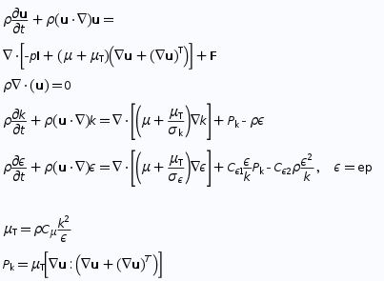
COMSOL Model Considerations
Extend excursion to t_{end} and beyond for lower ρ
  time to 1e14 fissions/s
  time to 0.2 Gy air fissions
Use simple 6-g point kinetics (low reactivity) and coupled heat transfer with k-ε turbulent flow
Convection heat transfer from RV to air
Step insertion as external reactivity
Feedback coefficients from Barbry, Kornreich, calculated (SCALE/MCNP w/k_{opts})
Fundamental mode power shape w/extrapolation
Experiment C_{p}, μ viscosity, κ thermal conductivity
Radiolytic gas is important after the peak, for total fissions over time. E_{g} thresholds beyond MAC 0.2 fissions
R-Z 2D axial symmetry, Model meshing RV solution heights and air above and below
Simple “swept mesh” ~ 5k rectangular elements. Solves in about 20 min on 16 GB RAM PC

Slide 14
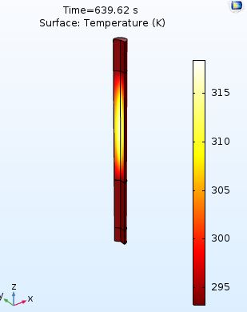
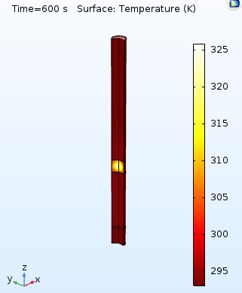
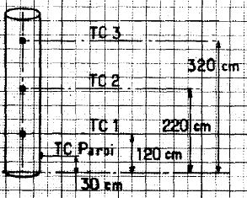
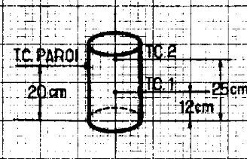
D01-02, D08-03 COMSOL Heat Transfer, Temp considerations
CRAC Kinetic Experiment 01, 08 Thermocouples
Integrated Data using (TC2)
at midpoint of total solution height
CRAC D01-02 larger volume, lower temperature rise, approx. adiabatic.
CRAC D08-03 smaller volume, higher temperature rise faster, adiabatic may not be approximate
COMSOL Temperature T_{AVE}, T_{MAX} “probes” over entire solution volume

Slide 15
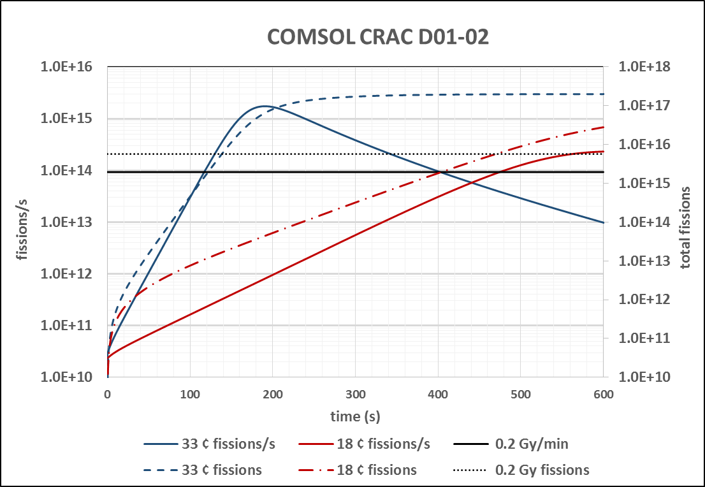
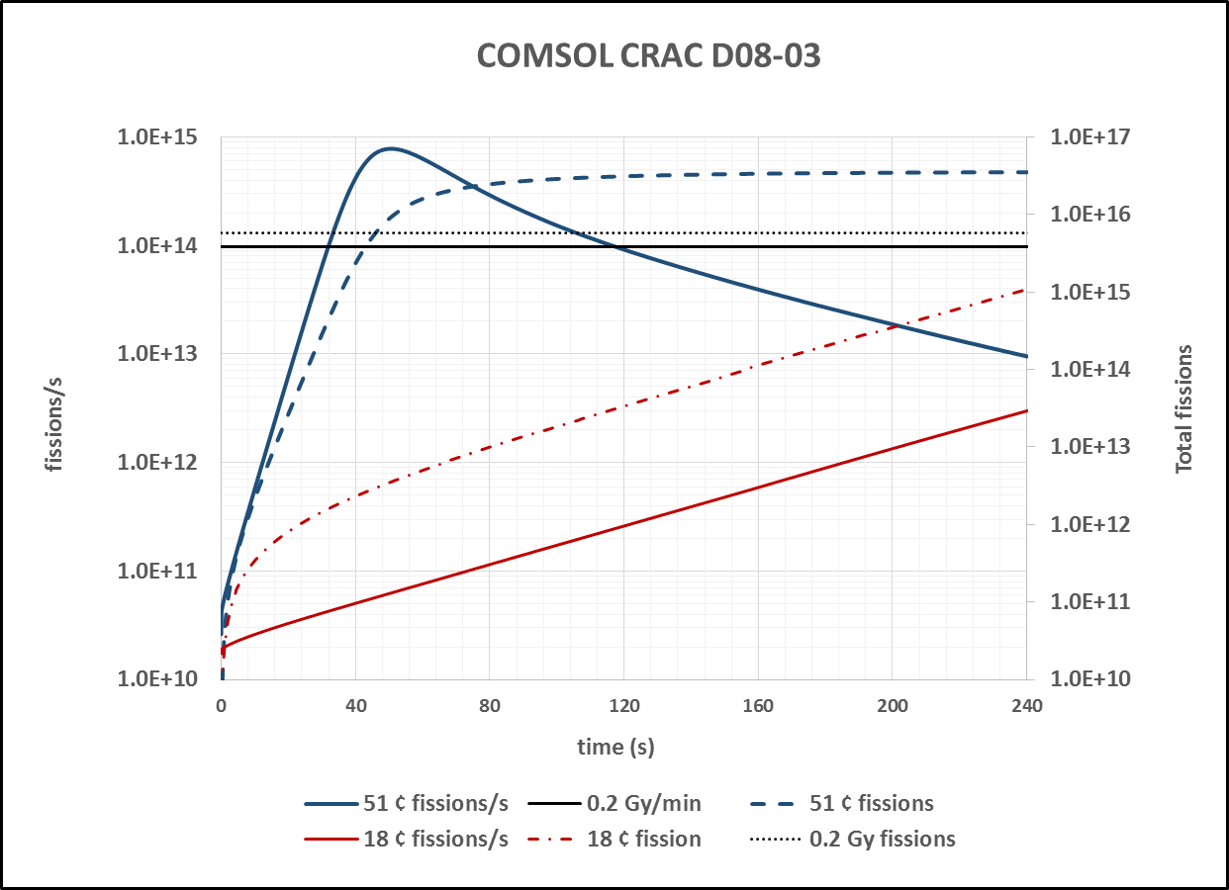
COMSOL “Reasonable” Power History Reconstructions
Peak powers and total fissions for final reactivity very close to reported values
D01-02 COMSOL 1.7E15 fissions/s 2.7E17 fissions
D08-03 COMSOL 7.8E14 fissions/s 3.6E15 fissions
Average Power D01-02 $0.33 (300 s) = 4.2E14 fissions/s (versus 3.3E14)
Average Power D08-03 $0.51 (120 s) = 1.8E14 fissions/s (versus 1.5E14)
COMSOL shows $0.18 will cross 1E14 fissions/s for rate detector
However a “0.2 Gy within 60 s” will need higher reactivity (integrating dose detector)

Slide 16
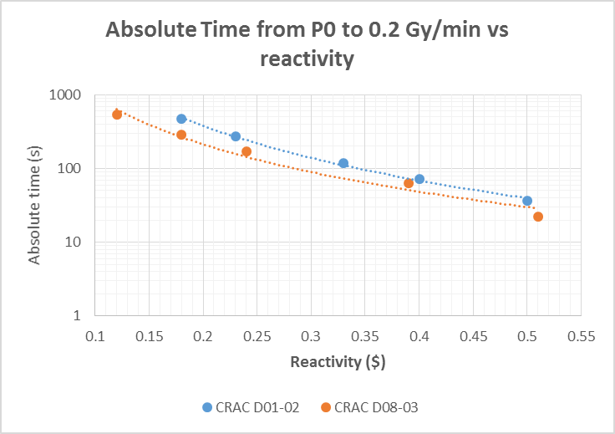
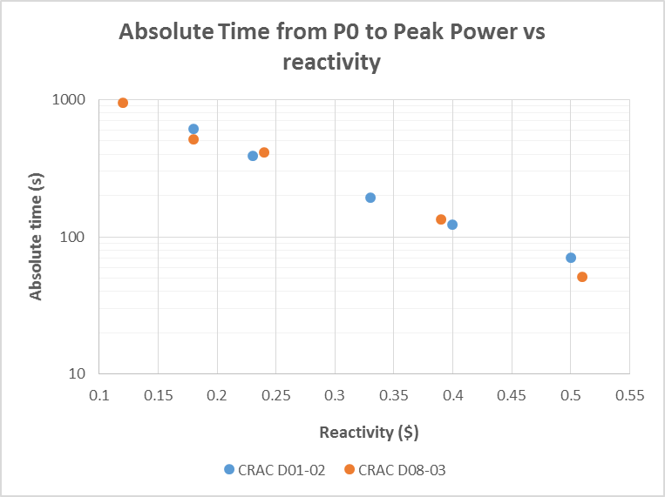
COMSOL Power History Results Summary
The COMSOL simulated peak power and total fissions at end point time were very close to the reported values for CRAC D01-02 and CRAC D08-03.
The absolute time to initial peak from P₀ were 194 s for D01-02 ($0.33), 51 s for D08-03 ($0.51)
The absolute time to 0.2 Gy/min for D01-02 is 117 s, 22 s for CRAC D08-03
The absolute time to 0.2 Gy for D01-02 is 139 s, 46 s for CRAC D08-03
0.2 Gy reached before peak power
0.2 Gy/min or 0.2 Gy reached first depends on reactivity insertion (ICNC2011)
Times maybe ± 5% of actual given accuracy to end point reactivity values

Slide 17
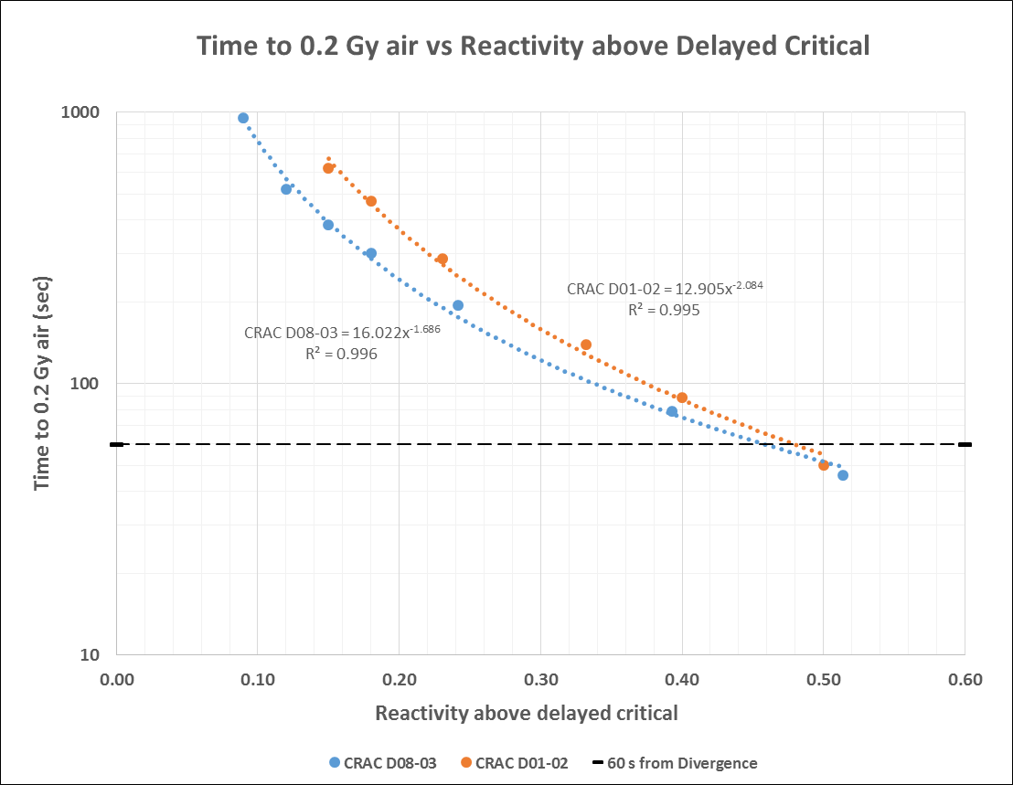
Reactivity versus “0.2 Gy within 60 s” From Beginning
60 s line
Not here
Its here
The reactivity required to achieve “0.2 Gy within 60 s” from the beginning is about $0.46 (D08-03) and $0.48 (D01-02)

Slide 18
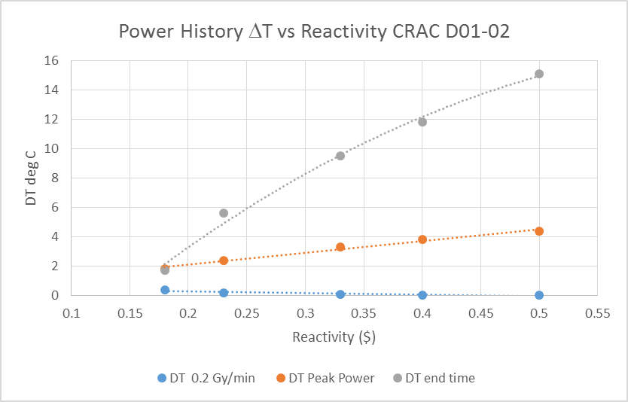
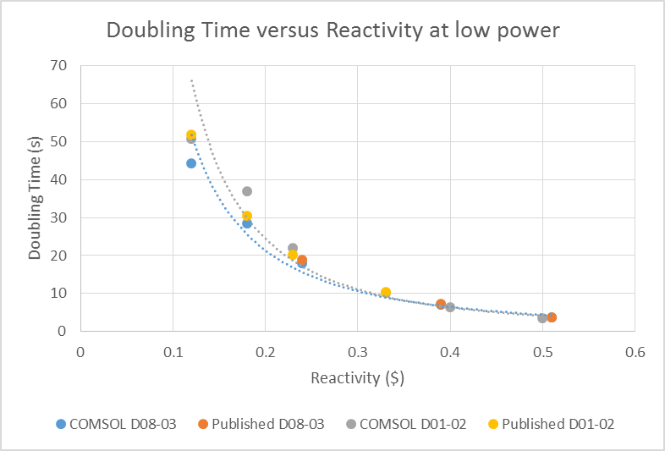
Summary of Temperature, Doubling Time Changes
CRAC D01-02 – the extrapolated reported ΔT from $0.33 would be 10.1 ºC versus the COMSOL 9.5 ºC
CRAC D08-03 – the reported ΔT from $0.51 was 13 ºC versus the COMSOL 18 ºC
Temperature rise at 0.2 Gy/min very slight for small step insertions. Higher as one moves to higher reactivity and concentration
T_{max}/T_{ave} indicator of P_{max}/P_{ave}
ANS-8.3 Appendix A notes P_{max}/P_{ave} of 5. T_{max}/T_{ave} ~ 2.0
Barbry notes α ~ Φ_{max}/Φ_{ave} ~ 2.3
COMSOL T2 at 1E12 fissions very close to published values
T2 increases as power increases to MAC by 20%
T2 increase will lengthen time to 0.2 Gy over uncompensated reactivity considerations

Slide 19
Conclusions/Takeaways
CRAC Divergence Experiment “reasonable power histories” can be synthesized from available data and multiphysics code– results vary as fissile concentration
Plausible times to peak power for D01-02, D08-03 noted end state reactivities ($0.33, $0.51) and experiment P₀.
Construction of “0.2 Gy within 60 s” from beginning for wide reactivity range.
From this work one may conclude:
Appendix A assumptions for MAC not in line real CRAC physics (average power, P_{max}/P_{ave},, Gy/fission air, T2 vs kW range, reactivity vs power)
Appendix A “Average Power” ρ vs as good indicator as Peak Power/Volume vs ρ, ω
Appendix A first paragraph (0.2 Gy within 60 s from beginning) and last sentence do not agree, yet a more applicable lower bound reactivity (18 cents) can be determined.
The amount of reactivity needed to get up to 0.2 Gy air within 60 s is substantial (> $0.45 ) based on these simulations and can be verified with other documented experiment slow excursion power histories
Rate based CAAS would still detect slower excursions ($0.25 for 1e14 fissions/s) yet integrating detector requires higher reactivity to fufill “0.2 Gy within 60 s”
COMSOL simulated power history shows CRAC Divergence Experiments can help define MAC “reactivity vs concentration” considerations and provide Appendix A clarity.
Likelihoods outside reactor need to be addressed by reasonable application to specific “credible” considerations.

Slide 20

Disclaimer
This work of authorship and those incorporated herein were prepared by Consolidated Nuclear Security, LLC (CNS) as accounts of work sponsored by an agency of the United States Government under contract DE‑NA0001942. Neither the United States Government nor any agency thereof, nor CNS, nor any of their employees, makes any warranty, express or implied, or assumes any legal liability or responsibility for the accuracy, completeness, use made, or usefulness of any information, apparatus, product, or process disclosed, or represents that its use would not infringe privately owned rights. Reference herein to any specific commercial product, process, or service by trade name, trademark, manufacturer, or otherwise, does not necessarily constitute or imply its endorsement, recommendation, or favoring by the United States Government or any agency or contractor thereof, or by CNS. The views and opinions of authors expressed herein do not necessarily state or reflect those of the United States Government or any agency or contractor thereof, or by CNS.
Copyright notice
This document has been authored by Consolidated Nuclear Security, LLC, a contractor of the U.S. Government under contract DE‑NA0001942, or a subcontractor thereof. Accordingly, the U.S. Government retains a paid‑up, nonexclusive, irrevocable, worldwide license to publish or reproduce the published form of this contribution, prepare derivative works, distribute copies to the public, and perform publicly and display publicly, or allow others to do so, for U.S. Government purposes.

Slide 21
Appendix A Differences with Divergence Experiment Data
Reactivity ($) |  | Peak Power fissions/s |  | Average Power3 Fissions/s
Lowest | Highest | Lowest | Highest | Lowest⁴ | Highest
$0.25¹ | $0.59 | 1.1E14² | 7.4E15 | 1.4E14⁵ | 1.3E15
D56-02 | D40-02 | D56-02 D56-03 | D40-02 ($0.59) | D11-03 ($0.55) | D37-02 ($0.41) Peak
1 - Appendix A notes $0.33 (D01-02) as the lowest reactivity insertion – D01-02 peak power is 1.6E15 fissions/s
2 –Appendix A notes 7.8E14 fissions/s as the lowest peak power (D08-03) with reactivity insertion ($0.51)
3 –Appendix A Average Power determined by Total Fissions/Total Time
4- Appendix A notes lowest “Average Power at 1.3E14 fissions/s for $0.33 D01-02 yet actual “Average” for $0.33 is 3.3E14 fissions/s
5- No experiment time is given for CRAC D51-11, D53-01, D56-02,D56-03, but if 5 min assumed, CRAC D56-02 would have 7.7E13 fissions/s

Slide 22
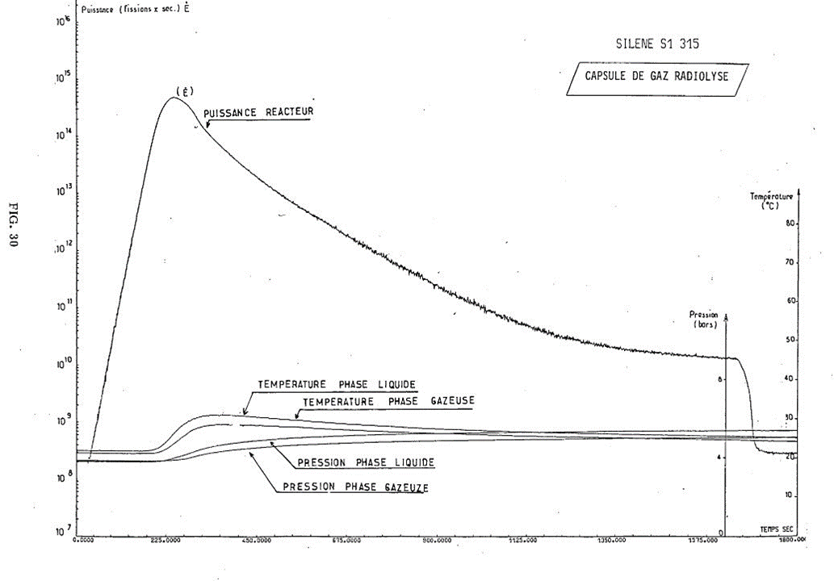
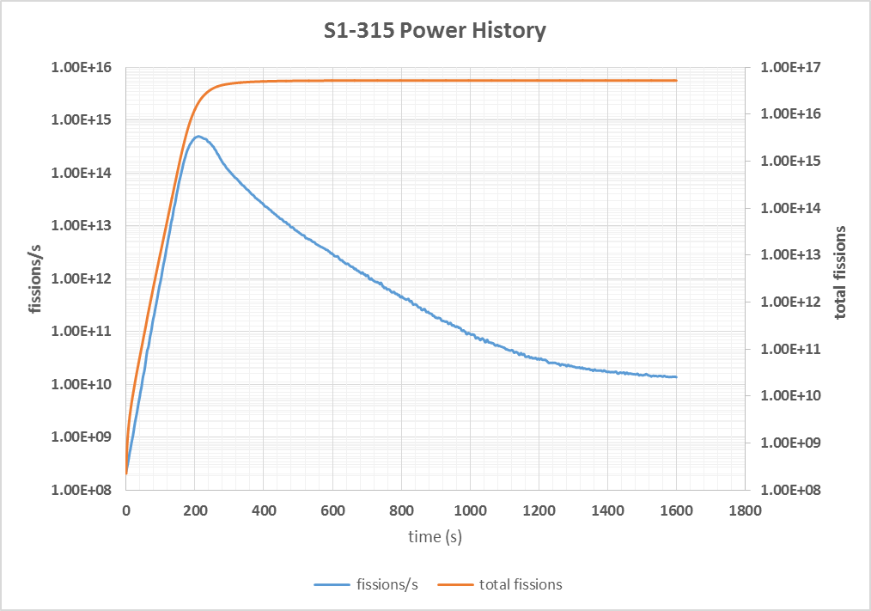
Spare Slide – Slow Experiment with Recorded Power History
SILENE S1-315 experiment from Barbry Technical Note SRSC NR 89.08 (November 1989)
Power history replicated with UNSCANIT
Total fissions vs time by numerical integration
T0 = 0 s, P0 = 2E8 fissions/s
71 gU/L V= 37.2 L
Peak Power = 4.9E14 fissions/s Total Fissions = 5.1E16
Total Reactivity = $0.38 T2 = 8.5 s
Time to 1E14 fissions/s = 160 s Time to 6E15 fissions (~ 0.2 Gy air) = 182 s

