Slide 1
The Difficulty of Defining the Terms “Credible” and “Unlikely” for Nuclear Criticality Safety Purposes
Douglas G. Bowen
Senior R&D Staff
Nuclear Data and Criticality Safety Group
Reactor and Nuclear Systems Division
Oak Ridge National Laboratory
June 12, 2017
ANS Annual Meeting
San Francisco, CA

Slide 2
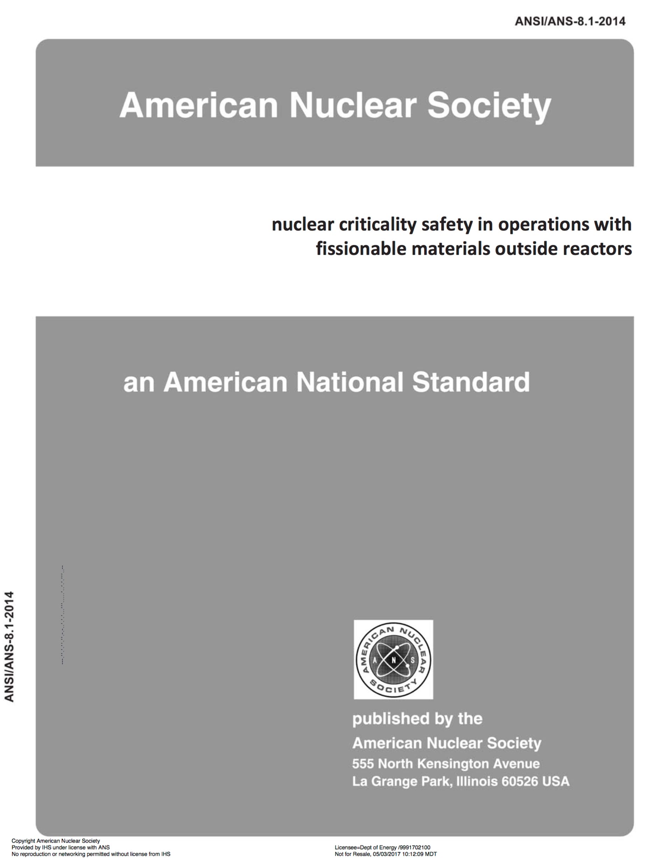
Agenda
Introduction
Terminology
ANS-8.1
Regulatory documentation that include definitions for “unlikely” and “credible”
NCS evaluation process and dependencies
ANS-8.1 assumptions about
Safety culture
Formality of operations
Example and lessons learned from personal experience
Conclusions

Slide 3
Introduction
During the last revision of the ANSI/ANS-8.1-2014, extensive efforts were made by the working group to
Ensure the statements in the standard clearly reflected their intent
Each requirement and recommendation in the standard was reviewed
Add definitions to the glossary to minimize ambiguity in the standard
e.g., “process conditions” or “parameter”
Consider definitions for the words “credible” and “unlikely”
Working Group experience
Definitions had been provided to the nuclear criticality safety (NCS) community from the US Department of Energy (DOE-STD-3007, -3009) that caused confusion at some sites
A Nuclear Regulatory Commission document (NUREG-1520) intends for licensees to provide appropriate definitions for these words in their site license
The purpose of this presentation is to discuss why the working group ultimately decided not to include definitions for credible and unlikely in the 2014 revision of ANS-8.1

Slide 4
ANS-8.1 Terminology
Although not uniquely defined in the standard glossary, “credible” and “unlikely” are used in the process analysis (PA) requirement (Section 4.1.2) and the double contingency principle (DCP) recommendation (Section 4.2.2), respectively
PA: Before a new operation with fissionable material is begun, or before an existing operation is changed, it shall be determined that the entire process will be subcritical under both normal and credible abnormal conditions.
The PA requirement is the fundamental requirement in the ANS-8 series standards for the prevention of a criticality accident during hands-on operations with fissionable material outside of reactors,
“. . . the entire process will be subcritical under both normal and credible abnormal conditions.”
DCP: Process designs should incorporate sufficient factors of safety to require at least two unlikely, independent, and concurrent changes in process conditions before a criticality accident is possible.
The DCP is one of seven technical practices in the standard that can aid in establishing the PA requirement based on the rational defense-in-depth approach to safety
The word unlikely, as used in the DCP, has some functional definition implied by its subsidiary relationship with the PA requirement
A standard dictionary provides adequate definitions for the words unlikely and credible
“unlikely” is defined as “improbable, doubtful, dubious, or far-fetched”
“credible” is defined as “believable, tenable, plausible, or reasonable”
No attempt is made in the ANS-8 series standards to define credible or unlikely quantitatively

Slide 5
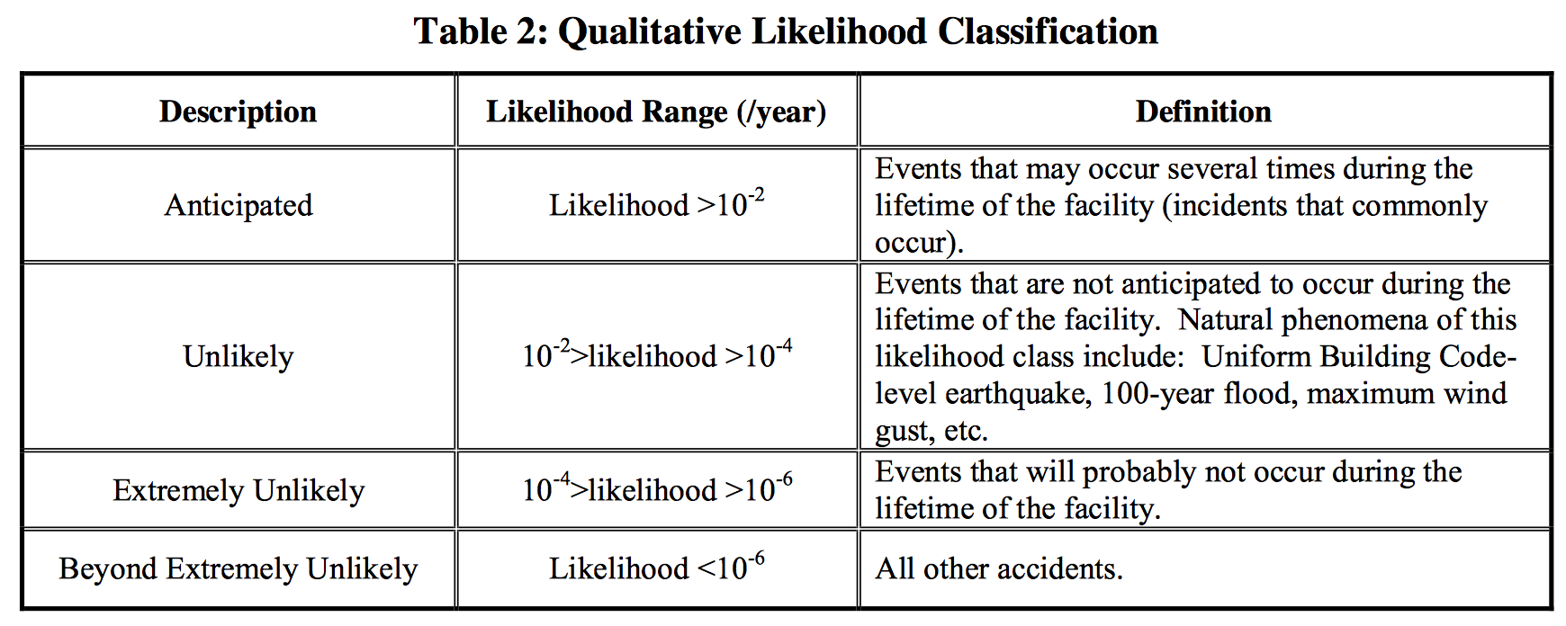
Other Terminology
DOE-STD-3007-2007, Guidelines for Preparing Criticality Safety Evaluations at DOE Non-Reactor Nuclear Facilities
UNLIKELY – the attribute of being improbable on the basis of commonly acceptable engineering judgment. An unlikely event is an event that is not expected to occur more than once in the lifetime of a facility. Due to the general lack of statistically reliable data, assigning numerical probabilities to events is not usually justifiable and when used should be backed up with references.
CREDIBLE – the attribute of being believable on the basis of commonly acceptable engineering judgment. Due to the general lack of statistically reliable data, assigning numerical probabilities to events is not usually justifiable and when used should be backed up with references.
DOE-STD-3009-2014, Preparation of Non-Reactor Nuclear Facility Documented Safety Analysis
UNLIKELY –
CREDIBLE – not defined in the standard, although ANS-8.1 Section 4.1.2, PA Requirement, is stated multiple times.
NUREG-1520, Rev. 2, Standard Review Plan for Fuel Cycle Facility License Applications
An integrated safety analysis defines potential accident sequences in a facility’s operations…
A licensee is required by 10 CFR 70.65 to provide a general description of the site, facility, processes, hazards, accident sequences, etc. and a definition of the terms “credible,” “unlikely,” and “highly unlikely"

Slide 6
NCS Evaluation Process and Dependencies
The NCS evaluation process guidance is provided ANSI/ANS-8.1 and -8.19
ANS-8.1
Requires that operations with fissionable materials outside of reactors must remain subcritical for all normal and credible abnormal conditions
Defines management responsibilities and expectations for site programs
ANS-8.19
Defines management, supervisor, NCS staff responsibilities and expectations for site programs
Provides the requirements and recommendations for documenting the NCS evaluation process and for control implementation and maintenance
The NCS evaluation process is sufficiently robust to prevent criticality accidents for operations with fissionable materials
Although not discussed explicitly in the standards, this process is highly dependent on a healthy formality of operations program (FOP) and a strong safety culture
How can one determine what is credible or unlikely if there are degradations of formality of operations or poor safety culture?
The ANSI/ANS standards assume there is a ”healthy” formality of operations program and strong safety culture in place

Slide 7
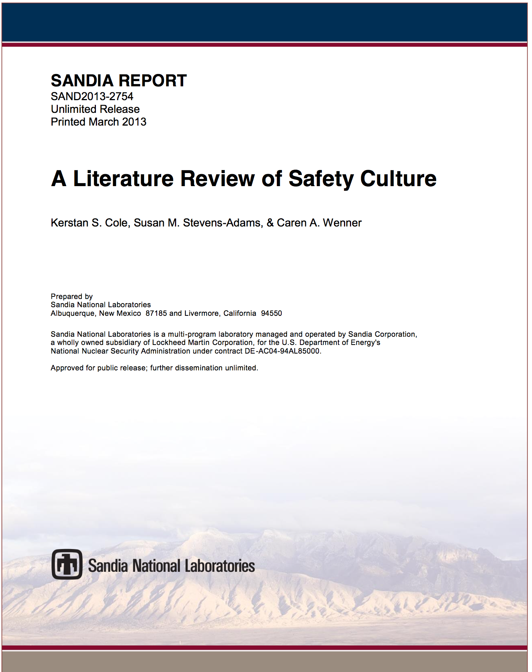
What is a Safety Culture?
Organizational Culture
“A pattern of basic assumptions, invented, discovered, or developed by a given group, as it learns to cope with its problems of external adaptation and internal integration, that has worked well enough to be considered valid and, therefore is to be taught to new members as the correct way to perceive, think, and feel in relation to those problems.”
Organizational Culture
Safety Culture
SCWE

Slide 8
What is a Safety Culture?
Organizational Culture
“A pattern of basic assumptions, invented, discovered, or developed by a given group, as it learns to cope with its problems of external adaptation and internal integration, that has worked well enough to be considered valid and, therefore is to be taught to new members as the correct way to perceive, think, and feel in relation to those problems.”
Safety Culture
“Refers to the attitudes, beliefs, and perceptions shared by natural groups as defining norms and values, which determine how they act and react in relation to risks and risk control systems. (safety culture)” [Hale, 2000]
Organizational Culture
Safety Culture
SCWE

Slide 9
What is a Safety Culture?
Organizational Culture
“A pattern of basic assumptions, invented, discovered, or developed by a given group, as it learns to cope with its problems of external adaptation and internal integration, that has worked well enough to be considered valid and, therefore is to be taught to new members as the correct way to perceive, think, and feel in relation to those problems.”
Safety Culture
“Refers to the attitudes, beliefs, and perceptions shared by natural groups as defining norms and values, which determine how they act and react in relation to risks and risk control systems. (safety culture)” [Hale, 2000]
Safety Conscience Work Environment (NRC Policy/Definition)
“…a work environment where employees are encouraged to raise safety concerns and where concerns are promptly reviewed, given the proper priority based on their potential safety significance, and appropriately resolved with timely feedback to the originator of the concerns and to other employees.”
Organizational Culture
Safety Culture
SCWE

Slide 10
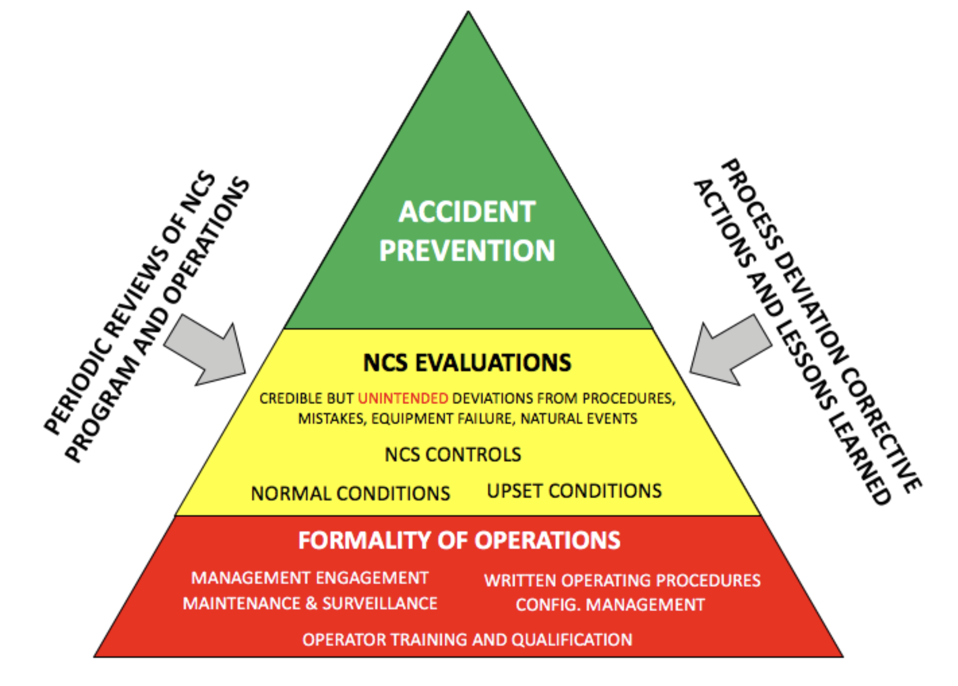
Formality of Operations Program
An FOP consists of “. . . formal documentation, practices, and actions implementing disciplined and structured operations that support mission success and promote worker, public, and environmental protection”
NCS, and safety in general, is best achieved when it is made an integral part of work planning and performance
Goal: to minimize the likelihood and consequences of human administrative and technical errors and to preclude organizational system failures that can affect NCS
The “NCS pyramid”
Illustrates how a site’s overall FOP is the foundation of a strong NCS program
Indicates that periodic reviews of an NCS program and fissionable material operations at a site and serious consideration of process deviation corrective actions and lessons-learned are ways to significantly improve a site’s NCS program.

Slide 11
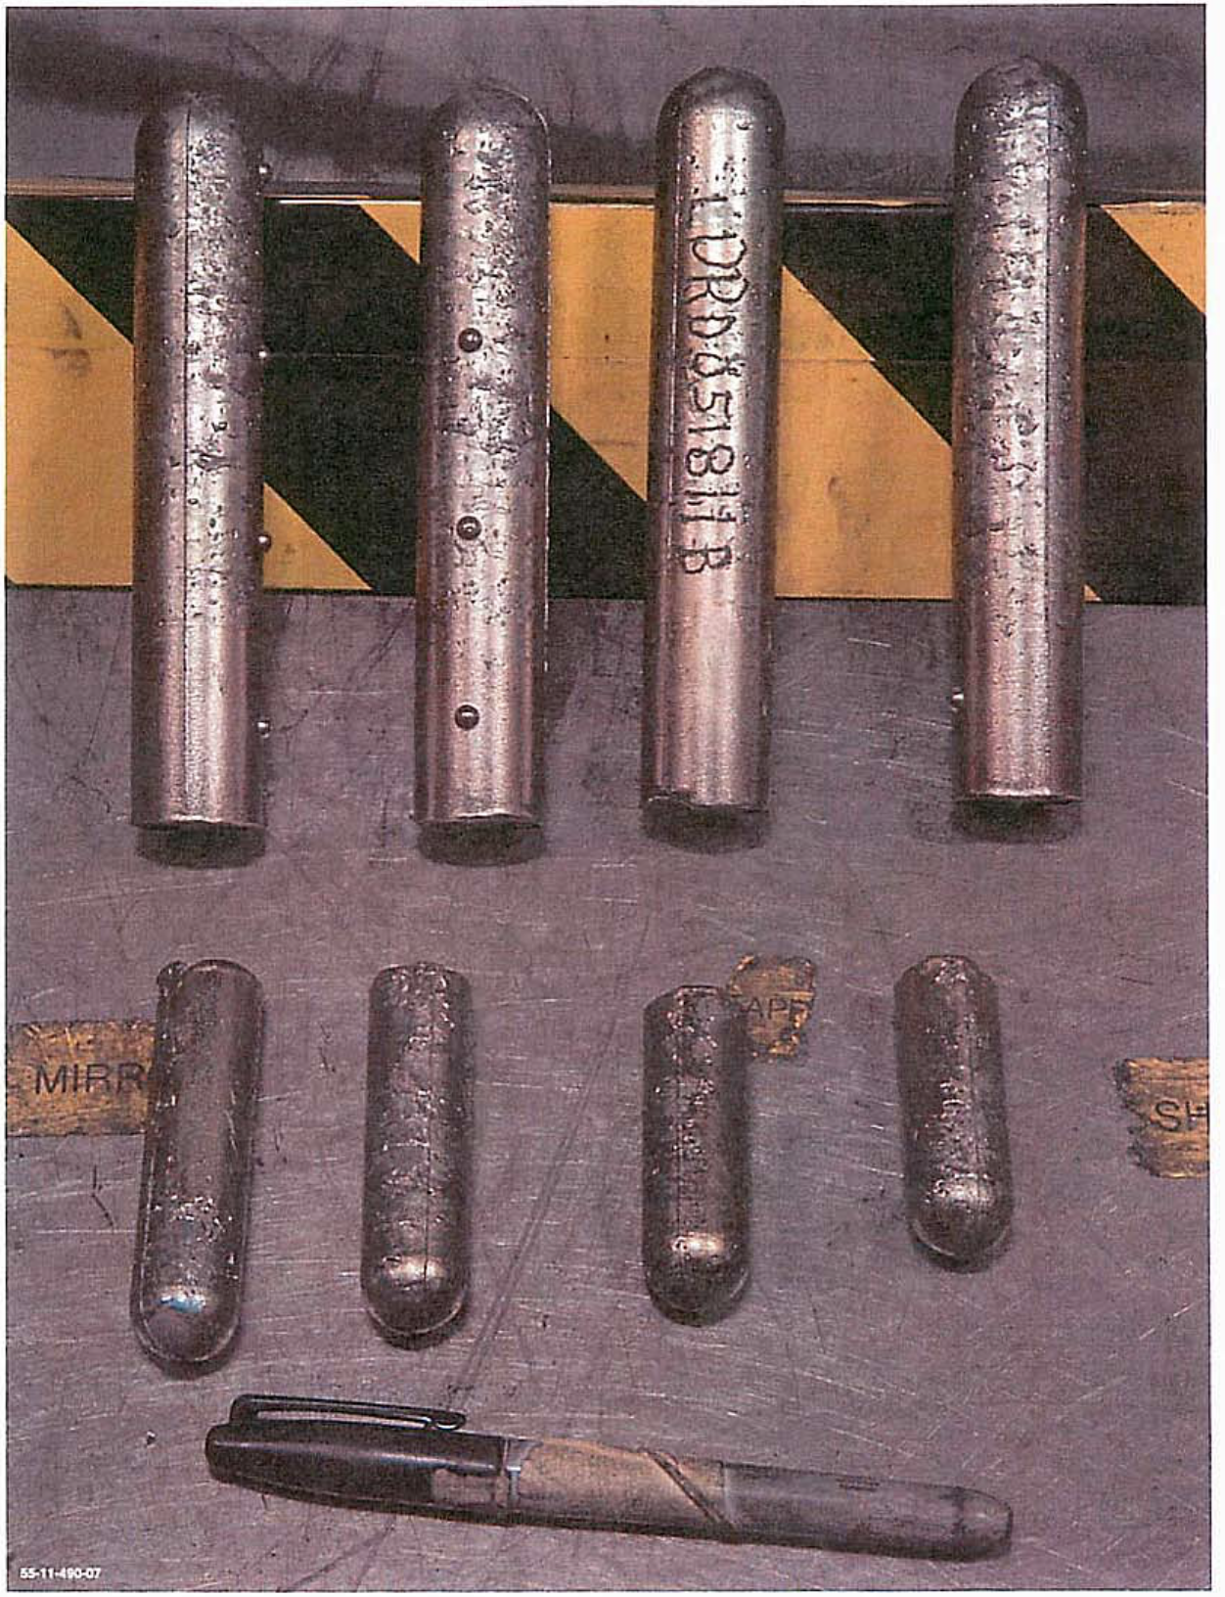
Example – Trending Infractions
The health of a site’s FOP can be glimpsed, in part, by the trending of process deviations
From 2010–2011, Los Alamos National Laboratory (LANL) conducted NCS operations reviews in the Plutonium Facility (PF-4)
Eight hands-on processes with significant quantities of fissionable materials were identified that did not have an NCS evaluation
There were 35 other infractions of various levels of severity from 2010 to mid-year 2011 that demonstrated that the FOPs was unhealthy
PF-4 and NCS management felt that NCS evaluations and controls were significantly degraded by poor formality of operations (i.e., poor training, incomplete NCS program implementation, etc.).
Corrective actions were initiated by facility management to improve the overall FOP health at PF-4.

Slide 12
Example – Trending Infractions, cont.

Slide 13
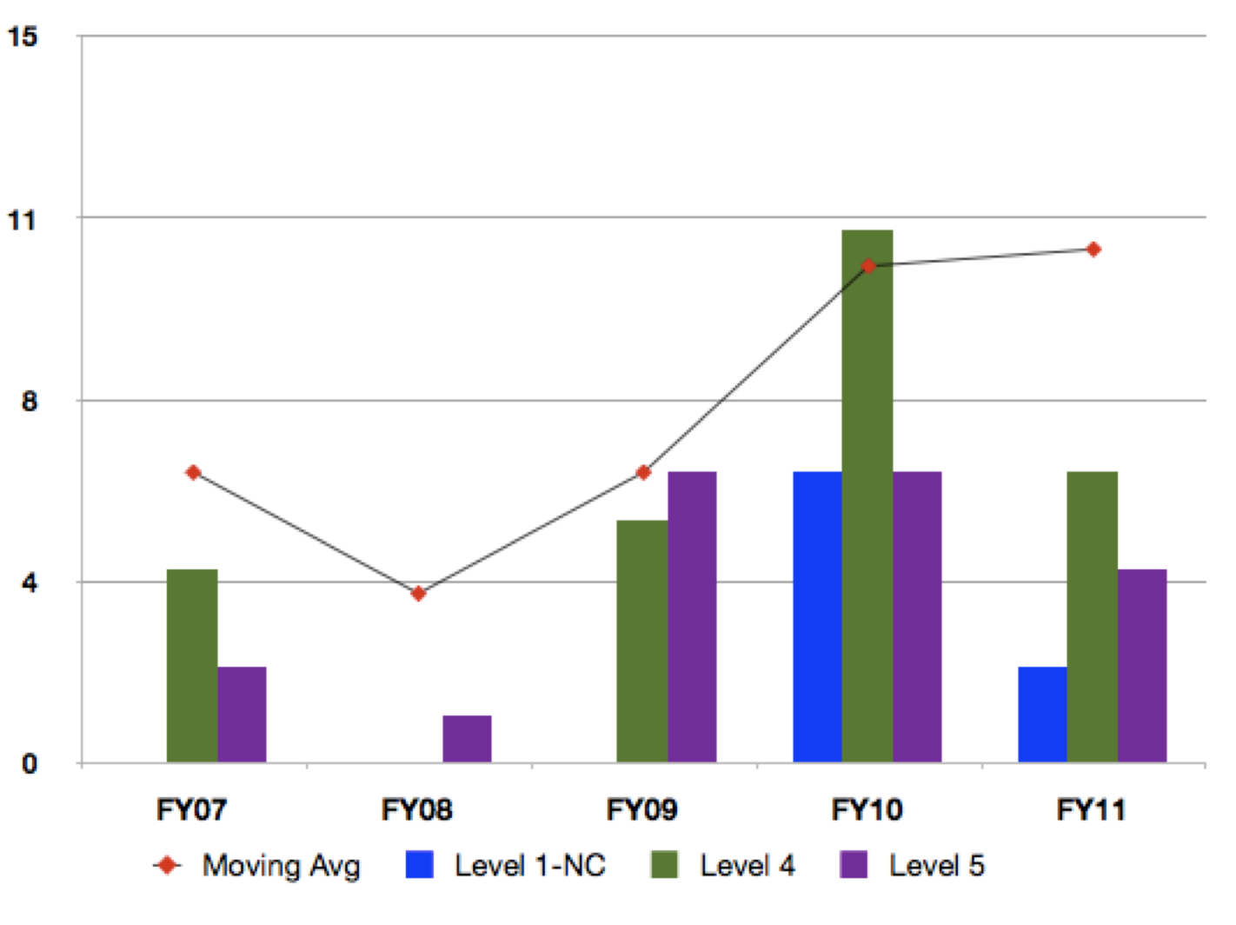
Example
These events, although unfortunate, provide a site the opportunity to improve their FOP and NCS programs
This example illustrates that site events such as management changes, new staff, increasing NCS program formality, and other issues could shift or degrade the safety culture and formality of operations such that significant events occur at a site (i.e., accidents, NCS infractions, deviations from procedures, etc.)
Thus, the health of a site FOP is not a constant, i.e., not changing over time, but, instead, varies as a function of time
Thus, the “…credible abnormal conditions” and “…unlikely changes in process conditions” at a site vary as a function of time as well
Either the safety culture, or formality of operations (or both) should be “fixed” before proceeding with operations

Slide 14
Lessons Learned
Because of these characteristics, in part, the ANS-8.1 working group had difficulty developing definitions for the words “credible” and “unlikely”
The meaning could be different from site-to-site
The working group felt that site management, using NCS staff as advisors (if applicable), should consider the following characteristics to define what “credible” and “unlikely” are in their respective site license or NCS program document
various fissionable material operations,
safety culture,
health of formality of operations,
process equipment characteristics,
facility and equipment age,
competency of the workforce, and
other characteristics

Slide 15
Conclusions
ANS standards are only valid if the safety culture and formality of operations is “healthy”
Abnormal conditions, although unfortunate, provide a site the opportunity to improve their FOP and NCS programs
The health of a site FOP is not a constant – it’s health varies as a function of time – vigilance is warranted
“Credible abnormal conditions” may be more likely
“Unlikely changes in process conditions” may be less unlikely
One reason for this decision was the health of FOP at a site is a complex arrangement of management engagement, operator competence, effectiveness of training, etc.
After some debate, the working group ultimately decided not to add definitions for these words to the standard glossary

