Slide 1
9995 Overloaded Drum Incident
Austin S. McGee
Austin.McGee@cns.doe.gov
Lead Nuclear Criticality Safety Engineer
Notes:
Introduction
Hello, my name is Austin McGee
Lead Nuclear Criticality Safety Engineer at Y12 for about 3 years.
Today I will be discussing an incident in the 9995 facility which is our onsite laboratory facility that services the entire site.
In this case we discovered an overloaded 30-gallon drum which would normally contain only a few grams of ²³⁵U. In this case, initial indications were that the drum actually contained around 200-g ²³⁵U.
Before we get into more detail about this event, lets first start at a high level with the history and mission of the Y12 National Security Complex to better understand the context for this event.

Slide 2
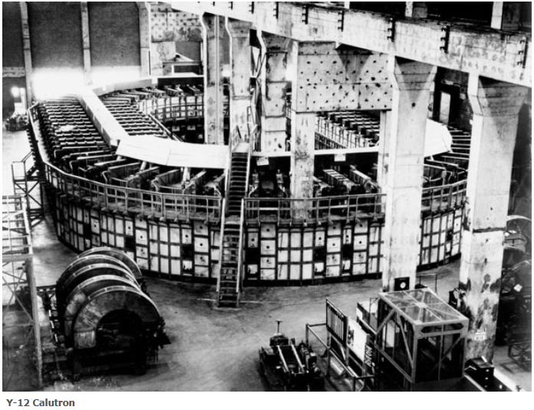
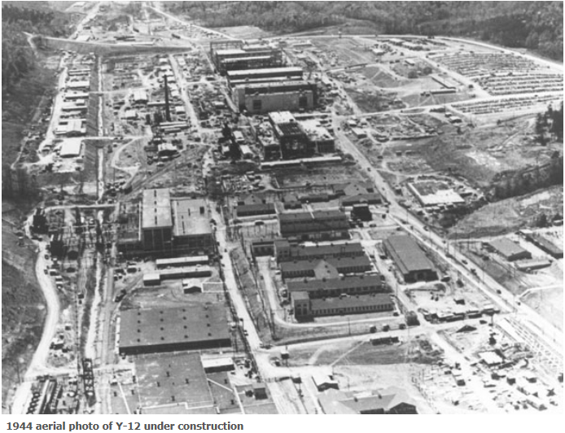
General Y-12
History
Constructed as part of the World War II Manhattan Project.
Provided the enriched uranium for the “Little Boy” nuclear weapon.
Afterward, Y-12 provided lithium separation and key components for the thermonuclear weapons that helped end the Cold War.
Notes:
The Y-12 national security complex came into existence during WWII as part of the Manhattan Project for the purpose of enriching uranium for use in a nuclear weapon. The enrichment process used was magnetic separation with caluatrons (picture).
The enriched uranium produced at Y12 was used for the “little Boy” nuclear weapon that was dropped on Hiroshima in 1945.
After WWII, the mission of the site changed and expanded to proved lithium separation and key components for thermonuclear weapons that held to end the Cold War.

Slide 3
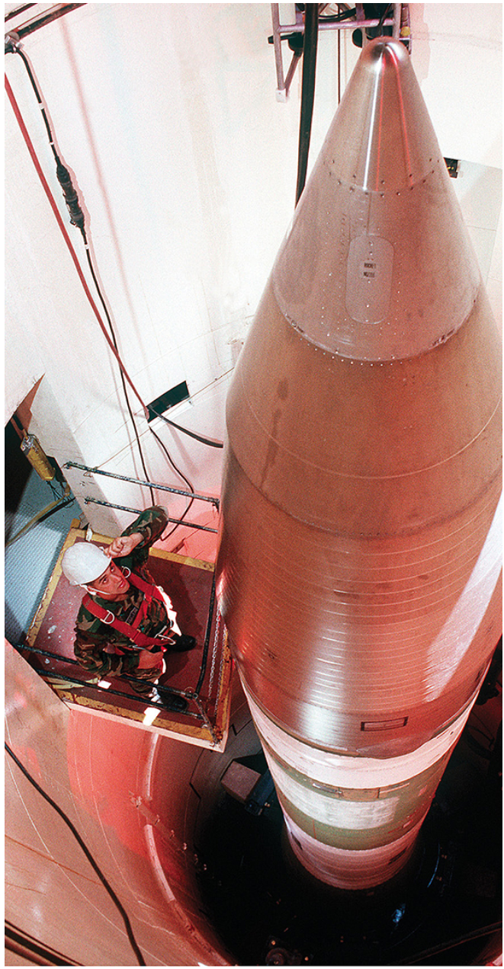
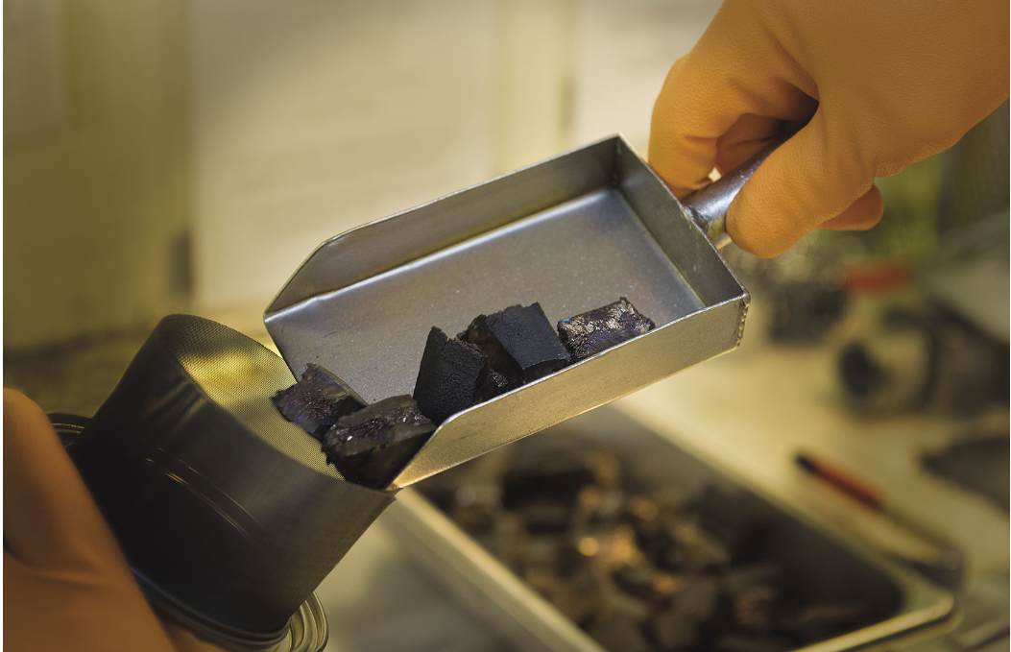
General Y-12
Current Mission
Maintain the safety, security and effectiveness of the U.S. nuclear weapons stockpile.
Weapon Component Production
Surveillance
Dismantlement
Storage
Notes:
The Y12 National Security Complex has three primary national security missions that protect our country and our allies around the world. The first mission is to maintain the safety, security, and effectiveness of the US nuclear weapons stockpile.
Weapon Component Production
Includes manufacture of new components which are sometimes combing with recycled components in a process called refurbishment.
Refurbishment extends the lifetimes of systems and ensures their effectiveness
Surveillance
- Determines how weapons in the active stockpile are aging.
Dismantlement
- Involves separating components of retired weapons and recovering nuclear material.
Storage
- Occurs throughout the process.

Slide 4
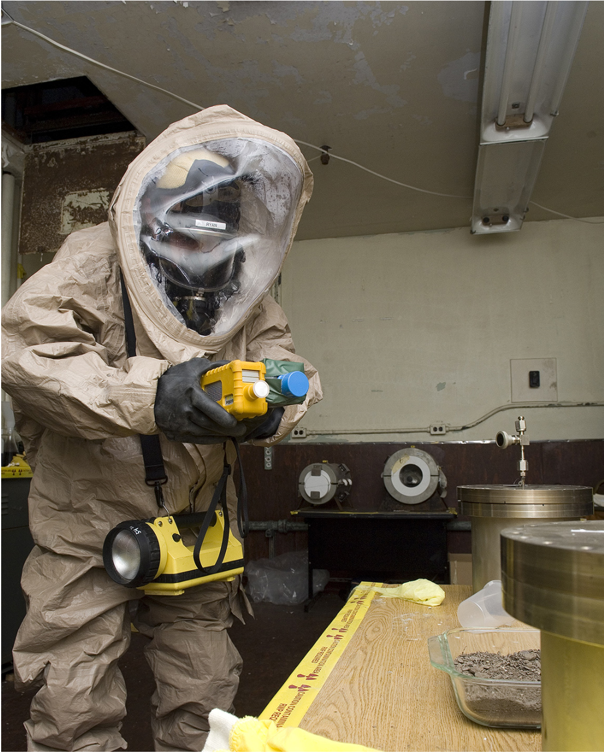
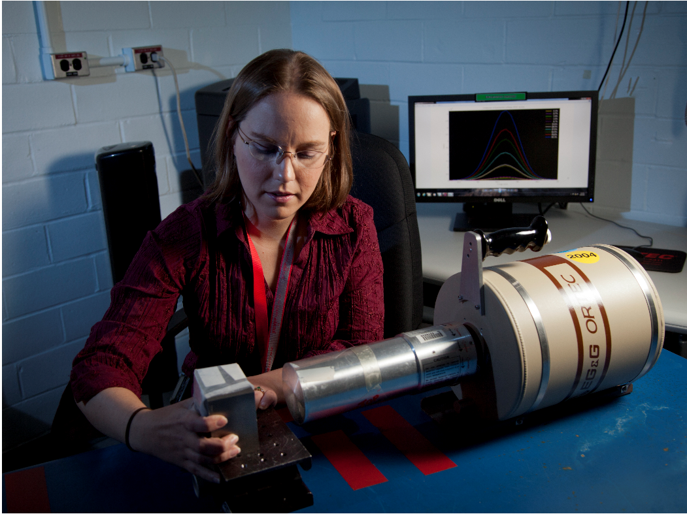
General Y-12
Current Mission
Reduce the global threat posed by nuclear proliferation and terrorism.
Notes:
Y-12 works with NNSA and other federal agencies to secure nuclear materials domestically and internationally.
Activities include:
Detection
Removal
Security of nuclear material
Making weapons material available for peaceful purposes such as fueling research reactors and producing medical isotopes.
Transportation and storage
Training in protection of nuclear material worldwide.

Slide 5
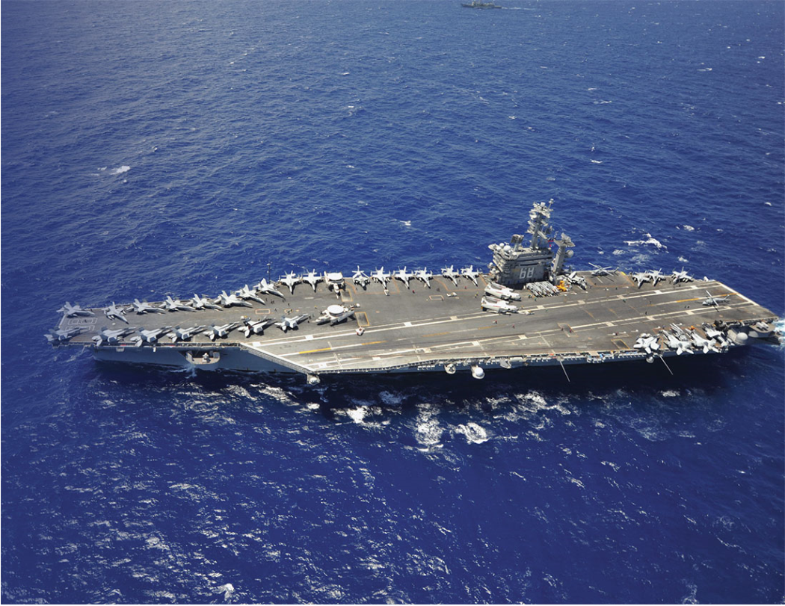
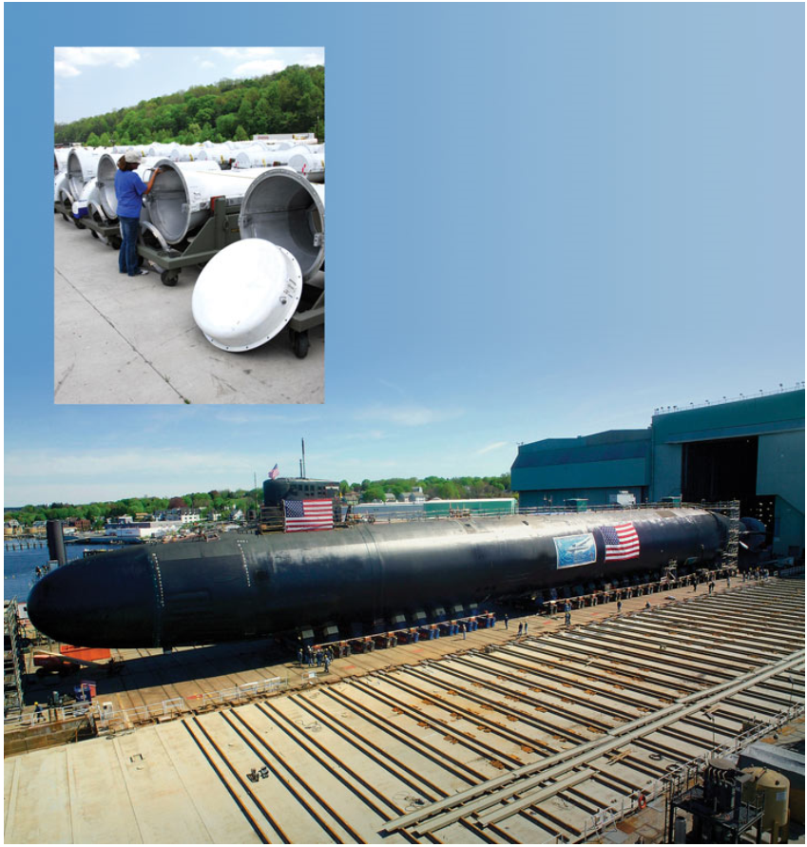
General Y-12
Current Mission
Provide feedstock to fuel the U.S. Nuclear Navy.
Y-12 uranium powers the Navy’s Nuclear Powered Aircraft Carriers and Submarines under an agreement with the NNSA’s Naval Reactors Office.
Notes:
Y-12 provides highly enriched uranium used in fabrication of fuel for reactors in the Navy’s nuclear-powered aircraft carriers and submarines.

Slide 6
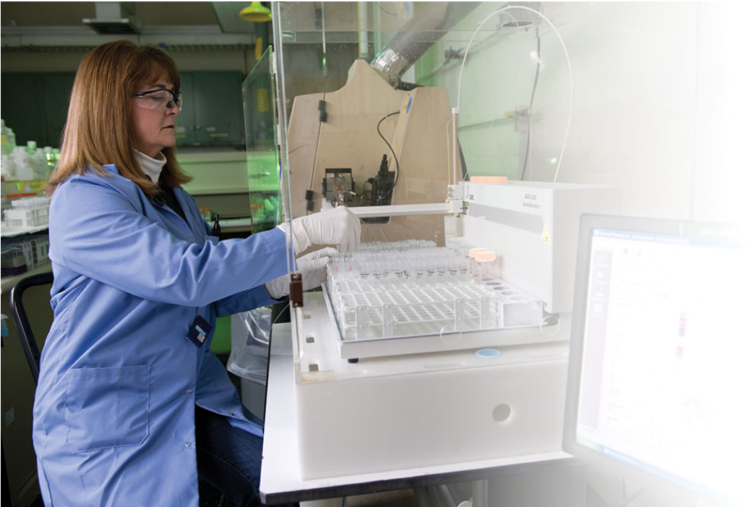
9995 Background
9995
On-site Laboratory which analyzes samples from around Y-12
Samples may be:
Environmental
Waste
Depleted Uranium
Accountable Fissile
Notes:
Zooming in to 9995, as stated before this is the on-site laboratory which analyzes samples from around Y-12 and was built in the 1950’s. 9995 is a hazard category 2 nuclear facility. These samples may come from various sources and may be Environmental samples, Waste, DU, or accountable fissile samples. These samples may undergo many different types of analysis.

Slide 7
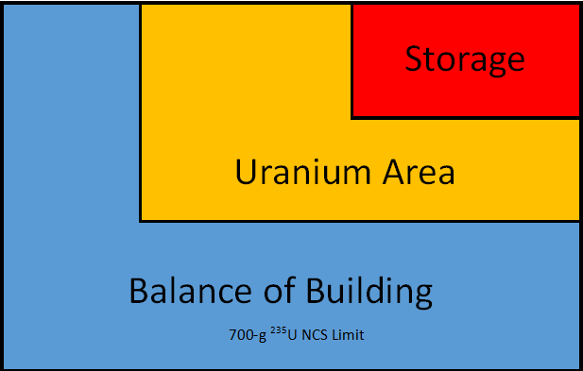
9995 Background
9995 is split into the following areas:
Uranium Area
Storage
Balance of building
Each area has a NCS evaluation
Notes:
Operationally, the facility is split into three segments. These are the storage area, the uranium processing area where much of the accountable uranium work occurs, and the balance of the building. Each of these areas has a criticality safety evaluation covering operations in that area plus one more evaluation that handles salvaging of material that is applicable to the entire facility. These evaluations are 15+ years old. New 3007-2007 compliant evaluations are currently being written to replace these old evaluations. The drum was loaded and stored in the balance of the building at the time that the overloading was discovered. The balance of the building has a 700-g ²³⁵U limit which elevates to the Technical Safety Requirements document for the facility.

Slide 8
The Event
Process that was being conducted
“Non-uranium” sample salvaging per procedure
Procedure allowed non-uranium samples to be bulked with no checks
Non-accountable (per NMC&A) samples were being treated as non-fissile
Release limits from the other nuclear facilities for solution has recently been changed from 400-ppm ²³⁵U to 1300-ppm ²³⁵U
Notes:
The process that was being conducted was “non-Uranium” sample salvaging per procedure. This procedure allowed for the samples to be bulked with no checks. It should be noted that these samples were “non-accountable” meaning they had been released from be accounted for by the nuclear materials control and accountability program. Because these samples were “non-accountable” the assumption of the facility was that these were non-fissile samples which turned out not to be true. It should also be noted that the release limits of organic solutions from other nuclear facilities has recently been increased form 400-ppm ²³⁵U to 1300-ppm ²³⁵U. This will play into the even as I will show you in more detail in the following slides.

Slide 9
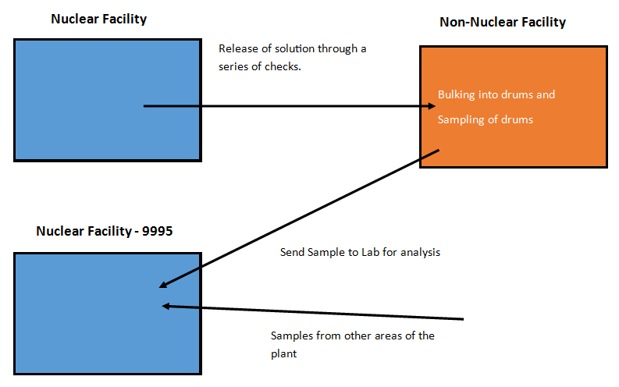
The Event
Non-Accountable Sample Process

Slide 10
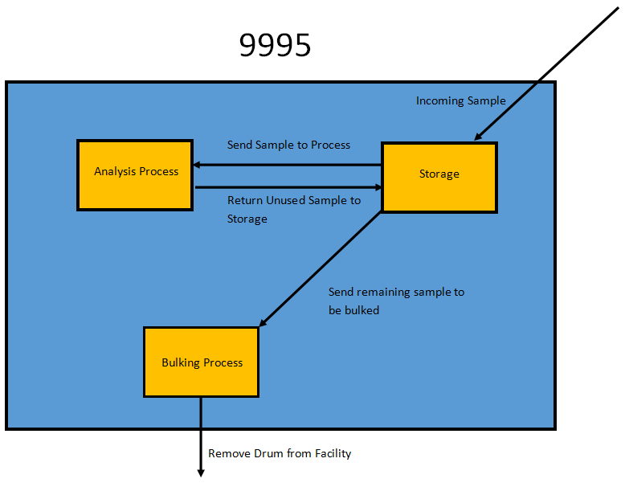
The Event
Non-Accountable Sample Process

Slide 11
The Event
Detection of Issue
10:30 on 9/20/16
Sampling results for a 30-gallon organic drum located in the balance of the building were reviewed and indicated that the drum contained 197.81-g ²³⁵U.
The drum under normal circumstances would contain a few grams of ²³⁵U and was intended to be less than 15-g ²³⁵U for transport.
NCS controls limited the drum to 60-g ²³⁵U.

Slide 12
The Event
Immediate Actions Taken
The facility entered into a Limiting Condition for Operation (LCO) because it was believed at the time that more than 700-g ²³⁵U may have been present in the balance of the building.
Area material quantities were checked and verified to be less than the 700-g ²³⁵U limit.
NCS was alerted to the issue and advised the facility to place the area around the drum under administrative control per procedure.
Declared a 10-2 Occurrence

Slide 13
The Event
Recovery Actions
1) Investigated source of material
Revealed that a large percentage of the material originated from 9212 Non-SNM release process
2) NDA personnel investigated drum
Could not quantify but gave some indication of the presence and location of material
3) Sampled the drum again
Sample results were between 60 and 100-g ²³⁵U
4) Drained the solution into safe geometry containers
5) Sent containers back to 9212 chemical recovery to be assessed
Follow up NDA of safe geometry containers indicated very low amounts of uranium.

Slide 14
Primary Causes
Confusion about the difference between “non-fissile” and “non-accountable.”
“Non-Accountable” refers to material which has been determined to meet criteria from the NMC&A group that does not require it to be tracked for material accountability any longer. This criteria is not a NCS limit.
The bulk of the material in the drum was released from a nuclear facility through a “non-SNM” process which includes NCS required checks to protect the assumptions of the documents which justify why a criticality accident is not credible outside of the nuclear facilities.
The NCS release limit for solutions in the non-SNM criticality safety evaluation had recently been changed from 400-ppm ²³⁵U to 1300ppm ²³⁵U.

Slide 15
Primary Causes
The Configuration Control Board/Operations Safety Board review failed to anticipate the downstream impact to 9995
The change control process was only conducted for the releasing facility
9995 was not made aware of the change in the non-SNM release limits
The configuration control program requires that the configuration control board ensure that downstream processes are not effected by the change.
It was possible for this event to occur before this change, however the change increased the probability of the event occurring.

Slide 16
Primary Causes
There was no running total of the amount of enriched uranium being bulked into the drum.
Primary Cause #1 prevented an accounting of fissile material in the drum

Slide 17
Lessons Learned
The distinction between “non-accountable” and “non-fissile” or “non-Uranium” should be well known by facilities handling these materials.
Y-12 Actions:
9995 procedures were changed to remove the term “non-Uranium”
The NCS chief engineer issued a bulletin explaining the distinction and its importance

Slide 18
Lessons Learned
Non-accountable fissile material that re-enters a nuclear facility for processing should be considered in NCS analysis.
Y-12 Actions:
A new process was created for the bulking of non-accountable radioactive samples
9995 procedures were changed to reflect this new process
NCS evaluated the new process and established controls.

Slide 19
Lessons Learned
The change control process should include a careful examination of the downstream effects of changes in a nuclear facility included a change to material release criteria.
Y-12 Actions:
Brief OSB/CCB Members.

Slide 20
Questions?

Slide 21
DISCLAIMER
This work of authorship and those incorporated herein were prepared by Consolidated Nuclear Security, LLC (CNS) as accounts of work sponsored by an agency of the United States Government under Contract DE‑NA‑0001942. Neither the United States Government nor any agency thereof, nor CNS, nor any of their employees, makes any warranty, express or implied, or assumes any legal liability or responsibility to any non‑governmental recipient hereof for the accuracy, completeness, use made, or usefulness of any information, apparatus, product, or process disclosed, or represents that its use would not infringe privately owned rights. Reference herein to any specific commercial product, process, or service by trade name, trademark, manufacturer, or otherwise, does not necessarily constitute or imply its endorsement, recommendation, or favoring by the United States Government or any agency or contractor thereof, or by CNS. The views and opinions of authors expressed herein do not necessarily state or reflect those of the United States Government or any agency or contractor (other than the authors) thereof.

