Slide 1
Mass / Moderator Log Errors
Brandon O’Donnell, NCS Engineer, BWXT Nuclear Operations Group - Lynchburg

Slide 2
Background
Routine NCS audit of Specialty Fuels Fabrication (SFF) facility in September, 2015 timeframe
Many gloveboxes in SFF facility were authorized to use “tiered” mass / moderator limits
10 kg ²³⁵U / 597 grams moderating material (H/X of 2), OR
3.6 kg ²³⁵U / 2,148 grams moderating material (H/X of 20), OR
350 grams ²³⁵U / no restriction on mass of moderating material
Audit of mass / moderator log entries revealed multiple violations of the moderator mass limit in a specific boxline

Slide 3
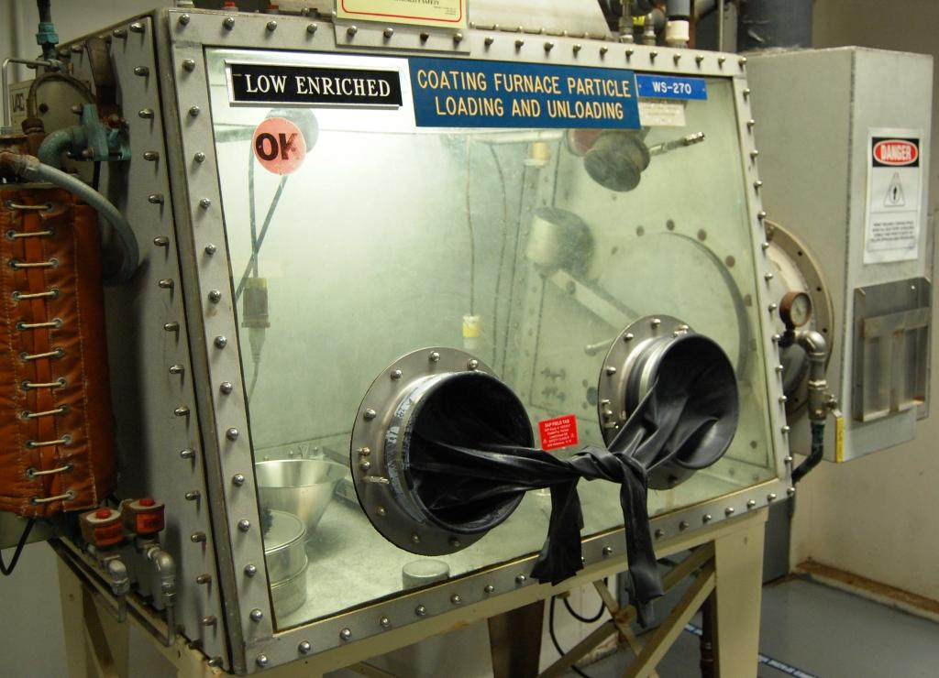
Background
General purpose use glovebox used for operations involving Advanced Gas Reactor (AGR) fuel

Slide 4
Background
Operations in the SFF facility utilizing mass / moderator limits were immediately suspended
Critique meeting was held with operators, operations management, and NCS
Initially believed that these were simply bookkeeping errors
Determined during critique meeting that these may not have been bookkeeping errors, but rather actual limit violations
Condition was reported to the Nuclear Regulatory Commission (NRC)

Slide 5
Background
Discovered during critique meeting that operator understanding was they needed to adhere to the mass limit or the moderation limit, but not both
Extent of condition review revealed similar issues with another glovebox in the SFF facility
Activities in non-SFF areas utilizing mass / moderator limits were temporarily suspended
Logs reviewed for accuracy – some issues identified, but none rising to the level of additional NRC reporting
Operators required to demonstrate understanding of NCS limits through training and testing

Slide 6
Underlying Issues
SFF facility is unique to other areas
Routinely goes down for extended periods of time (months to years) depending on available work
Work scopes are constantly changing
Other plant areas operate with considerably more continuity
The application of mass / moderator limits requires tracking two parameters simultaneously to ensure compliance
Operator training is paramount
At the time, paper logs were being used
The “addition / removal” math is a manual process

Slide 7
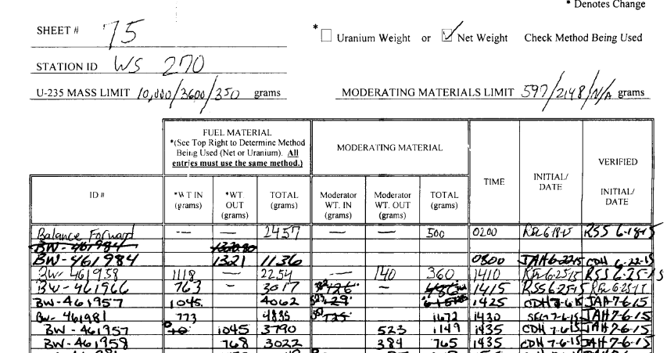
Underlying Issues
Paper log

Slide 8
Corrective Actions
At the time, there was no division-wide policy on suspending and restarting fuel operations, so one was created
Any operation shutdown for more than 6 months has to be formally removed from service
Restart of such operations require Change Review Board review and approval
Automated computer based mass / moderator logs implemented in the place of manual paper logs
Developed by process engineering and goes through layers of safety and QA review
“Addition / removal” math is done automatically
Provide visual warnings if an operator attempts to add material that would result in violation of a limit

Slide 9
Corrective Actions
Areas using mass / moderator logs developed and implemented area specific procedures that provide detailed instructions on the use of mass / moderator logs
This is used in conjunction with the automated computer based mass / moderator logs
The use of “tiered” mass / moderator limits in the SFF facility was eliminated
Control scheme developed to meet production needs while being as “operator friendly” as possible
Operators, process engineers, and management involved every step of the way

Slide 10
SFF Control Scheme
For a moderation controlled glovebox, what really matters?
Liquids and other materials that intimately mix with the fuel
Operations desire was to track net weight of material being added to or removed from a glovebox
Requires no knowledge of the uranium or ²³⁵U value
Two modes of operation defined
“Fuel operations” = large net mass allowed but no liquids, net mass includes both fuel and non-fuel material that will be blended with fuel material
“Cleanout operations” = insignificant net mass with liquids allowed

Slide 11
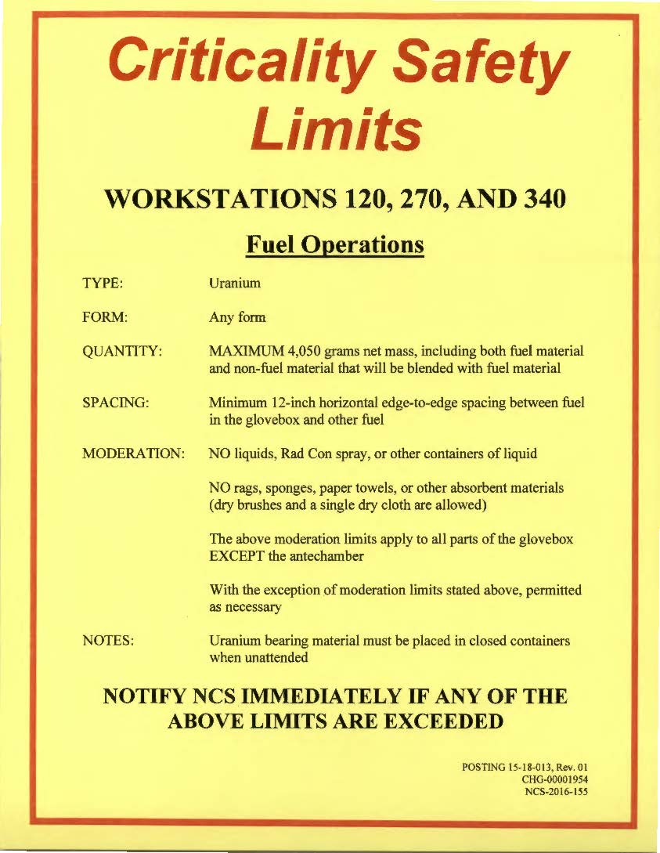
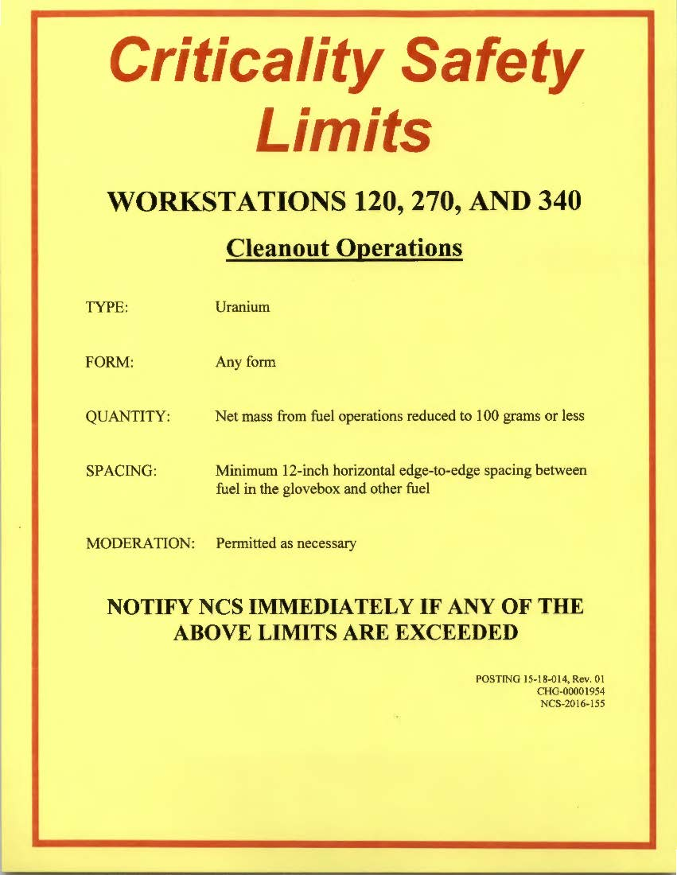
SFF Control Scheme

Slide 12
SFF Control Scheme
Ingress of liquids is limited in two other ways:
Glovebox integrity
Passive engineered control
Maintained through periodic inspections for visible “cracks” in the glovebox structure and seals (such as around windows)
Transparent to the operator, except when performing maintenance activities which may degrade glovebox integrity
Prohibition on use of water during fire fighting
Administrative control
Managed by the Emergency Operations Center (EOC) in the event of a fire

Slide 13
Key Lessons Learned
Operations need a formalized policy on suspending and restarting fuel operations
Complicated control schemes like the use of “tiered” mass / moderator limits need robust operator aides, and training is paramount
All facilities should employ NCS control schemes that leave little room for interpretation
Especially true for facilities that routinely go down for extended periods of time or with constantly changing work scopes

Slide 14
Audience Discussion
How are facilities like the SFF handled elsewhere?
How are others handling control schemes like the “tiered” mass / moderator limits?
How are suspending and restarting fuel operations handled elsewhere?

