Slide 1
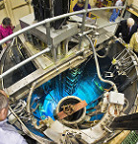
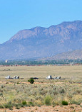

SNL’s “Safe” Move Event
Presentation for the NCSD Panel Session

Slide 2
Weapons Complex Morning Briefing
Oct. 29, 2015
“A contractor in September caused a criticality safety breach that forced the evacuation of a section of the Sandia National Laboratories…”
Notes:
The press… makes it sound significant.

Slide 3
Background: Sept. 8, 2015
During an end of day facility shutdown check an ACRR operator, nobody else was present, noticed an abnormal placement of a SNM safe.
She stopped shutdown activity, evacuated immediately, without attempting to correct the abnormality, and notified her facility manager and supervisor and NCS team.
Notes:
Reality is pretty boring.
Management did a good job in publicly recognizing her for the correct response and questioning attitude.
But no good deed goes unpunished, so now she is in our NCSE training program.

Slide 4
What Happened?
Facility Management and Operations Center (FMOC) person was granted unescorted access (~14:30) by the Facility Supervisor to ACRR High Bay to perform measurements.
  This was post reactor operations and down-posting of the area
  FMOC worked around operations schedule but wanted to perform measurements to prepare for next day.
  FMOC had general Rad training (GERT), ESH and area access training.
Facility “good” practice = be present during FMOC activities.
  The 2 facility persons normally involved were not available that day.
A SNM safe and a cabinet were in the way. The cabinet was not moveable, the safe was on wheels.
FMOC did not notice the NCS sign or the rad labels on the safe and proceeded to move it.
Notes:
FMOC was doing measurement activities associated with plugging holes due to equipment removal and installation and previous asbestos abetment work.
Neither FMOC or Operations recognized potential issue with blocked access to the area needing to be measured. It was not clear communication about the scope of this activity.

Slide 5
What Happened II?
Later, 2 other individuals (an experimenter and a radiation control technician [RCT]) noticed the safe was out of its normal position, but did not think it as a NCS issue.
  The RCT performed rad. survey on the now exposed backside of the safe - aware it may present an elevated rad. field, which it didn’t.
Sometime after 16:00, during end of day checks an operator noticed abnormal safe placement, immediately evacuated and notified per NCS noncompliance response.
  Operator was unsure if a violation had occurred, but did not attempt to perform measurement to confirm.
Notes:
Missed opportunity to identify much earlier. Neither had NCS on their mind, not normally the ones that handled material and just thought it odd but someone must have a reason attitude.
During the noncompliance response process, the operator stated she suspected it was about 2-3 feet separation but that she just saw it as she came around a corner, knew it was abnormal and there was no reason based on the days planned activities.

Slide 6
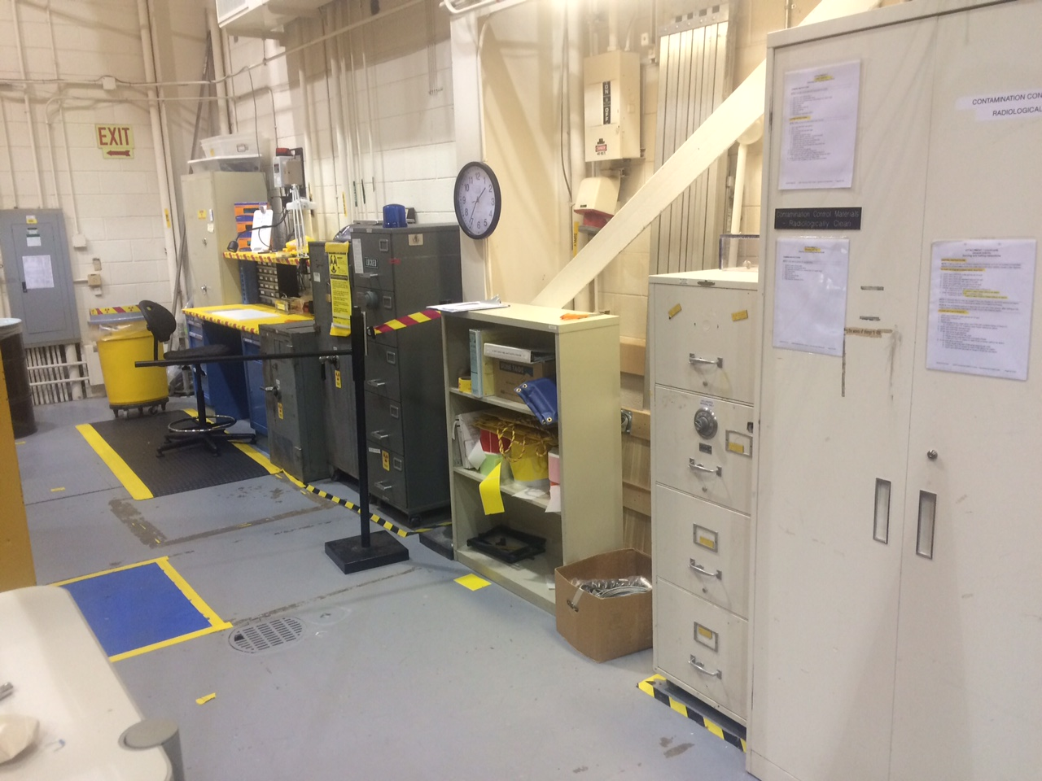
Picture Normal Condition
Notes:
Big cabinet (right side of picture) is in front of the area requiring measurement.
4 drawer safe (right side of picture) is controlled ≤ NCS threshold mass (≤700 g U-235, etc). It was moved but required ≥6 ft spacing from all other fissionable materials.
3 safes to left side of bookshelf are the NCS controlled area. Each safe has a specific mass limit (≤500 g U-235, etc) but no spacing requirement, allowance for transient items.
There was U, Pu, and Np associated. Translated into U-235 FEM the total mass in the 3 NCS controlled safes and the ≤NCS threshold safe was less than 900 g U-235 FEM.
FEM= Fissile Equivalent Mass

Slide 7
Picture Normal Condition II

Slide 8
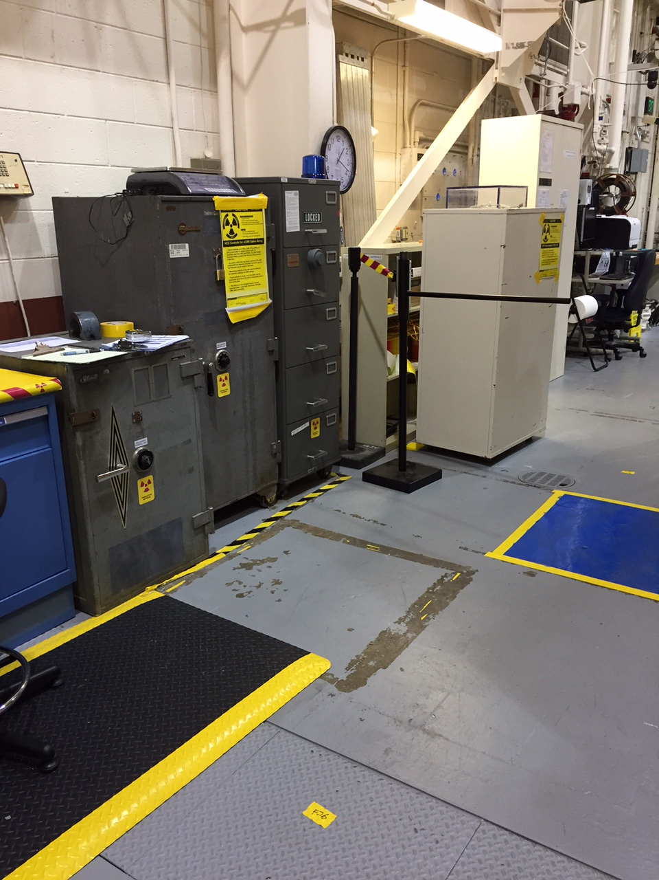
Picture Moved Safe
Notes:
Near safe was empty at the time, this was not relied on or used for justification of distance.

Slide 9
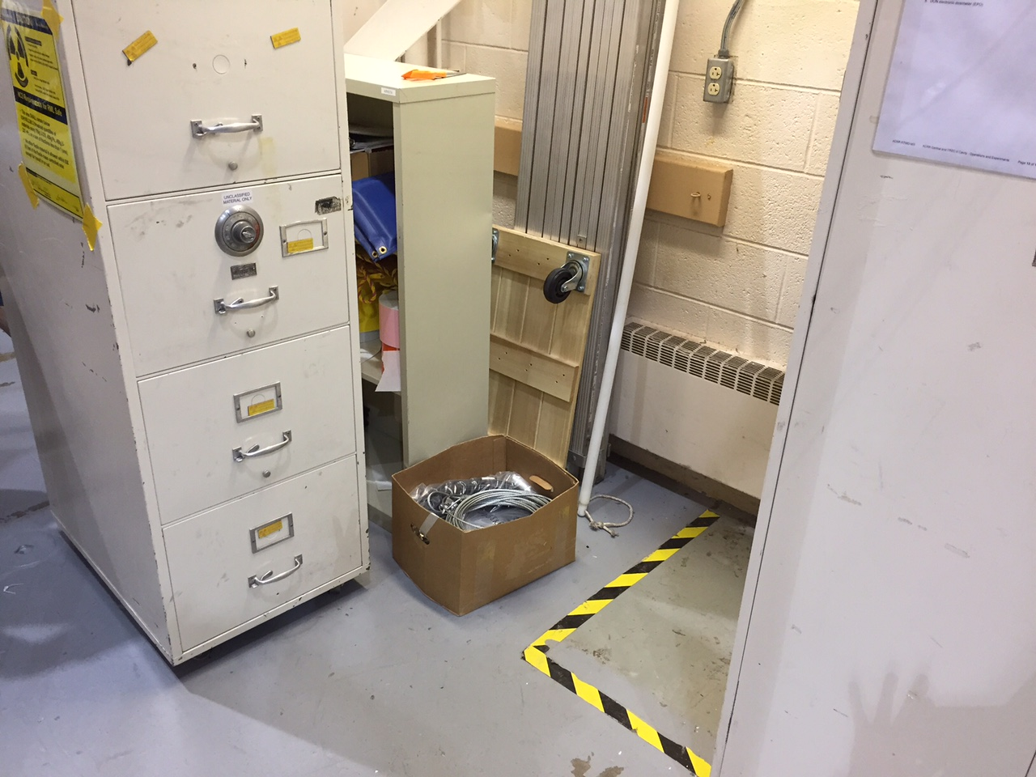
Picture Moved Safe II
Notes:
Note the yellow Rad labels on each drawer as well as the 11x17” NCS posting on top left of picture.
Posting on side of safe to avoid interference when opening.
FMOC person stated never noticed Rad markings and NCS posting, or tape on floor. Trained that yellow postings and radiation symbol (trefoil) denote items that should be consulted about before moving/handeling/etc.

Slide 10
NCS response
Determined a NCS noncompliance event, ORPS reportable.
  No immediate concern of a criticality event.
  Secured facility – went home for evening
  Committee meeting next morning to decide and approve re-entry plan.
  Re-entry confirmed violation of 6-ft spacing- reduced to 26-in (minimal distance).
  Safe returned to original location.
Notes:
Two NCSEs responded. Facility manager/supervisor/operations, upper management, SFO, etc.
No NCS concern decision was based on the real amount of material, the suspected condition (significant spacing, insignificant moderation and lack of geometry) and the evaluated upsets.
Nearest safe empty but not relied on to credit spacing. Smallest

Slide 11
Lessons Learned
Training and access control/escorted
Communication / better pre-job walk-downs
Job duty handoffs
Updated NCS evaluation
Engineered restriction for wheels associated with SNM safes, storage cabinets/carts, etc.
Time and Effort associated with response and reporting and follow up actions.
Notes:
I had over 200 emails in ~3 months on this. Management, Operations, etc must have had many more I was not involved with.
Had to many meetings. Even pre-meetings for other meetings.
Had EA-12 (Office of Nuclear Safety Enforcement) conference calls/emails/communications.

