Slide 1
Combining RHF and HFIR Disposition Campaigns – Analysis, Opportunity, and Lessons Learned
Tracy Stover and John Lint
Savannah River Nuclear Solutions, LLC
ANS Annual Conference June 2017
SRNS-STI-2017-00286

Slide 2
Background and Motivation
SRS H-Canyon facility has been tasked to disposition a number of ORNL’s HFIR cores
Inner and outer assembly core
Dissolver insert specifically designed for HFIR
Has been previously performed (1976-1988)
HFIR cores have been accruing at both SRS and ORNL ever since
Both facilities running out of room to store the fuel so it is time to reprocess
Mission: dissolve, purify, and recover HEU to blend down into LEU for commercial reactors

Slide 3
Background – What is a Dissolver and Dissolver Insert
First step in fuel separations and purification at H-Canyon
Dissolver
Stainless steel pot
Loaded with nitric acid
Dissolves uranium-aluminum fuel
Notes:
Uranium-aluminum alloy and usually aluminum clad
The insert fits down inside the dissolver. The picture is true, the dissolver sits on a sloped floor. Canyon cells are sloped so that spills and leaks will collect in a sump.

Slide 4
Background – What is a Dissolver and Dissolver Insert
Dissolver insert
Drops into column in plug-n-play fashion
Feeds fuel to acid solution
Controlled geometry
Controlled feed rate
Gravity or complete submersion
Existing dissolver inserts
Circular well
Slab well
HFIR well
Notes:
Circular is 10 5” wells and was designed originally for SRS reactor assemblies but is currently used for bundled research reactor fuels
Slab consists of four 4.5”x15” wells
HFIR is specifically designed for the dissolution of ORNL’s HFIR cores.
Long cylindrical feed materials are gravity fed into the system. HFIR and likely RHF would be submerged in acid completely

Slide 5
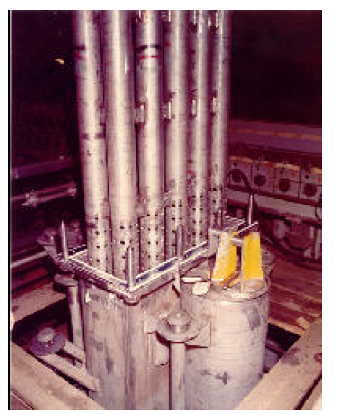
Background – What is a Dissolver and Dissolver Insert
Notes:
Left: HFIR insert
Right: 10-well insert
Center: 10-well insert being placed into dissolver column

Slide 6
HFIR vs. RHF
HFIR has a “sister”…
Reactor a Haute Flux
French research reactor
Laue-Langevin Institute in Grenoble, France
58 MW HEU heavy water cooled/moderated
Mainly neutron source (just like HFIR)
Operated since 1971
Major renovations in 1991-93, 2004-07 and 2012-16
Request for fuel from Y-12 in 2010
Projected to operate until 2030?

Slide 7
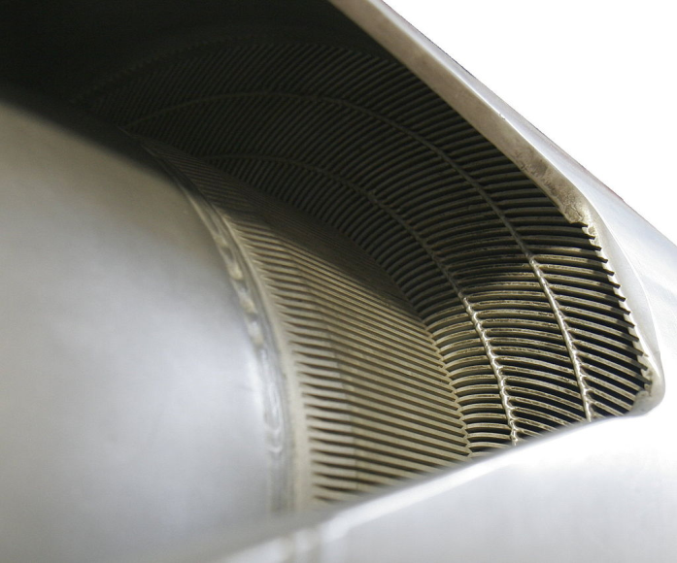
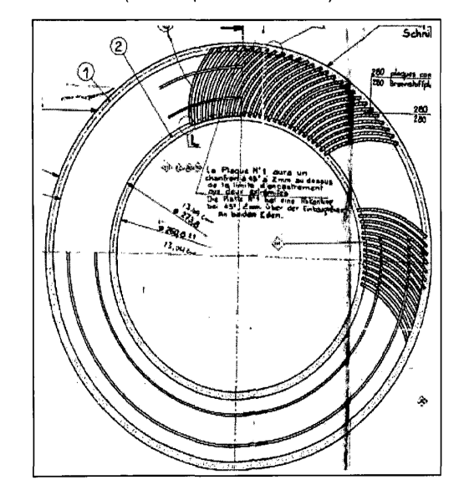
HFIR vs. RHF
Notes:
HFIR is shown on the top, with the RHF shown on the bottom

Slide 8
Geometry Similarity
Parameter | RHF Element | HFIR Outer Element | HFIR Inner Element
Fuel Plate Height (cm) | 90.3 | 60.96 | 60.96
Fuel Plate Width (cm) | 8 | 8.1 | 9.21
Fuel Plate Thickness (cm) | 0.127 | 0.13 | 0.13
Fuel Meat Height (cm) | 81.3 | 50.8 | 50.8
Fuel Meat Width (cm) | 6.7 | 7.00 | 7.79
Fuel Meat Thickness (cm) | 0.051 | 0.08 | 0.08
Outer Collar ID (cm) | 39.76 | -- | --
Outer Collar OD (cm) | 41.36 | 43.6 | 29.8
Inner Collar ID (cm) | 26.08 | 28.5242 | 12.863
Inner Collar OD (cm) | 27.38 | -- | --
Notes:
I would direct the listener to the summary paper which has a much more complete listing
The main take aways are that the RHF is ~30 cm taller both overall and in the fuel meat. Also, the RHF and the HFIR outer are most similar in radial geometry. It is this similarity that facilitates the use of the HFIR dissolver insert to process the RHF cores. As you might conclude from the geometry, yes this is an undermoderated core in both cases.

Slide 9
Chemical & Nuclear Similarity
Parameter | RHF Element | HFIR Outer Element | HFIR Inner Element
Plates/assembly | 280 | 396 | 171
Total U (g/element) | 9212 | 7316.6 | 2791
Total ²³⁵U(g/element) | 8568 | 6804.4 | 2595.8
Al Mass (g/element) | 100760 | 84283.4 | 44209
Al/U Ratio | 10.94 | 11.52 | 15.84
U Enrichment (wt.%) | 93.0 | 93.0 | 93.0
Al (s) + 3.75 HNO₃ (aq) Al(NO₃)₃ (aq) + 0.225 NO (g)
+ 0.15 N₂O (g) + 0.11 N₂ (g) + 2 H₂O (l) + 190 kcal/mol Al
U (s) + 4 HNO₃ (aq) UO₂(NO₃)₂ (aq) + 1.8 NO (g)
+ 0.05 N₂ (g) + 0.1 NO₂ (g) + 2 H₂O (l)
Notes:
I would direct the listener to the summary paper which has a much more complete listing.
From a criticality standpoint, the enrichment and the overall mass of uranium are of key importance. From a chemistry standpoint, it is the aluminum to uranium ratio. The chemical reaction, and thus the dissolver bulk fissile concentration, is limited by the stoichiometry of the process.
For every mole of Al we need 3.75 moles of acid and every mole of U we need 4 moles of acid. With a fixed amount of solution at a fixed acidity you limit how much material can actually be dissolved.

Slide 10
Why RHF
SRS is currently storing RHF cores for eventual disposition
They fit in the outer element well of the HFIR dissolver insert
Existing hardware to transport RHF cores from storage to H-Canyon
Opportunity to disposition these cores while the facility is configured for HFIR work

Slide 11
Modeling: HFIR vs. RHF
Notes:
From left to right: HFIR outer, HFIR inner, RHF. All are divided into radial layers for modeling dissolution. RHF is taller but otherwise resembles the HFIR outer. The HFIR model shown is axially discretized as its from a production model requiring axial zoning for burnup.

Slide 12
Modeling the RHF Element
Axially homogenous
Assumed fresh isotopics, no burnup credit
9 radial layers including the inner and outer collars
7 phase dissolution, 1 fuel layer each
0, 12.5, 25, 50, 75, 87.5, 100% dissolved
Al and U dispersed into bulk solution with each step and concentration recalculated
Homogenized over outer height of core
Notes:
Burnup depleted the core to about 84 wt.% uranium. Even with Pu buildup the fresh is more limiting.
RHF, like HFIR, is an undermoderated core, so increasing the H/²³⁵U increases multiplication. Since the model is not further discretized into axial sub-segments, it is conservative to smear the U over the overall height of the RHF element as opposed to smearing the axial non-fuel aluminum into the active fuel height. This locally distributes the U in each radial layer and thus increases the H/²³⁵U ratio in each layer. This is a localized effect as the H/²³⁵U of the entire dissolver-plus-core system remains the same. This results in a slightly higher neutron multiplication.

Slide 13
HFIR Dissolver Insert
2 wells about 20 feet deep
Stainless steel with posts in each well
Holes for cross flow and dispersion
Holes result in about 15% of volume
Modeled as a tube 85% stainless steel and 15% bulk dissolver solution
Same treatment as in HFIR analysis
Note: during modeling, conservatively maintain 0 M excess nitric acid
Adds conservatism
Notes:
These holes comprise at most 15% of the volume of the well insert, which is therefore modeled as homogenized 85% stainless steel and 15% bulk fissile solution to account for the holes.

Slide 14
Normal Conditions
RHF cores loaded into HFIR dissolver insert outer element well
Three cores already dissolved with U and Al dispersed into the bulk solution
1.904 g U-235/L
0.830 M Al
Terminal bulk solution:
2.539 g U-235/L (below 11.5 g U-235/L)
1.107 M Al (below 2 M)
Notes:
11.5 gU-235/L would be the uranium criticality safety limit for H-canyon bulk solutions
2 M is the precipitation limit for aluminum

Slide 15
Normal Conditions
Excess conservatism
Normal fill does not submerge RHF
Excess solution modeled to cover RHF to 2.54 cm depth
Adds ~1200 L addition bulk solution to model
Equivalent to an additional 27% of an RHF core
Notes:
There is excess solution modeled to increase moderation and reflection at the top of the RHF core.

Slide 16
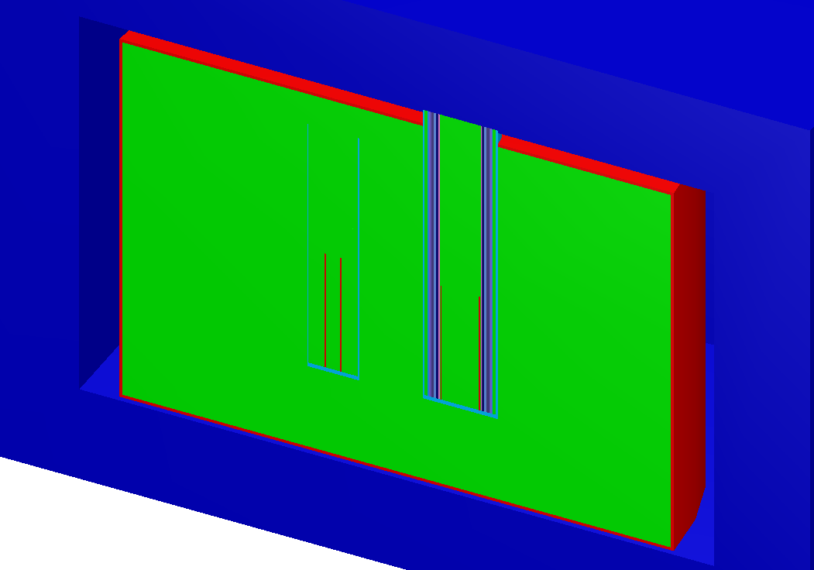
Credible Abnormal Conditions
Overmassing the system
Only fits in outer element well
Limited height available
2nd core modeled on top of first
Begin at same 1.904 g U-235/L and 0.830 M Al
Calculate solution at nominal 13,500 L but fill the dissolver
Adds ~9000 L of additional solution or about 2 RHF worth
Would need 7 cores to achieve terminal configuration
Notes:
Three credible abnormal conditions were identified as leading to potential inadvertent criticality scenarios.

Slide 17
Credible Abnormal Conditions
Overconcentration of the system
2 methods
Dissolve until acid consumed
Operator error
3.75 mole acid per mole Al and 4 mole acid per mole U
Maximum capacity of 16,532 L at 10.4 M
RHF contains 3732 mole Al and 39.2 mole U
Maximum U is 6.29 g U-235/L based on 12.125 RHF cores
On the 13,500 L basis dissolve RHF core in 5.655 g U-235/L and 2.741 M Al for a terminal 6.29 g U-235/L
No excess acid
Operator error – charge 12 cores, evaporate solution more than 50% without detection → Not Credible.
Notes:
Three credible abnormal conditions were identified as leading to potential inadvertent criticality scenarios.
Note this scenario exceeds the Al solubility limit.
At this point it is probably fair to note that SRNS currently has less than 12 of these cores in inventory.

Slide 18
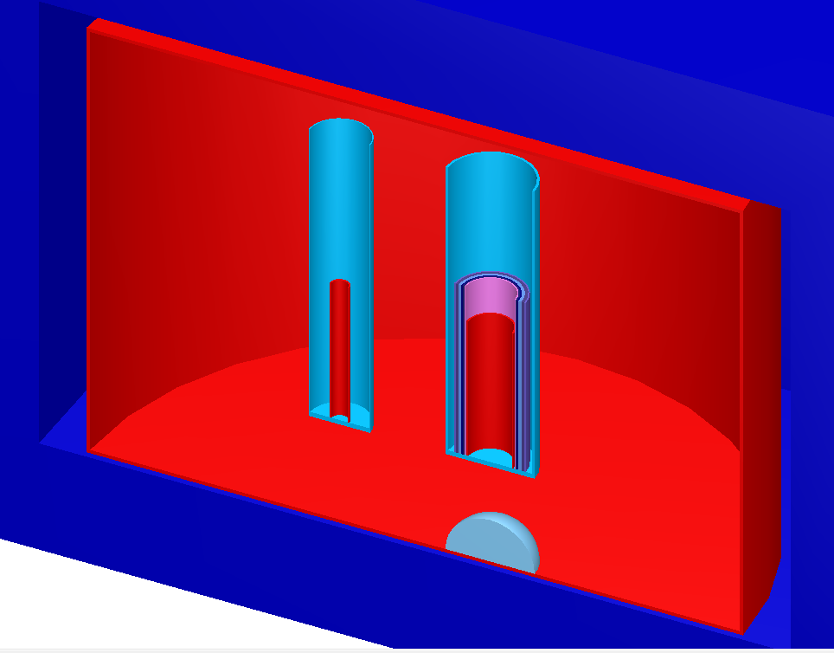
Credible Abnormal Conditions
Undissolved solids
Not exact, dissolved material tends to disperse especially as boiling occurs
Assume 10% of the mass of an RHF core accumulates in a hemisphere under the dissolver well on the tank bottom
Modeled in 3 manners
Uranium + aluminum at density defined by radius equal to well radius
Uranium only at density defined by radius equal to well radius
Uranium only at density defined by uranium metal density
Notes:
Three credible abnormal conditions were identified as leading to potential inadvertent criticality scenarios.
Artificial configuration bounds any possible accumulation of undissolved solids.

Slide 19
Sensitivity Study
Mechanical design tolerances
Dissolver insert steel thickness
Removed walls so as to not place requirement on thickness
Axial positioning of dissolver insert
Varies +0.378 / -7.657 cm from nominal 57.15 cm above the bottom of the dissolver
Analyzed limiting condition cases only

Slide 20
Results
Selected a k-safe of 0.966 based upon in-house validation of SCALE bias for HEU uranyl nitrate solutions
All normal conditions met k-safe
All credible abnormal conditions met k-safe
All sensitivity studies met k-safe

Slide 21
Results
Notes:
Shown is the normal (solid) and over concentration (dashed) dissolutions of RHF cores. These are in turn compared to the HFIR dissolutions in Williamson’s paper on HFIR. Not only does the RHF meet the k-safe it is also bounded by the dissolution of a HFIR core (inner and outer element). This is not unexpected since the RHF core had less U-235 mass than the combined inner and outer HFIR core and also since its chemistry and availability result in a lower initial bulk solution fissile concentration.

Slide 22
Overmass, Undissolved Solids, Sensitivity
Condition | Description | k-best estimate
Over mass | Most reactive dissolution step for 2 RHF elements, dissolved filled with fissile solution | 0.817
Undissolved Solids | Al and U in low density theoretical hemisphere | 0.736
Undissolved Solids | U in low density theoretical hemisphere | 0.738
Undissolved Solids | U in nominal density hemisphere | 0.737
Corrosion | Limiting over mass case with insert well walls removed | 0.852
Insert Height | Limiting over mass case, insert height at min | 0.818
Insert Height | Limiting over mass case, insert height at max | 0.819
Insert Height | Limiting undissolved solids case, insert height at min | 0.742
Insert Height | Limiting undissolved solids case, insert height at max | 0.737

Slide 23
Lessons Learned
Knowledge transfer is not perfect, especially in an industry with a sharp age gap and significant retirements
Could have resulted in missed business opportunity and facility reconfiguration mid-campaign
Of 10 HFIR disposition campaigns in the 70s and 80s, 7 included RHF disposition!
Most recent HFIR campaign did not include RHF (guess what our starting point was…)
Few people personally involved with the campaigns remain in the facility or on site
RHF was being examined for a different campaign when the similarities with HFIR were noted
Senior program manager reviewing that work recalled 1980s work
Notes:
It was not until a senior manager happened to see that other work and recall he had a list of the campaigns H-Canyon had done since 1955. It was this record that provided confirmation that past HFIR campaigns had co-dispositioned RHF fuel in the HFIR insert. At that point the analysis would be remiss in not analyzing both fuel types for any upcoming campaign.

Slide 24
Conclusions
RHF can be safely dissolved in the H-Canyon processes in the HFIR dissolver insert
RHF is bounded by the HFIR core dissolution which can be done without additional criticality safety controls
Both are bounded by chemistry to make events incredible
RHF could be added to the HFIR campaign, and to avoid potential future facility rework, should be added
Facilities should improve their knowledge transfer programs, especially legacy facilities and ones which handle many different types of materials

Slide 25
Acknowledgements
Special thanks to Mr. Michael Lewcyzk for providing historical confirmation of RHF dissolution.
Thanks to Mrs. Brittany Williamson whose work with HFIR dissolution (Ref. 1) and helpful feedback served as a springboard for this successful analysis.
Thanks to Mr. Austin Meredith for his work to integrate this analysis in the overall HFIR evaluation.

Slide 26
Extra Slides

Slide 27
Handling and Transportation
Outside scope of analysis and already bounded by analysis for the storage facility
Includes moving, dropping, deforming, and grouping dry RHF cores
RHF has its own safety significant transportation device to get it from storage to H-Canyon, just like HFIR
RHF has been fitted with handling devices to allow it to be moved by crane but which also prevent stacking and the possibility of nesting it with a HFIR inner core

